Slide 1
Kaonic atoms studies at DAFNE: from SIDDHARTA-2 to future perspectives
INTERNATIONAL CONFERENCE ON EXOTIC ATOMS AND RELATED TOPICS
(EXA 2021)
Florin Sirghi (INFN-LNF)
for the SIDDHARTA-2 collaboration

Slide 2


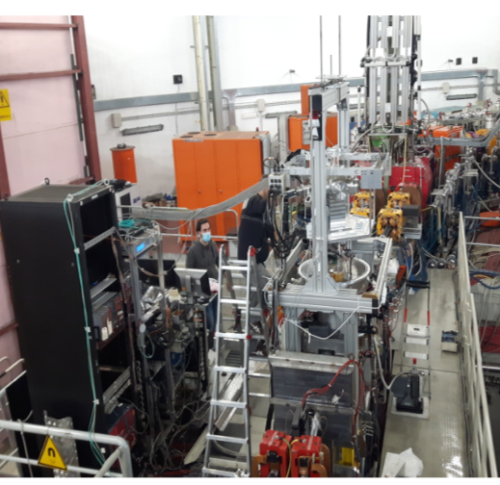





SIDDHARTA-2 Collaboration
SIlicon Drift Detector for Hadronic Atom Research by Timing Applications
LNF- INFN, Frascati, Italy
SMI- ÖAW, Vienna, Austria
Politecnico di Milano, Italy
IFIN–HH, Bucharest, Romania
TUM, Munich, Germany
RIKEN, Japan
Univ. Tokyo, Japan
Victoria Univ., Canada
Univ. Zagreb, Croatia
Helmholtz Institute Mainz, Germany
Univ. Jagiellonian Krakow, Poland
Research Center for Electron Photon Science (ELPH), Tohoku University, Japan
Notes:
SIDDHARTA-2 is an international collaboration, the list of the institutions participating is quoted together with the list of the funding agencies.

Slide 3
Contents
Kaonic atoms – state of the art
SIDDHARTA-2 @ DAΦNE – present status
SIDDHARTINO - K-⁴He test measurement
SIDDHARTA-2 action plan
Future plans at DAΦNE

Slide 4
The scientific aim
To perform precision measurements
of kaonic atoms X-ray transitions (shift and width)
to obtain unique information about QCD in the non -perturbative regime in the strangeness sector
Starting with the
most precise measurement for kaonic hydrogen – done by SIDDHARTA in 2009
NOW first measurement of kaonic deuterium - autumn 2021 by SIDDHARTA -2
To extract the antikaon-nucleon isospin dependent scattering lengths
chiral symmetry breaking (mass problem), EOS for neutron stars

Slide 5
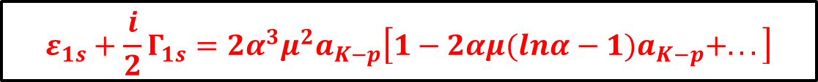
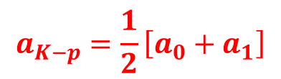
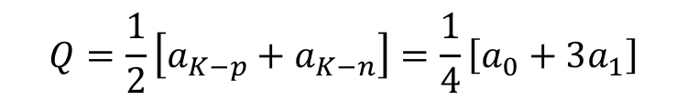

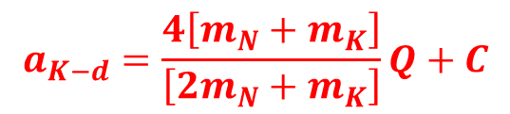
Deser Formula
Deser-type relation (including the isospin-breaking corrections) connects shift ε_{1s} and width Г_{1s} to the real and imaginary part of ɑ _{K-p}
A similar formula holds for ɑ _{K-d}
The connection between the scattering lengths ɑ _{K-p} and ɑ _{K-d} and the s-wave KN isospin dependent (I=0,1) isoscalar a₀ and isovector a₁ scattering length:
C, includes all higher-order contributions, namely all other physics associated with the K⁻d three-body interaction.
Fundamental inputs
of low-energy QCD effective theories.

Slide 6
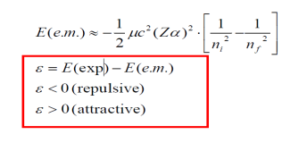
Kaonic atoms
K- captured in excited orbit, replacing the electron
n
s p d f
electromagnetic cascade
4
3
2
E_{2p}
K_{β}
Γ
2p → 1s x-ray transition
Strong Interaction causes:
energy shift ε
of the last energy levels form their purely electromagnetic values
AND
level width Γ
finite lifetime of the state corresponding to an increase in the observed level width
repulsive
E_{1s}
1
}
ε
Only Coulomb
attractive
ε = E_{2p} _{→ 1s} (exp) – E_{2p} _{→ 1s} (e.m.)

Slide 7
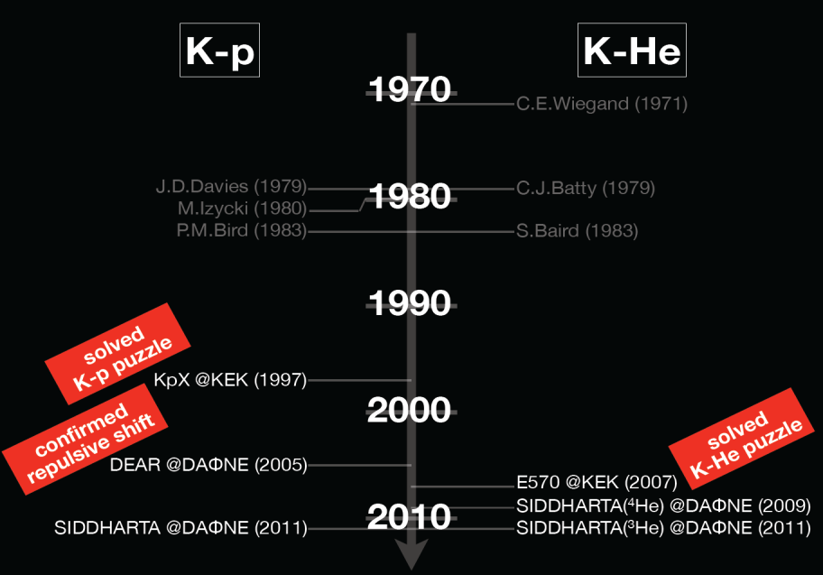
Kaonic atoms history

Slide 8



STILL MISSING!!!
the measurement of the kaonic deuterium
the most important experimental information missing in the field of the low-energy antikaon-nucleon interactions

Slide 9
SIDDHARTA-2 improvements
SIDDHARTA-2 is a development both on the
DAFNE collider side and on the experiment side.
SIDDHARTA-2 apparatus consists in a series of improvements with respect to the SIDDHARTA aiming to dramatically:
increase the S/B ratio and also the signal rate:
by gaining in solid angle
taking advantage o
new SDDs technology and
of the reduction of the background:
by improving the SDDs timing
implementing of an additional veto system

Slide 10
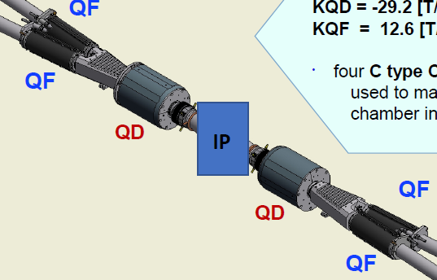
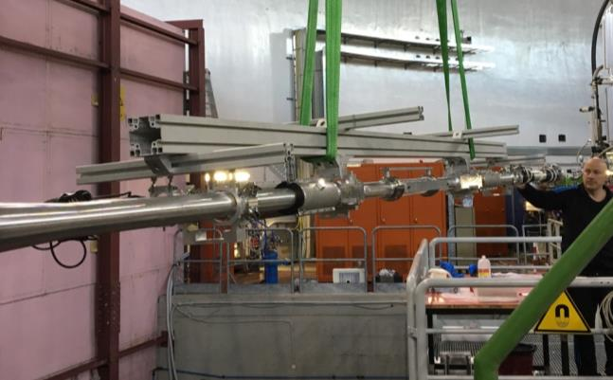
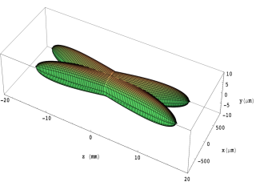
  New interaction region on DAFNE collider
focusing
quadrupole (QF)
quadrupole
permanent magnet (QD)
New optics for collisions
with reduced
horizontal and vertical
beam dimensions
a
DAFNE Upgrade

Slide 11
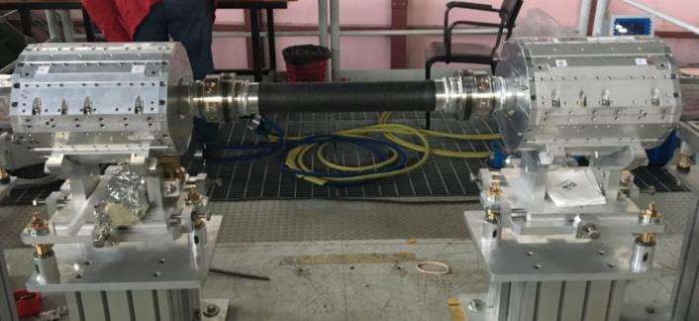
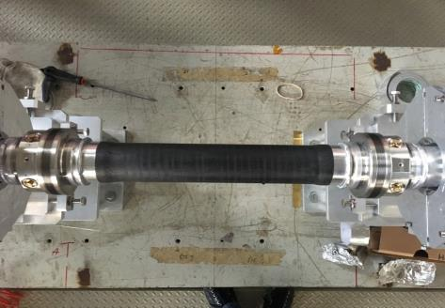
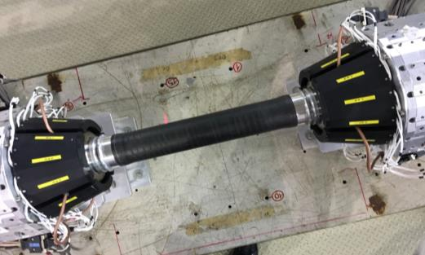
New beam pipe
flanges removed
major source of
asynchronous background
carbon fiber reinforcement
thickness ~ 500 micron
internal ultra pure aluminum
ø 55mm, thickness ~ 150 micron
DAΦNE luminosity monitor

Slide 12
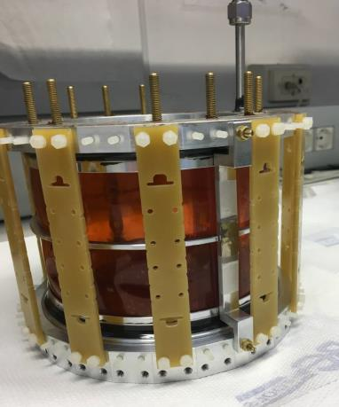
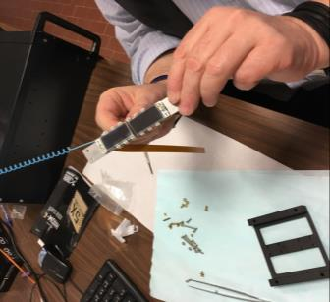
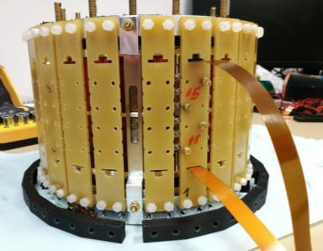
Light target and Silicon Drift Detector assembly
Target cell wall is made of a
2-Kapton layer structure
(75 µm + 75 µm + Araldit)
increase the target stopping power
almost double gas density with
respect to SIDDHARTA (3% LHD)
SDDs placed 5 mm from the target wall
calibration foils inserted near to the SDD are activated by the X-ray tubes
The new advance technology allow to setup a cryogenic target (20K) detector system with an efficient detector packing density,
covering a solid angle for stopped kaons in the gaseous target of ~ 2π.

Slide 13
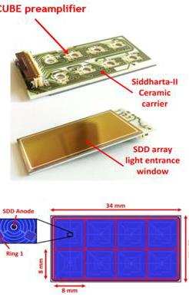
New technology for SDD detectors
difference with respect to the SDDs in SIDDHARTA:
the change the JFET structure on the SDD chip to a complementary metal-oxide semiconductor integrated charge sensing amplifier CUBE
able to operate at very low temperatures
better drift time (400ns vs. 800ns)
reduction of the single element size – more compact assembly (from 10×10 to 8×8mm2 = 64mm2 – less dead area
Monolitic 4x2 SDD array produced by Fondazione Bruno Kessler (FBK) in Trento, Italy
Notes:
The old sdd with integrated jfet charge amplifier was replaced by the new 4x2 SDD-chip array fabricated by FBK with an external CUBE amplifier. Due to the thin entrance window it will be possible to detect photons even below 500 eV. The area of a single SDD-cell is 8x8 mm2 (the size selection was mainly driven by drift time considerations) and has a square shape.
To run the SDDs in a temperature regime of 30 – 50 K the SDD-chip is glued to a special shaped ceramic board which will then fixed to a copper block using six M1 screws with plate springs to compensate for the different thermal expansions. A thin layer of high-vacuum crease will ensure a good thermal contact

Slide 14
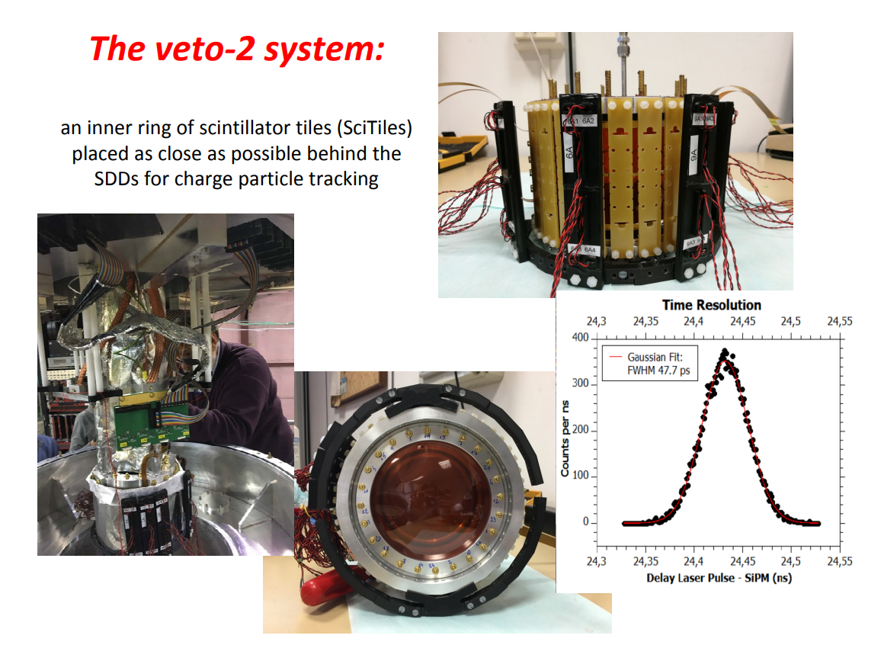
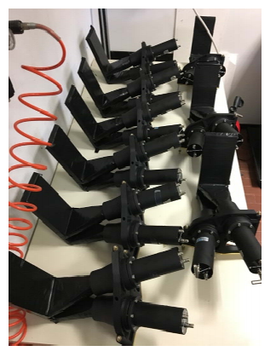
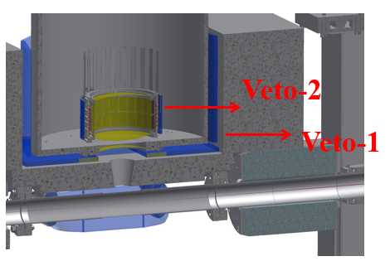
The Veto systems
The veto-1 system:
outer barrel of scintillators, acting as a gas stopping detector to identify the products of K- absorption on gas nuclei, characterized by a long moderation time (4-5 ns) (suppress the X-rays produce by the kaons stopped in gas from kaons stopped in setup material)

Slide 15
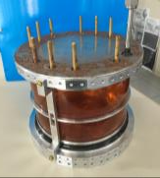
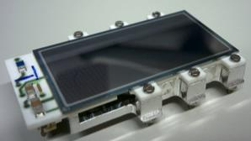

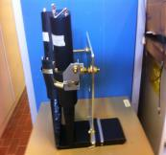
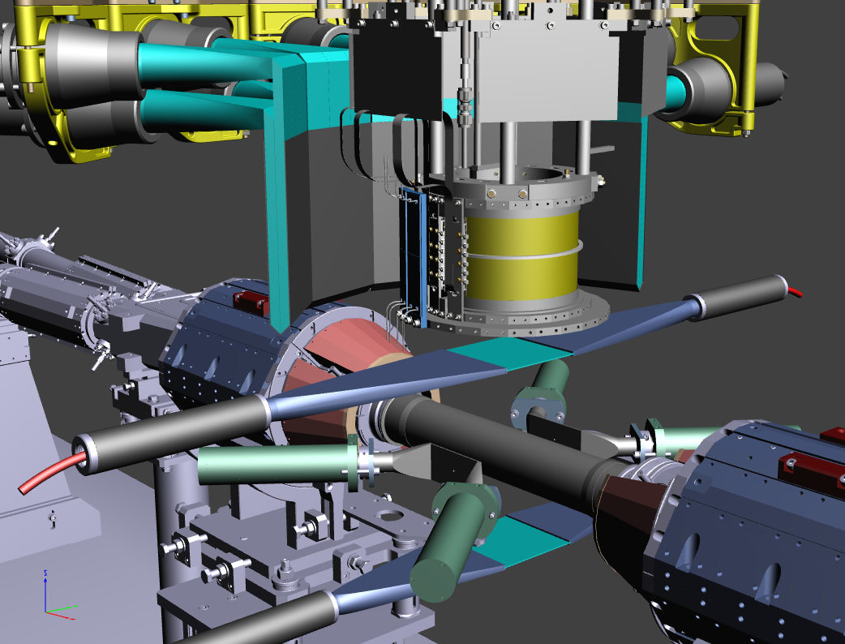
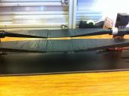
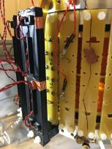

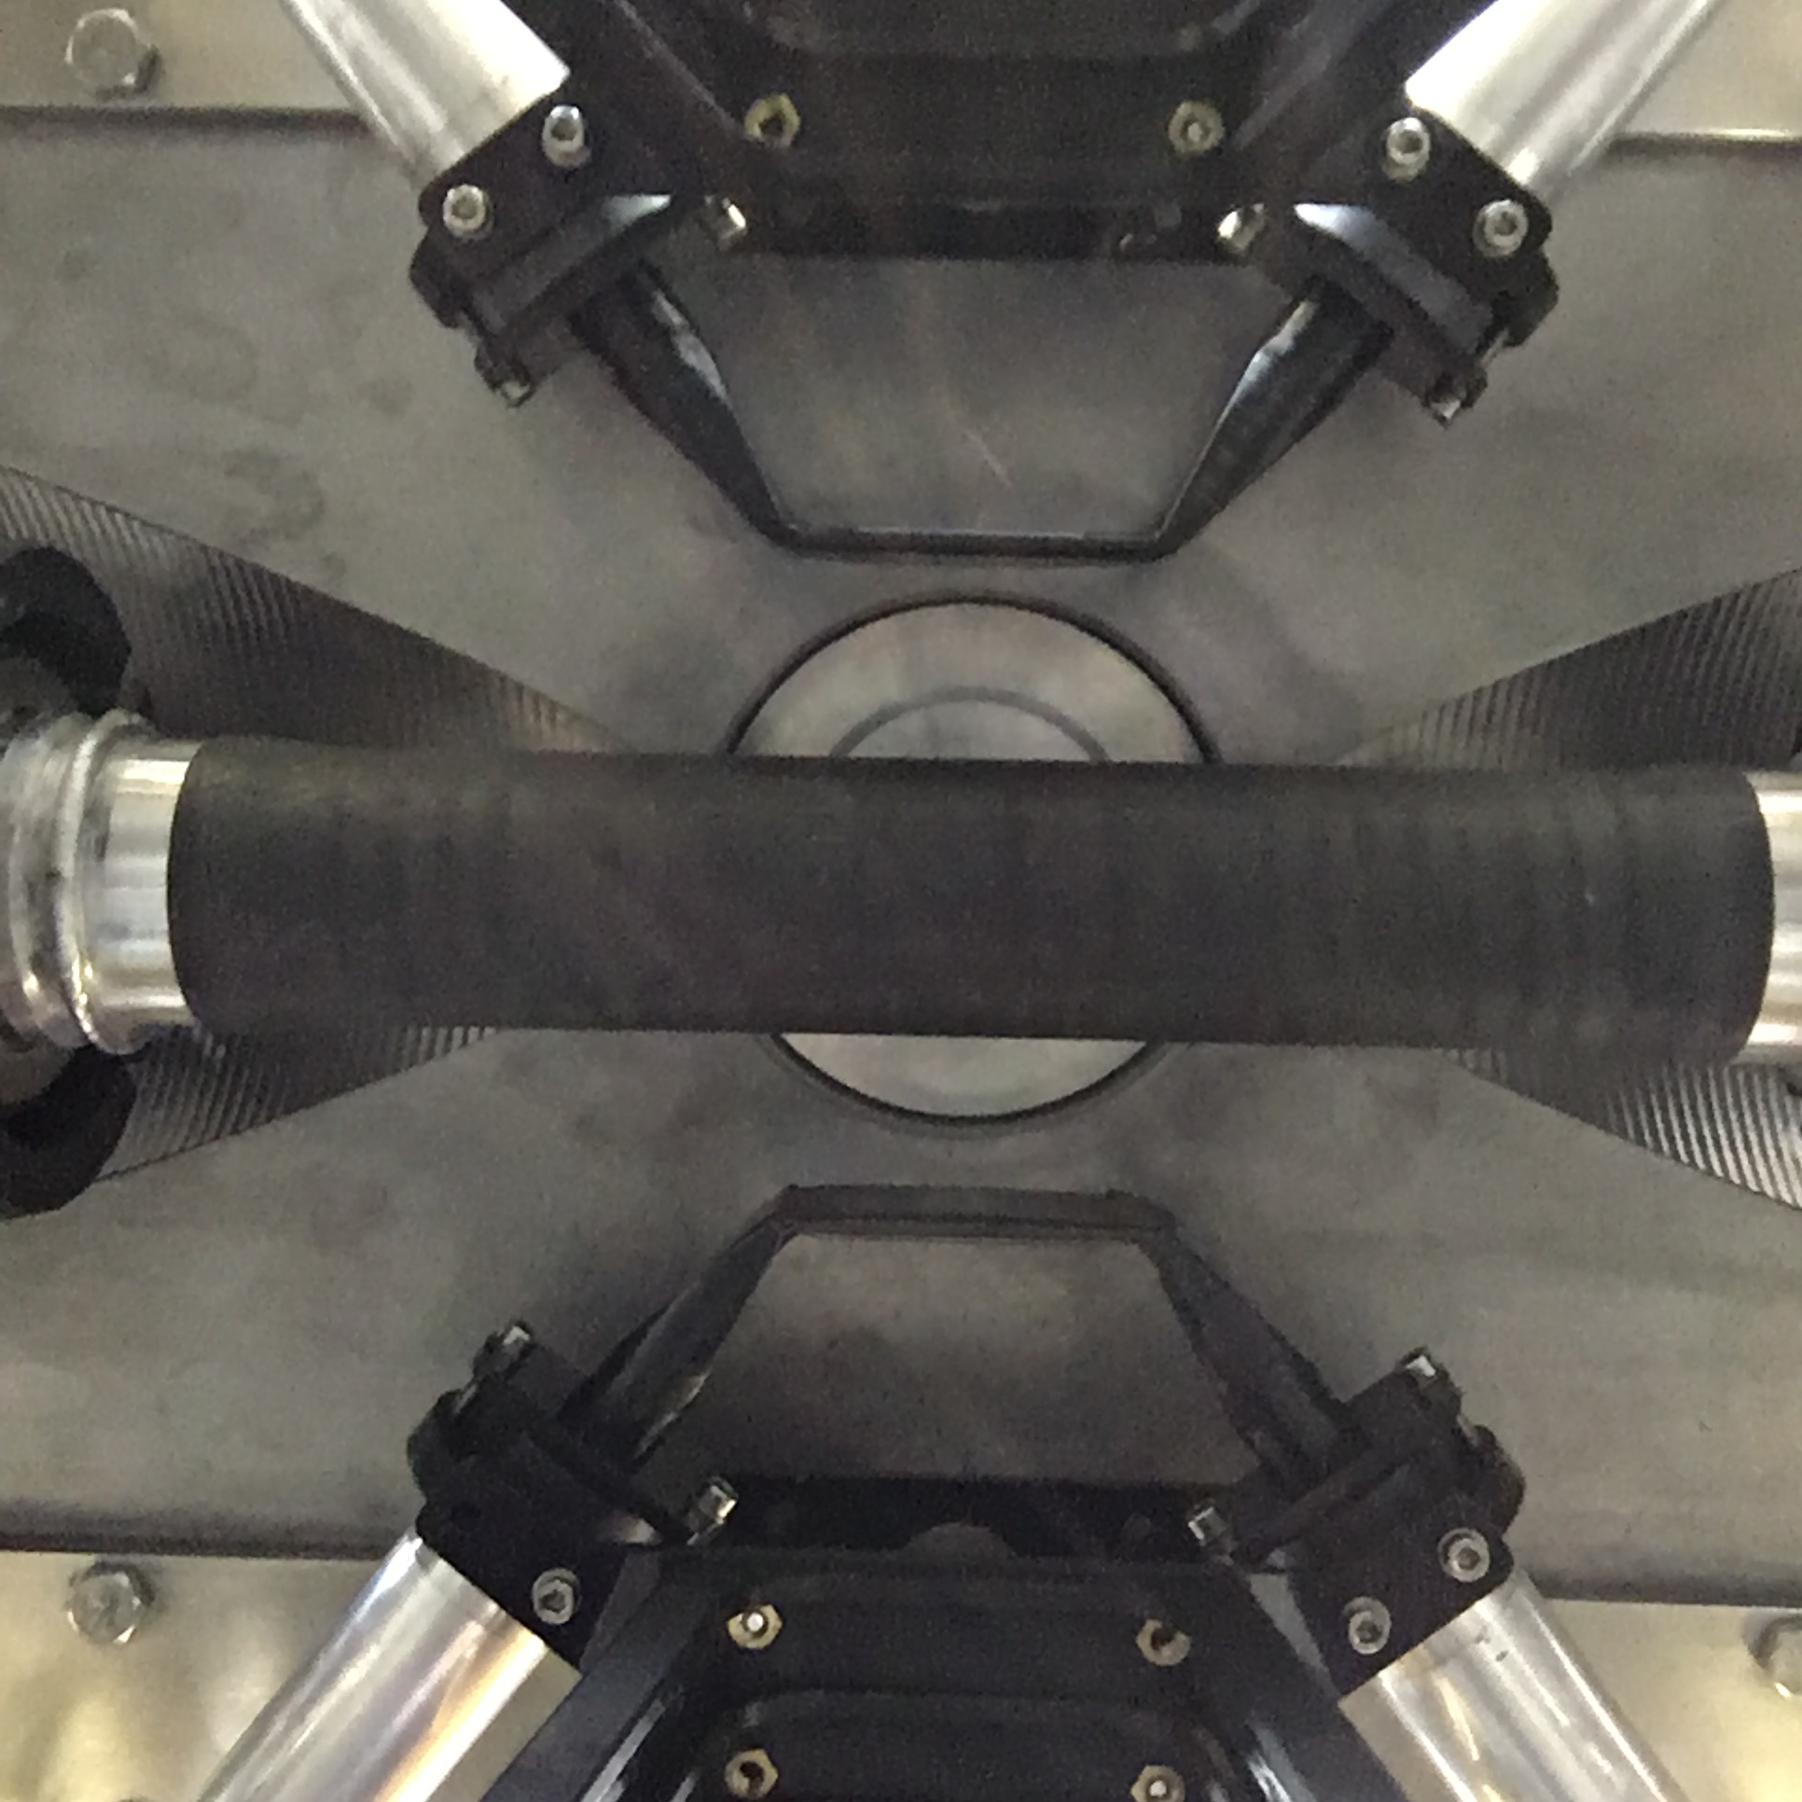
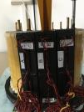
SIDDHARTA-2 apparatus in one slide
equipped with
384 SDD channels
target filled with gas (deuterium)
Kaon trigger
complete
Veto systems
luminosity monitor
Ready for the first measurement of
Kaonic Deuterium

Slide 16
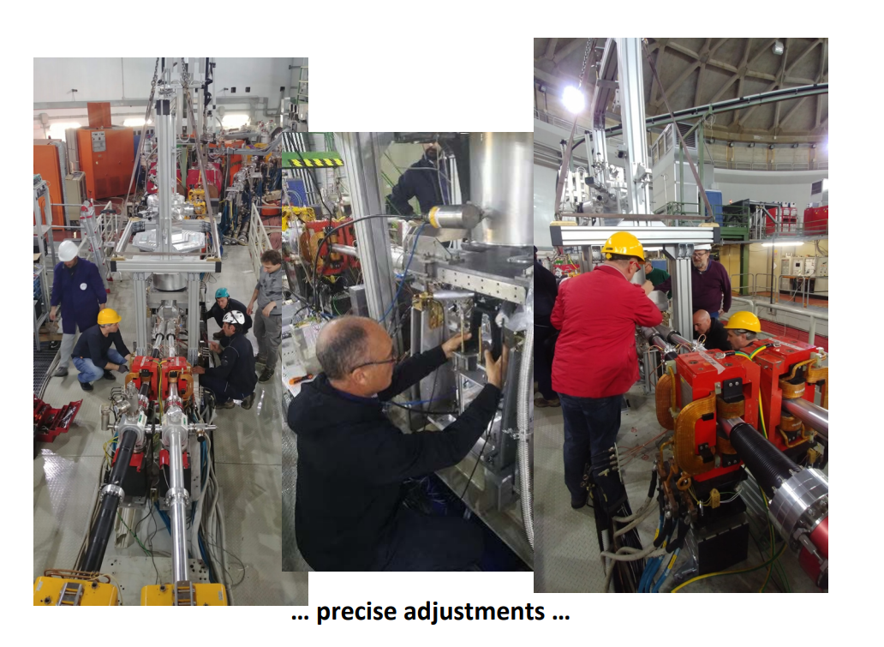
SIDDHARTA-2 @ DAΦNE installation

Slide 17

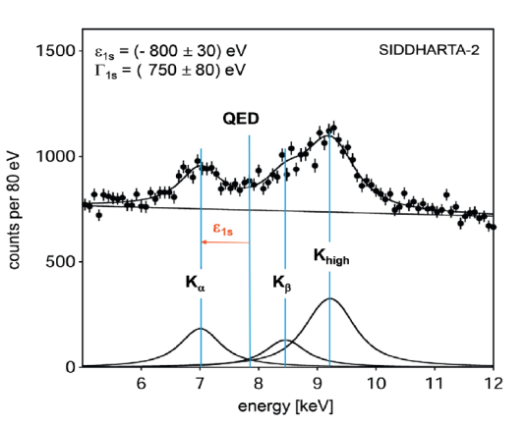
SIDDHARTA-2: Kaonic Deuterium measurement
achievable precision
Kaonic deuterium run
for S/B as 1/3:
for an integrated luminosity
of 800 pb⁻¹
to perform the first measurement of the strong interaction induced energy shift and width of the kaonic deuterium ground state
(similar precision as K⁻p) !
Simulated SIDDHARTA-2 kaonic deuterium spectrum, assuming a shift of -800 eV and width Γ ~ 750 eV of the 1s state, as well as a Kα yield of 10⁻³.
Notes:
This window of opportunity should be realized.

Slide 18
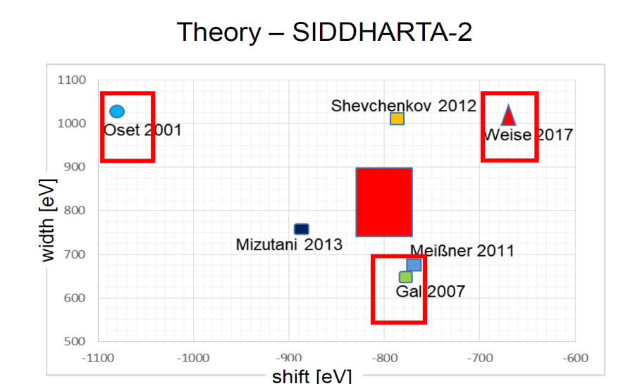
SIDDHARTA-2 targeted precision for deuterium
The experimental result will set essential constraints for theories
and will help to disentangle between different theoretical approaches

Slide 19
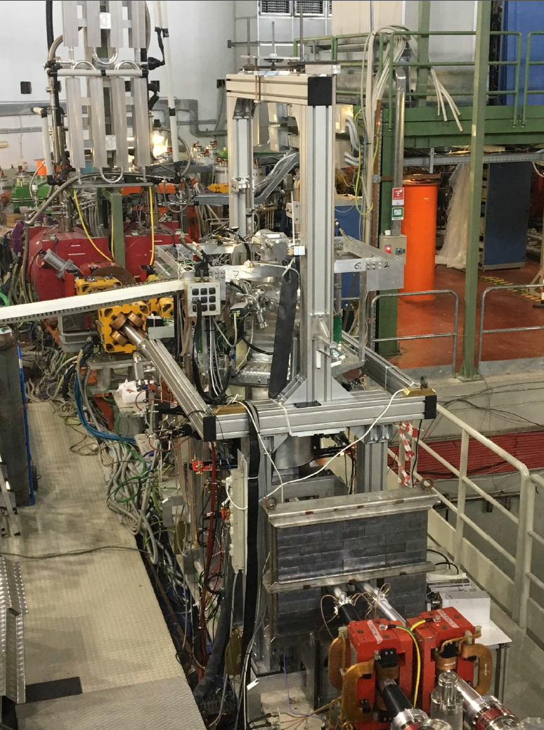
SIDDHARTA-2 PRESENT STATUS
We conclude the
Phase1 in June 2021 SIDDHARTINO setup
During the commissioning of DAFNE (new colliding optics, new interaction region)
we perform refined optimization
and the K-⁴He test measurement
with the SIDDHARTINO setup
(only 8 SDD arrays)
Aim: confirm when DAFNE background conditions are similar to the one measured in SIDDHARTA 2009

Slide 20
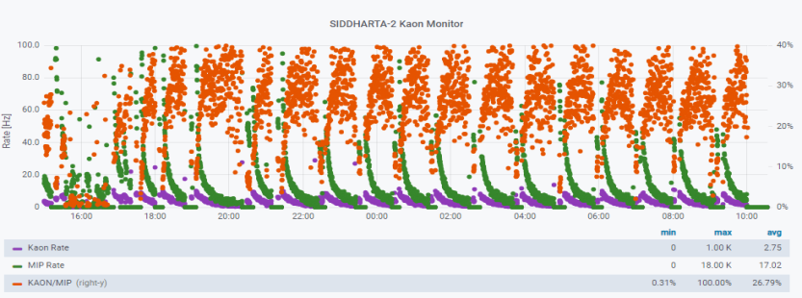
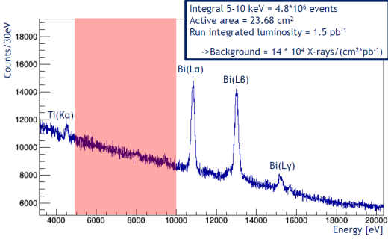
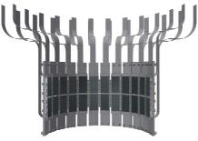
SIDDHARTINO = SIDDHARTA-2 with 8 SDDs arrays
On-line feedback is fundamental during the commissioning phase
optimization of the SDDs response, trigger, DAQ, calibration procedure
Bi (Lγ)
ONLY
64 SDD channels (out of 384)
1 BUS structure

Slide 21
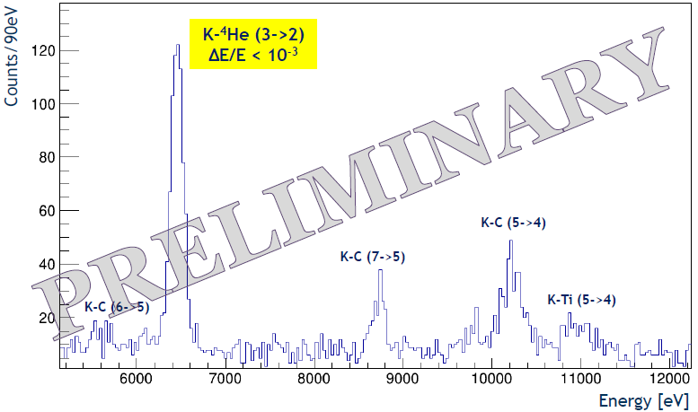
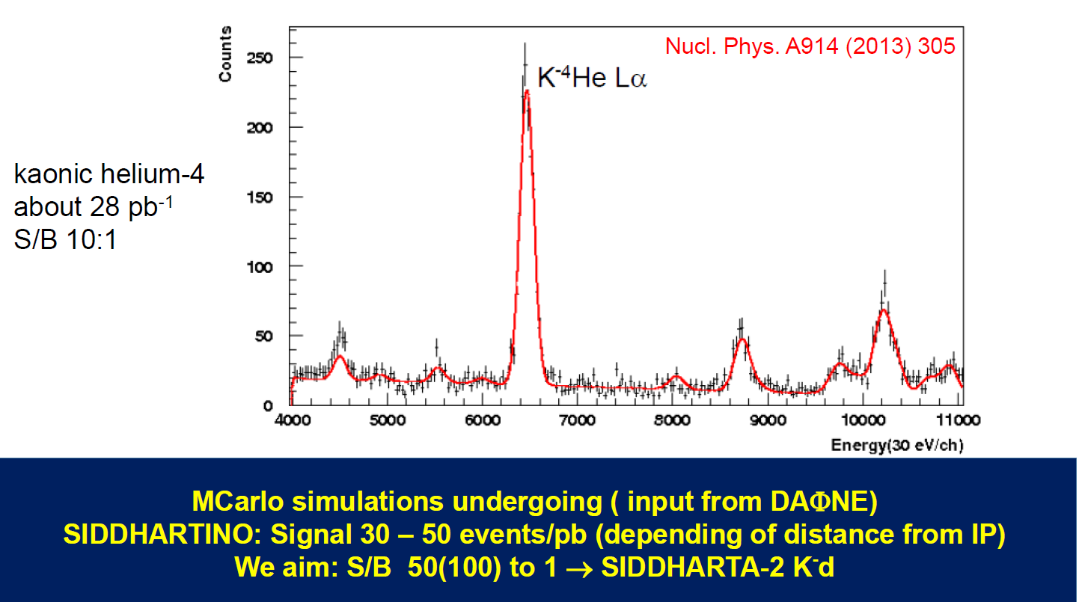
SIDDHARTINO – K-⁴He test measurement
S/B was 10/1 for the K-⁴He
measurement with ~ 30 pb⁻¹
SIDDHARTINO
measured spectrum for ~ 15 pb⁻¹
Aim:
to set the working conditions for SIDDHARTA-2
by a comparison with SIDDHARTA (S/B)
SIDDHARTA 2009
measured spectrum for ~ 30 pb⁻¹
Notes:
The SIDDHARTINO aim is to perform kaonic he measurement in order to set the working condition by a comparison with sidd 2009
In terms of s/b.
This is the KHe4 spectrum measured by SIDD in 2009, we measure the KH very nice, with a s/b = 10/1 , now we want to improve it and bring it to 100/1 which will set a nice conditions to go for the final setup and to measure the KD .

Slide 22
SIDDHARTA-2 action plan
Action plan for Kaonic Deuterium measurement:
    Install all the SDDs (48 SDD arrays), veto systems and start
    the kaonic deuterium measurement for a total integrated luminosity of 800 pb⁻¹
First run with SIDDHARTA-2 setup as planned
(about 300 pb⁻¹ integrated) – start in October 2021
Second run with optimized shielding, readout electronics and other necessary optimizations;
(for other 500 pb⁻¹ integrated) – after summer 2022
Test runs for futures kaonic atoms measurements (HPGE, 1mm SDD, …)

Slide 23
Future plans at DAΦNE
DAΦNE is a unique machine to perform fundamental physics measurements at the strangeness frontier with a strong impact on many sectors:
- selected targets for heavy (KPb) kaonic atoms transitions (HPGe)
strong impact in solving the charged kaon mass puzzle
- light (KHe, KLi, KBe) kaonic atoms transitions (Cd(Zn)Te, 1mm SDD’s)
- Ultra-High precision (under eV) kaonic atoms measurements (VOXES)
- low-energy kaon-nucleon scattering processes (GEM-TPC active target)
- low-energy kaon-nuclei interactions
more details in: https://arxiv.org/pdf/2104.06076.pdf
Towards LOI/Technical Design Report in preparation

Slide 24
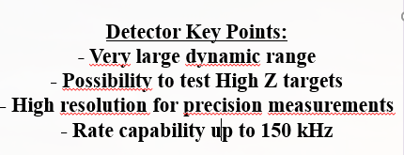
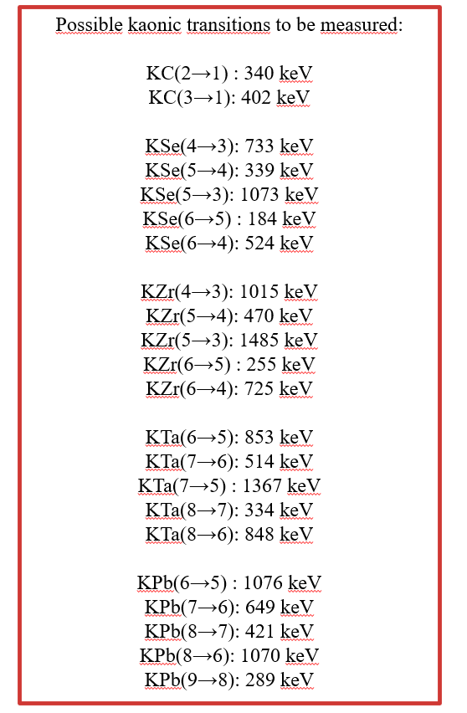
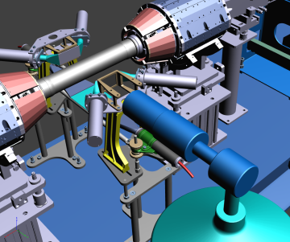
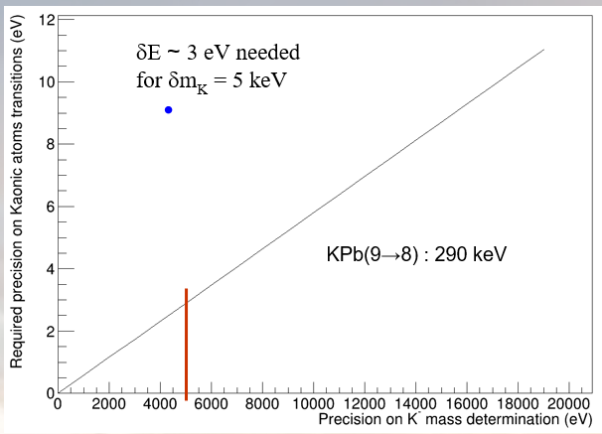
Heavy (high Z) kaonic atoms using High Purity GE
Charged Kaon Mass puzzle:
ready for a feasibility test run using Pb target
Target just behind the luminometer,
which is used as trigger
Dedicated measurements:
Targets : Se, Zr, Ta, Pb
(systematic errors minimisation, cascade processes in heavy kaonic atoms )
simultaneous measurements of atomic transitions from various n levels and with different ∆n
~ 360 pb-1 (~ 40 days) of beamtime requested
!!! Similar estimations for each target !!!

Slide 25
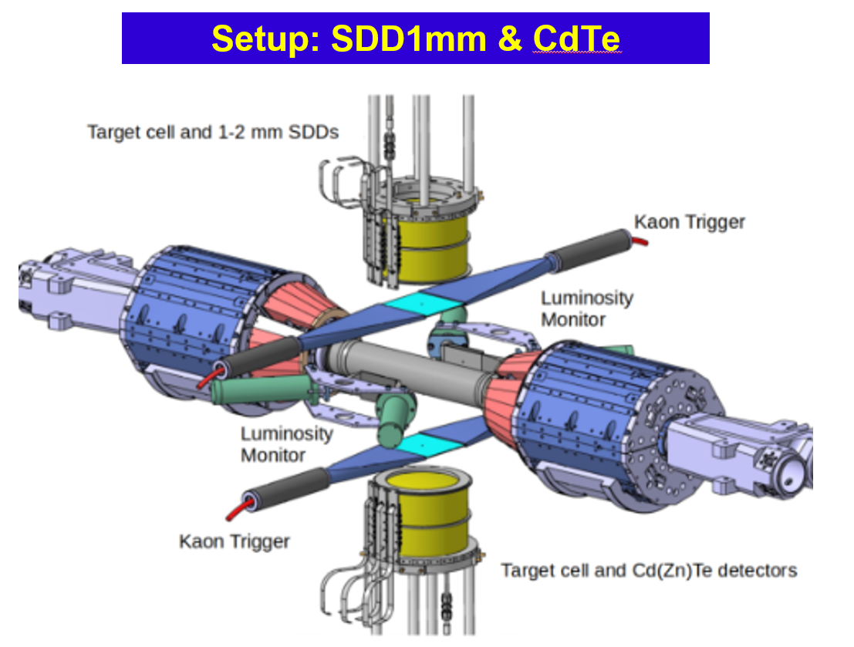
Light kaonic atoms measurements
Expected impact:
kaon-nuclei potential and chiral models below threshold and the nature of Λ(1405).
astrophysics: search for dark matter with strangeness and the equation of state for neutrons stars
In particular, the first measurement of 3He,4He (2p → 1s) transition, will put stronger constraints on the theoretical models describing the kaon-nucleon interaction in systems with more than two nucleons
Targets : ^{3,4}He, ^{6,7}Li, ^{8,9}Be, ^{10,11}B
both low level and high level transitions with ∆n = 1, 2, ...5, and energies in the range 10-100 keV

Slide 26
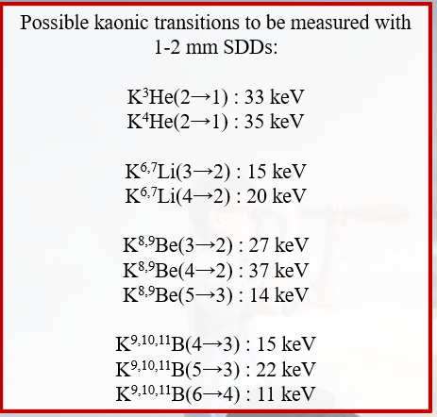
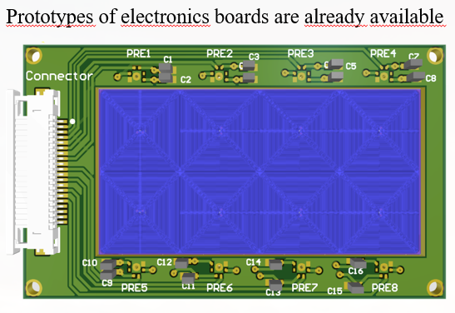
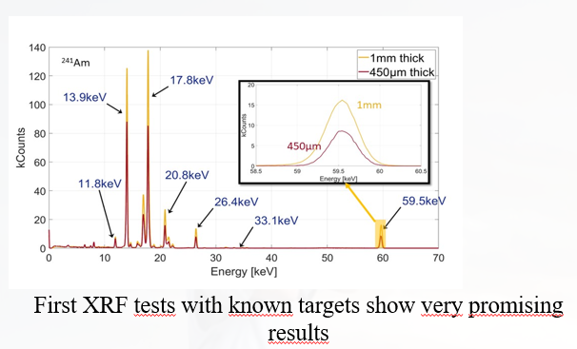
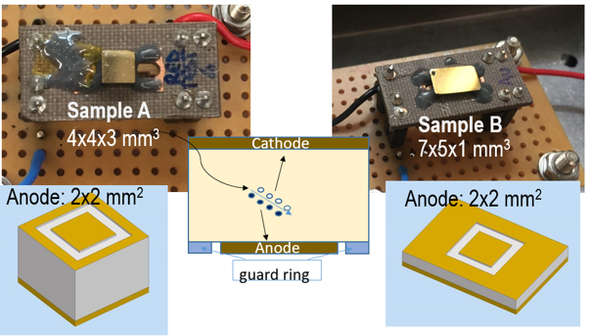
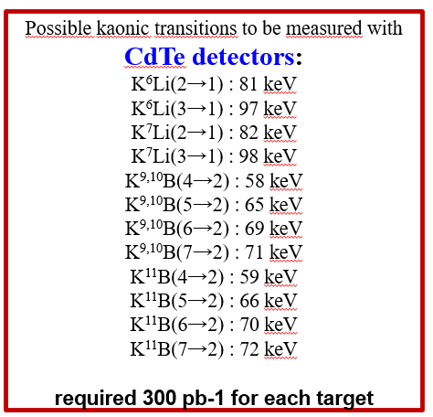
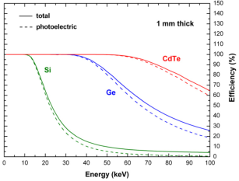
New detectors - SDD 1mm thickness / Cd(Zn)Te
SDD 1mm
FWHM ~ 150 eV (SDD)
Cd(Zn)Te
Cadmium(Zinc)Telluride detectors will be developed in the STRONG2020-ASTRA
First prototypes will be available in 2022
FWHM ~ 1000 eV

Slide 27
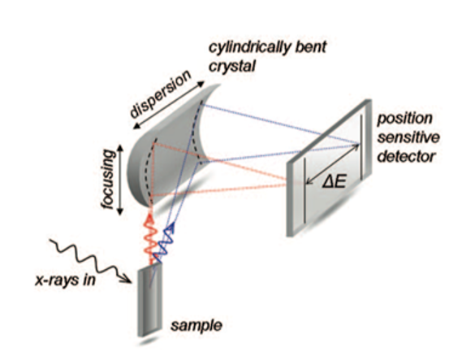
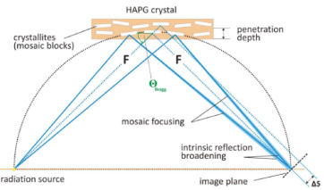



Ultra-High precision (under eV) kaonic atom measurements (VOXES spectrometer)
Mosaic crystal consist in a large number of nearly perfect small crystallites.
Mosaicity makes it possible that even for a fixed incidence angle on the crystal surface, an energetic distribution of photons can be reflected
Spectrometer with
Highly Annealed Pyrolitic Graphite - HAPG
mosaic crystals in Von Hamos configuration

Slide 28
Conclusions
SIDDHARTINO apparatus was fully working and we conclude the phase 1 of the project performing the Kaonic 4Helium test measurement
We are ready and very motivated to go on with SIDDHARTA-2 for kaonic deuterium measurement (full installation is ongoing)
Several proposals and many interesting developments are already in advanced state

Slide 29

On behalf of the SIDDHARTA-2 collaboration
Thank you!

Slide 30
Spares

Slide 31

Kaon-nuclei scattering and interaction
The present knowledge of total and differential cross sections of low energy kaon-nucleon reactions is very limited.
Below 150 MeV/c there is a “desert” - the experimental data are very scarce and with large errors and practically no data exist below 100 MeV/c.
Studies of Hyperon-nucleon, Hyeron-multinucleon (AMADEUS experience)
Kaon-nucleon scattering/interaction data are fundamental to validate theories: chiral symmetries; lattice calculations; potential models etc.
Measurement of the low-energy scattering process of kaons, and of the Λ(1405) kaon induced production, on various targets such as hydrogen, deuterium, helium-3 and helium-4 using a GEM-TPC active target.

Slide 32

elastic scattering, layout
Measurement of the low-energy scattering process of kaons, and of the Λ(1405) kaon induced production, on various targets such as hydrogen, deuterium, helium-3 and helium-4.
Time Projection Chamber (TPC) with a Gas Electron Multiplier (GEM) readout device, allows the study of kaons interactions directly in the TPC gas/target volume

