Slide 1
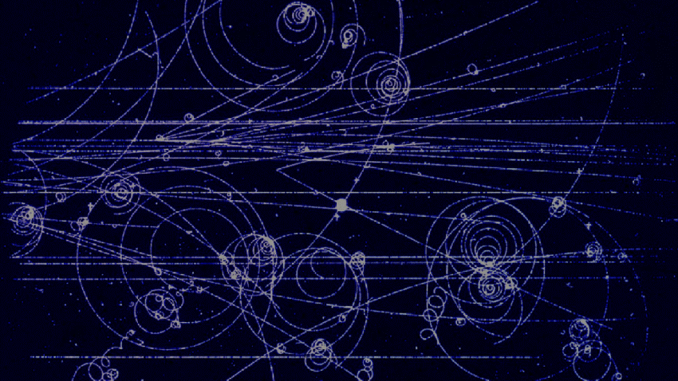




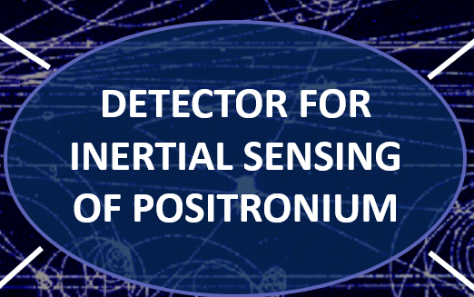
CLICK ON BUBBLES FOR MORE INFORMATION
(LOOK AT SLIDES IN PRESENTATION MODE)

Slide 2
ABSTRACT
Positronium (Ps), the metastable bound state of an electron and a positron is produced and studied
at AEgIS (CERN). As a neutral matter-antimatter complex, Ps is a suitable candidate for force-sensitive inertial measurements on antimatter by means of deflectometry/interferometry. A detector capable of simultaneously measuring the impact position and time of arrival of very small numbers of Ps atoms with a spatial resolution in the order of 10 µm and a time-resolution in the order of 100 ns is necessary to conduct such experiments.
A hybrid imaging/timing detector for a pulsed low-intensity beam of Ps fulfilling these requirements was developed. The detection scheme is based on field-ionization of the incoming Ps atoms, followed by the detection of the positrons released in this process. The ionization products are imaged by a microchannel plate (MCP), which is read out by a TimePix3 chip, providing a time resolution on a ns-scale. An event centroiding algorithm reconstructs the impact position of the atoms on the detector with sub-pixel
resolution.
The performance of a prototype of this type of detector was tested with a positron beam.
A detailed description of the detection principle and the results of the performance tests are presented.
An overview of the experiments that can be performed with this detector, once implemented in the Ps
beamline at AEgIS is given.

Slide 3
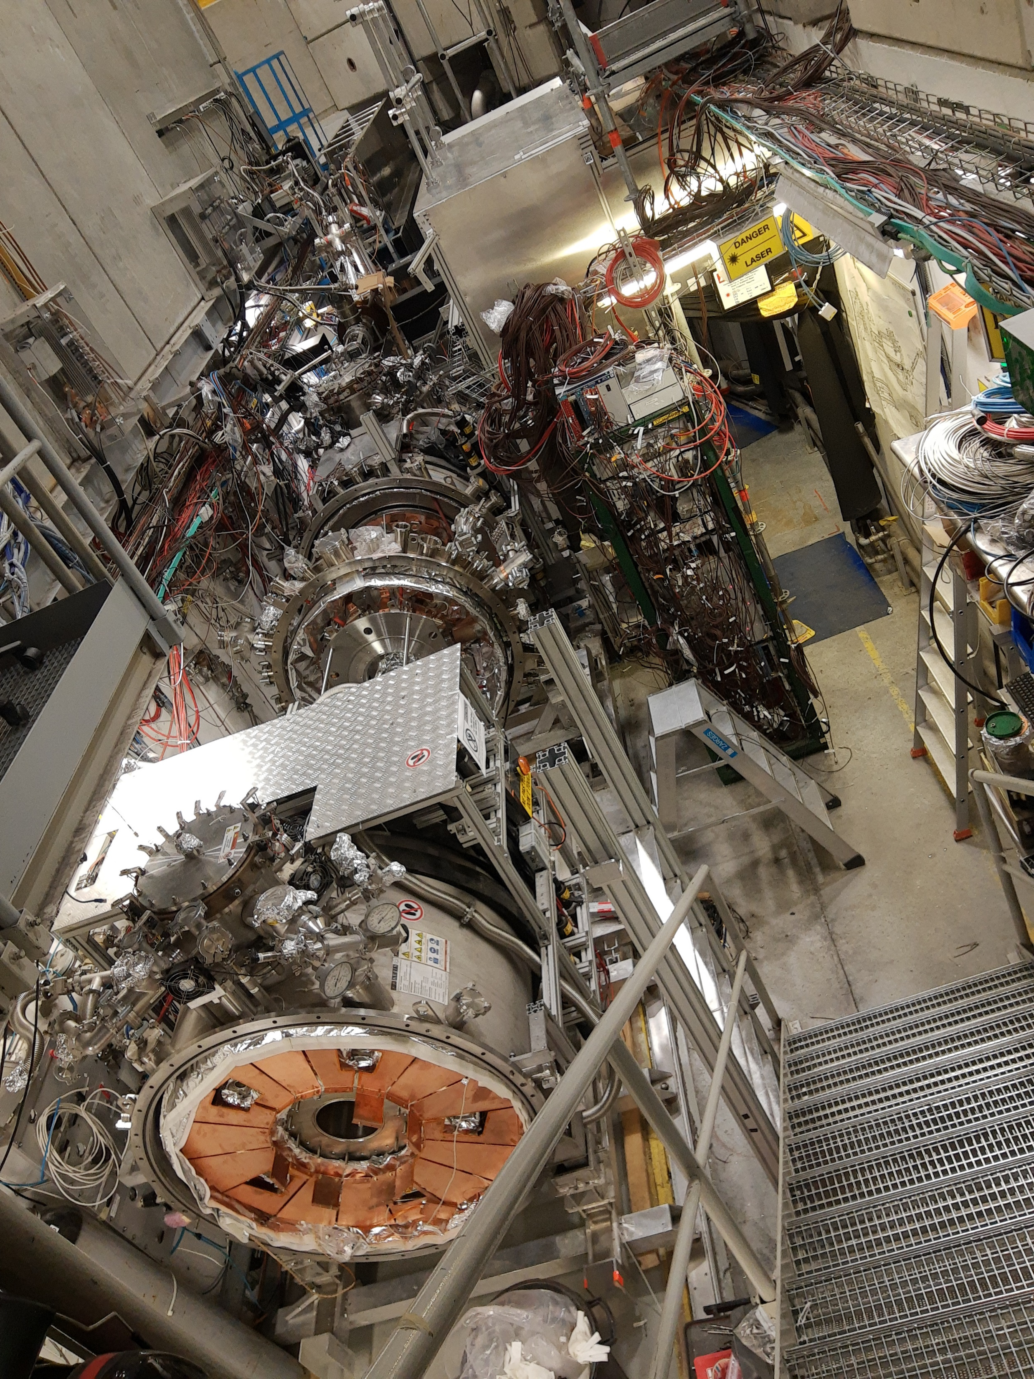



AE$\overline{g}$IS
AE$\overline{g}$IS is one of the experiments based at CERN’s AD (Antiproton Decelerator) and ELENA (Extra Low ENergy Antiproton ring).
The main goal of AE$\overline{g}$IS is to study the free fall of antimatter in the Earth’s gravitational field.
Two antimatter systems are being produced and studied at AE$\overline{g}$IS:
  Antihydrogen, composed of an antiproton and a positron
  Positronium, the metastable complex of an electron and a positron
  MORE ABOUT AE$\overline{g}$IS
The AE$\overline{g}$IS apparatus (08/2021)

Slide 4
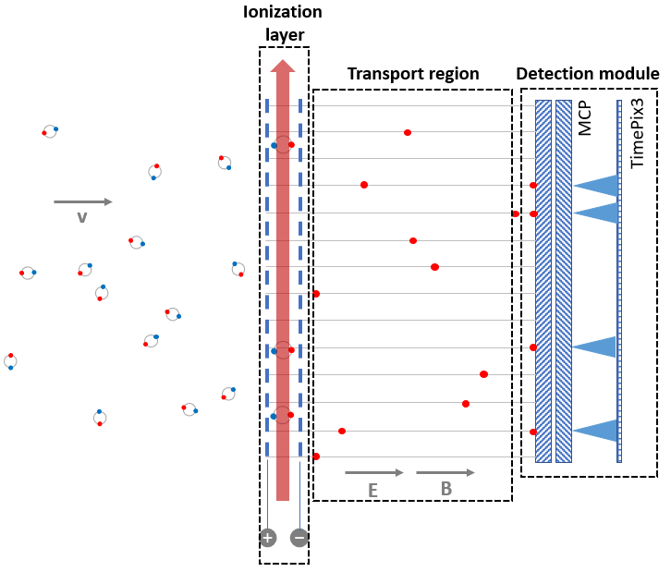



DETECTION PRINCIPLE
The detection principle is based on the methodologies described in [1] and [2].
The incoming Ps atoms are ionized by a combination of field- and photo-ionization, followed by the detection of the ionization products released in this process.
The spatial position of the Ps atoms in the detector plane is conserved by the positrons being bound to magnetic field lines during transport to the detection module.
The positrons are imaged by the detection module, which consists of a microchannel plate (MCP) read out by a TimePix3 ASIC (TPX3). With the TPX3 chip as a readout anode, the device provides a time resolution on a ns-scale.
Sub-pixel resolution is achieved by means of an event centroiding algorithm, reconstructing the impact position with high accuracy.
[1] C. Amsler et al. (AEgIS collaboration): A ~ 100 µm-resolution position-sensitive detector for slow positronium, Nuclear Instr. and Methods in Physics Research B 457 (2019) 44-48
[2] J. Vallerga et al.: MCP detector readout with a bare quad Timepix at kilohertz frame rates,
JINST 6 (2011) C01049

Slide 5
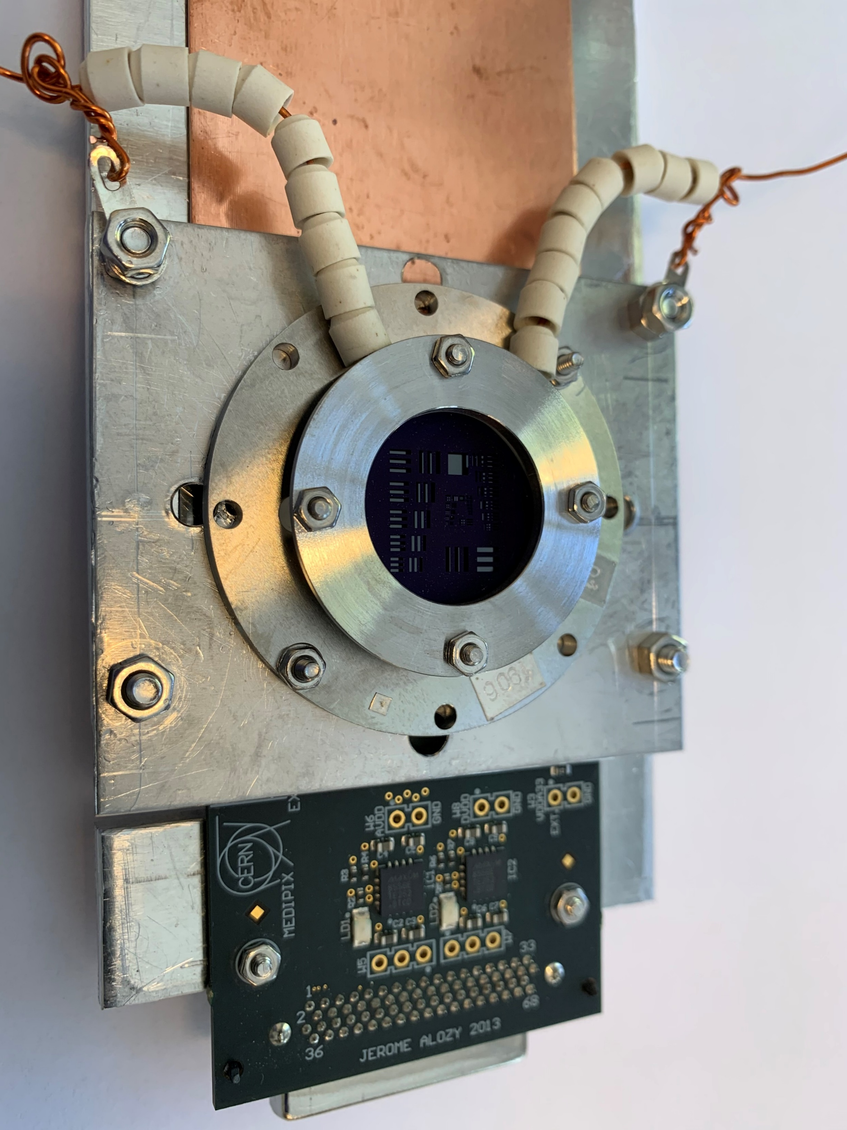
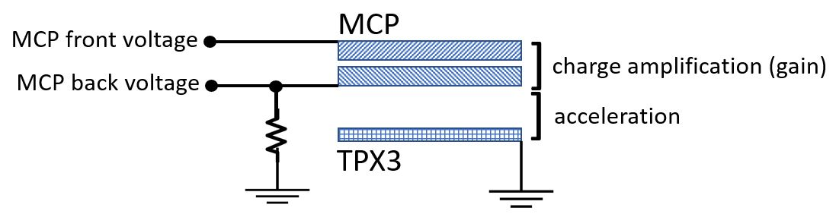



DETECTION MODULE
The detection module was tested with a low energy positron beam.
MCP chevron stack:
10 µm channel diameter
12 µm channel pitch
18.6 mm active area
TimePix3 ASIC:
130 nm CMOS technology
Matrix of 256 x 256 pixels
55 x 55 µm² pixel size
1.562 ns timing resolution

Slide 6
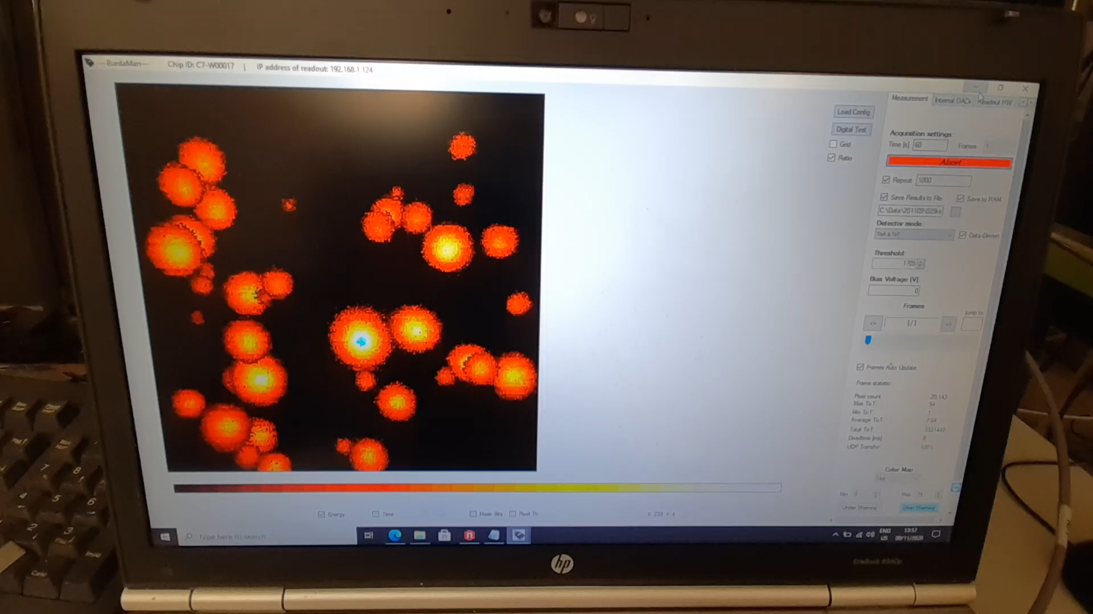
Katherine, the readout system used allows a direct visual feedback.
Positrons hitting the MCP front face produce secondary electrons which get amplified in the channels. The electron clouds emerging from the MCP back side expand in the gap between the MCP and the chip.
On the screen you can see the electron
clouds impinging on the TimePix3 ASIC.

Slide 7
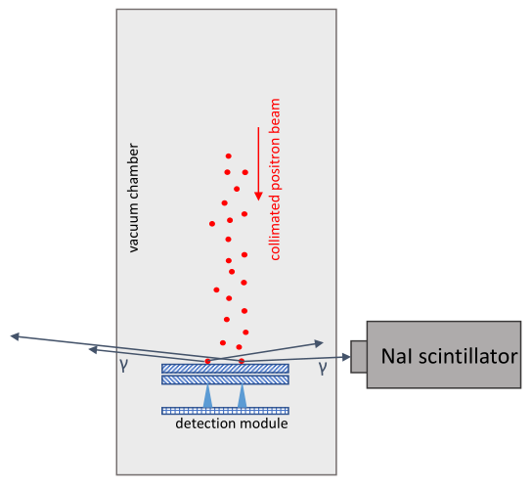
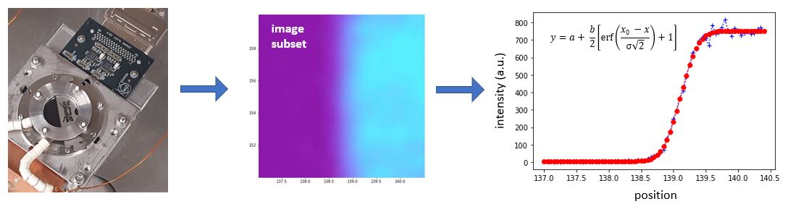
DETECTION EFFICIENCY
The efficiency of the detection module was
measured as the ratio of positrons impinging
on the surface of the MCP and the number of
clusters registered by the device. The number
of positrons was measured with a calibrated NaI
scintillator coupled to a photomultiplier tube.
The results, as in table 2, show a strong
dependence on the MCP gain voltage and the
acceleration voltage between the MCP back
face and the TPX3 ASIC.
METHODS
SPATIAL RESOLUTION
The spatial resolution of the detection module was determined with the edge
spread function method. An image of a sharp edge was obtained with a
positron beam of 0.5 keV. The image intensity along the edge is integrated and
fitted with an error function. The resolution is extracted from the parameters of
the fit.

Slide 8
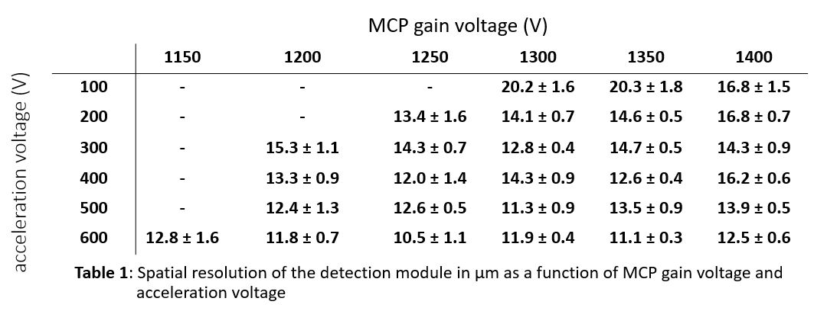
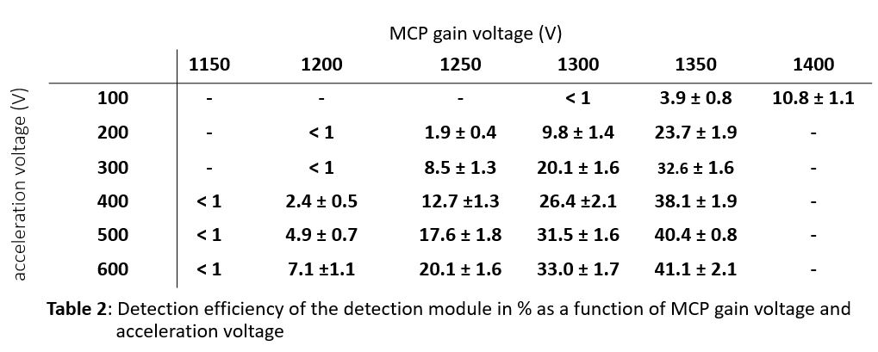
SPATIAL RESOLUTION
RESULTS
Displayed in table 1 and table 2 are the results of the spatial resolution – and detection efficiency tests as a function of the MCP gain factor and the acceleration voltage between the MCP back face and the TPX3 ASIC.
Both parameters show a strong
dependence on the MCP gain voltage and the
acceleration voltage. Optimizing the parameters according to the applications, the detection efficiency can reach up to about 40% and a resolution limited by the inter channel distance of the MCP can be achieved.
DETECTION EFFICIENCY

Slide 9
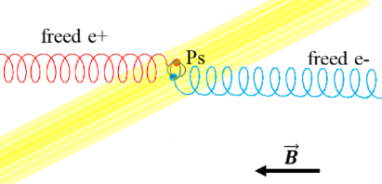
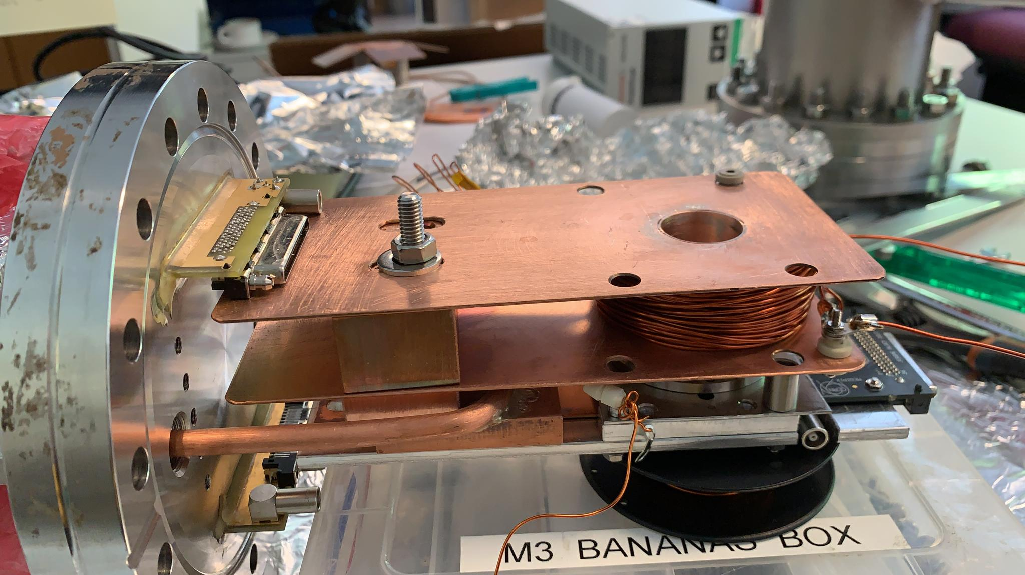
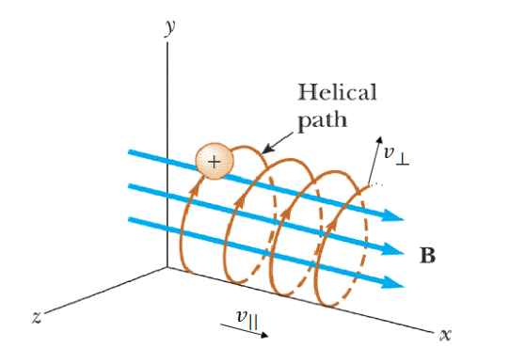
TRANSPORT REGION - work in progress -
By applying a strong magnetic field in longitudinal direction, charged particles can be transported. They will circle around the magnetic field lines in a helix-like movement, called gyration. The magnetic transport of the positrons released in the ionisation process towards the MCP is used to preserve their spatial position in the ionisation plane. The smaller the cyclotron radius of the positrons, the better the spatial resolution that can be achieved.
Field-/Photo-Ionisation
First tests of the effects of a magnetic field with a coil
Image: B. Rienäcker, Investigation of positron/positronium
converter targets at AEgIS (CERN), Master’s thesis, 2015

Slide 10
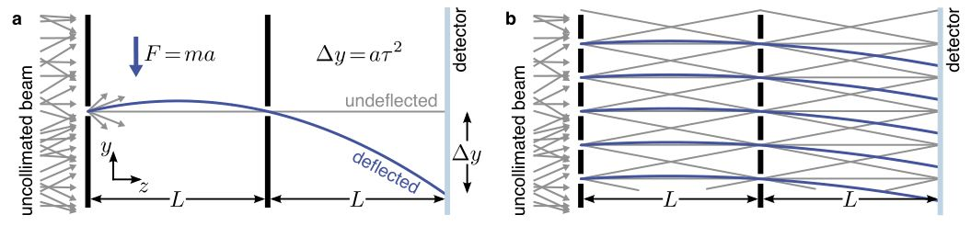
INERTIAL SENSING
An inertial-sensing device can be composed of two gratings and a detector. Particles not being stopped or deflected from either of the gratings generate a periodic pattern on the detector plane.
An external force, like a magnetic force or gravity, acting on the particles will shift the position of this pattern. Information about this force can be extracted from the magnitude of the shift [5]. To measure the deplacement, an atomic detector with a spatial resolution in the order of 10 µm is required. (Image from [4])
[4] P. Bräunig: Atom Optical Tools for Antimatter Experiments, University of Heidelberg (2014)
[5] S. Mariazzi et al.: Toward inertial sensing with a 23S positronium beam, Eur. Phys. J. D 74 (2020) 79

Slide 11

POSITRONIUM
Positronium (Ps) is a metastable hydrogen-like matter-antimatter bound state of an electron and a positron.
It exists in two different ground states:
- Singlet 1¹S (para-Ps) with a lifetime of 0.125 ns
- Triplet 1³S (ortho-Ps) with a lifetime of 142 ns
Excitation of Ps to Rydberg states (Ps*) increases its lifetime up to several tens of microseconds.
Next to antihydrogen and muonium, positronium is considered a suitable candidate to measure the gravitational interaction between matter and antimatter [3].
[3] A. Mills Js, M. Leventhal: Can we measure the gravitational free fall of cold Rydberg state positronium?,
NIM in Physics Research B 192 (2002) 102–106

