Slide 1
The VICAV Dictionaries
Working on a Virtual Research Environment
Karlheinz Mörth
Austrian Centre for Digital Humanities
Austrian Academy of Sciences
Lexical Data Masterclass 2018, Berlin, 4.12.2018

Slide 2
Presentation
Whence we come
Institutional setting + projects
Scholarly background (linguistic issues + text technology)
The dictionaries
VICAV toolbox
Viennese Lexicographic Editor (VLE)
VICAV 3.0
Interoperability mechanisms
Where to from here?

Slide 3
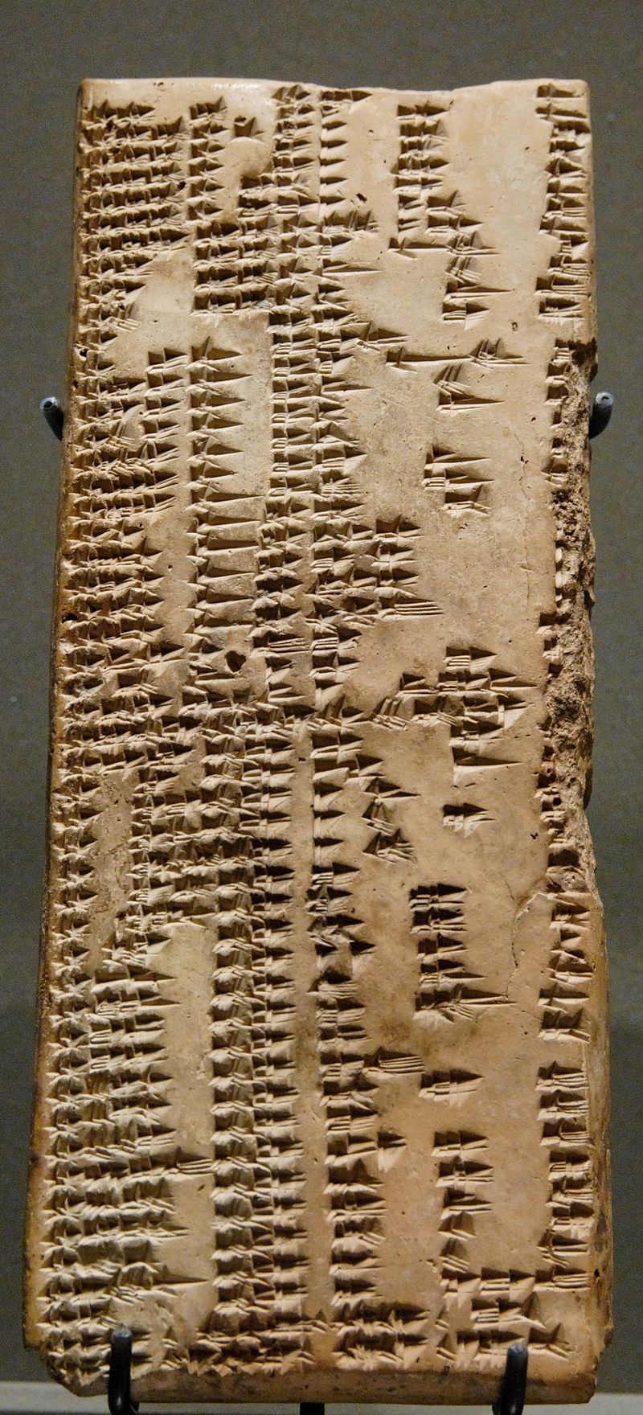
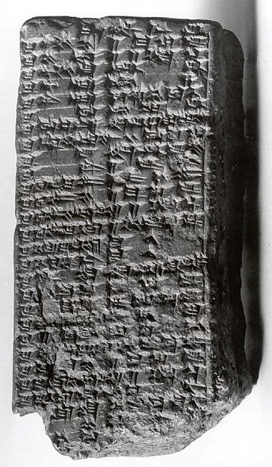
Prolegomena
Lexicography →
Urra=hubullu
2000
1000
0
www.metmuseum.org/art/collection/search/321714
https://en.wikipedia.org/wiki/Urra%3Dhubullu#/media/File:Sumerian-akkadian_lexicon_Louvre_AO7662.jpg

Slide 4
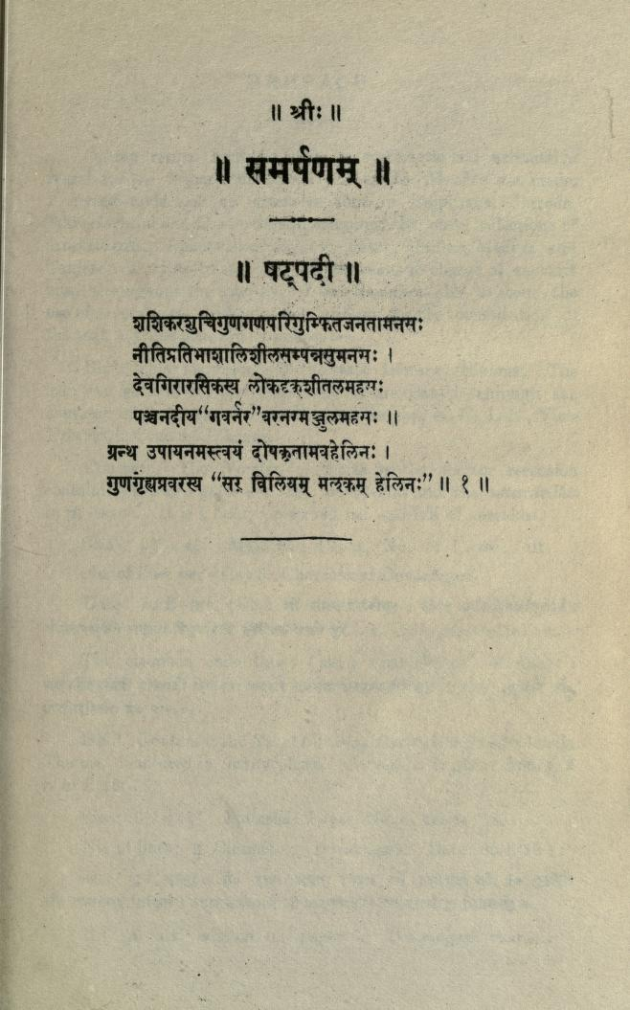
Prolegomena
Lexicography →
2000
1000
Nirukta (निरुक्त)
0
https://archive.org/details/nighantuniruktao00yaskuoft

Slide 5
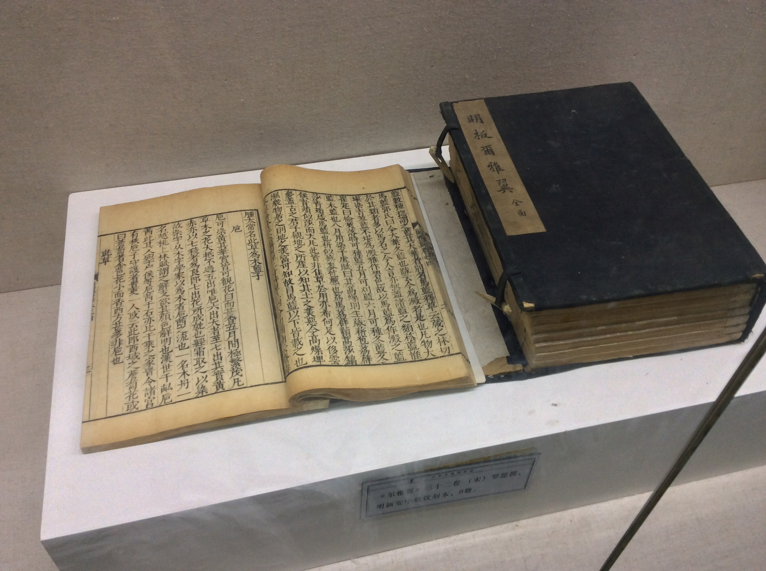
Prolegomena
Lexicography →
2000
1000
爾雅 (Erya)
0
https://commons.wikimedia.org/wiki/File:Erya_Yi_-_Chinese_Dictionary_Museum.JPG

Slide 6
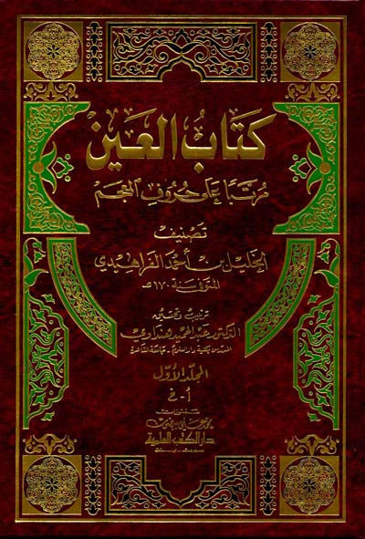
Prolegomena
Lexicography →
2000
1000
0
http://www.al-ilmiyah.com/bookpage/9782745129840.html
كتاب العين (Kitāb al-ʕayn)

Slide 7
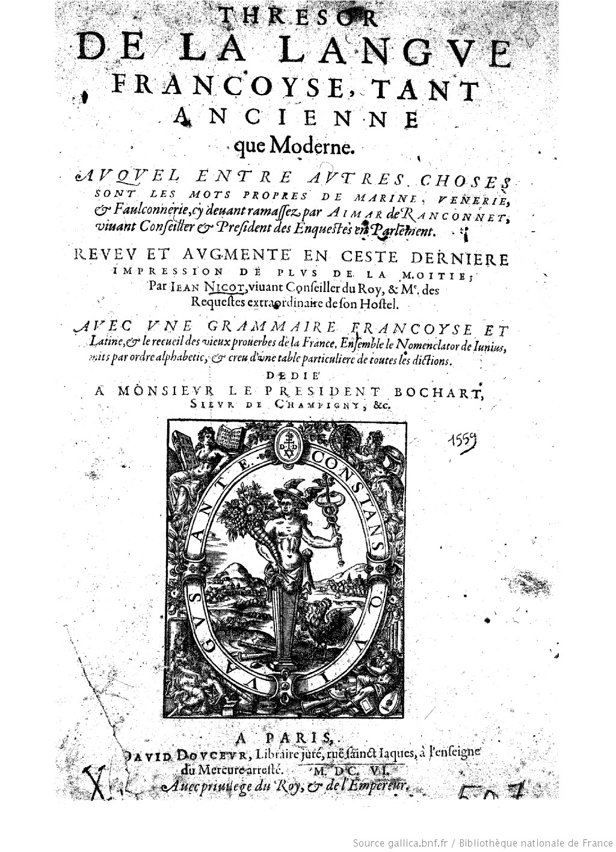
Prolegomena
Lexicography →
1600
Trésor de la langue Française (Jean Nicot; 1606)
1620
1640
1660
1680
1700
http://gallica.bnf.fr/ark:/12148/bpt6k50808z
1720
1740
1760
1780
1800

Slide 8
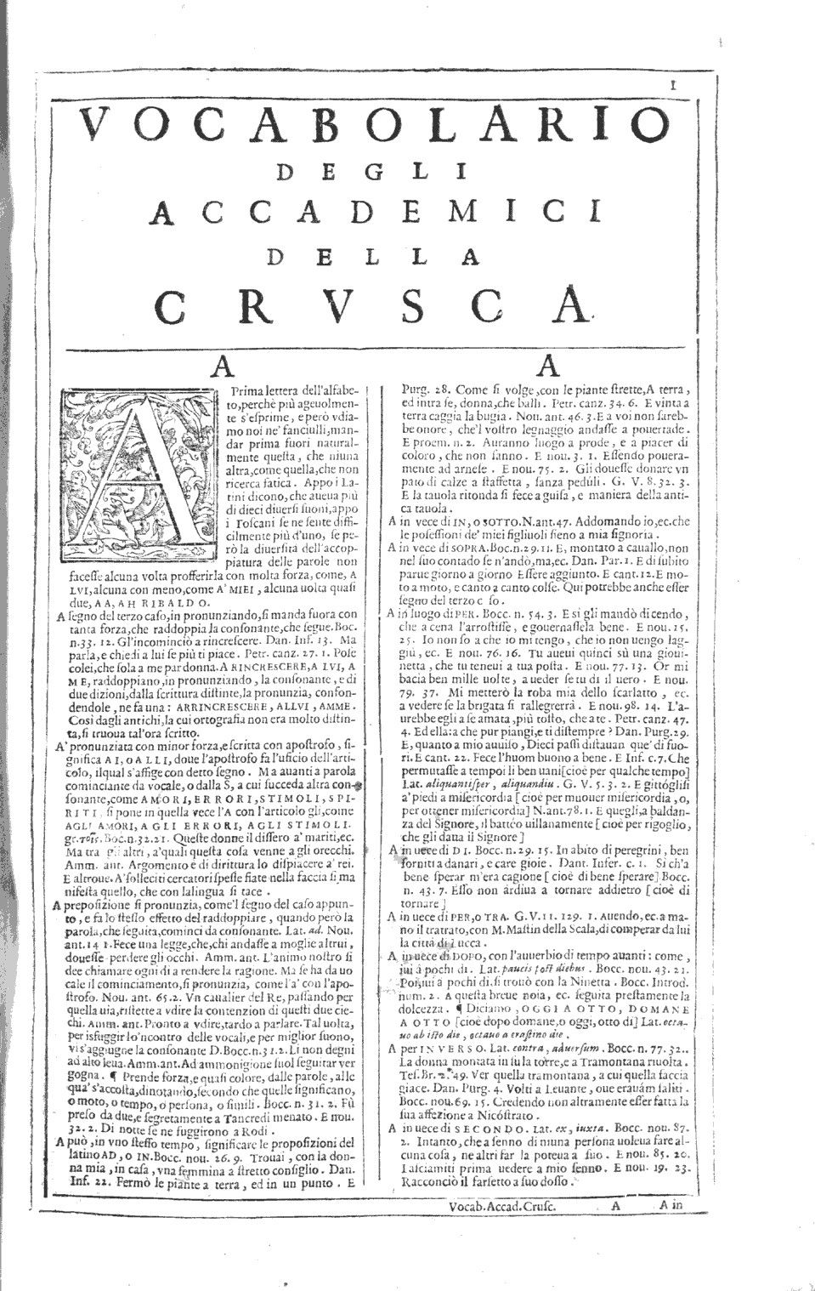
Prolegomena
Lexicography →
1600
Trésor de la langue Française (Jean Nicot; 1606)
Vocabolario della lingua italiana (Agnolo Monosini; 1612)
1620
1640
1660
1680
1700
http://gallica.bnf.fr/ark:/12148/bpt6k50808z
1720
1740
1760
www.lessicografia.it/pagina.jsp?ediz=1&vol=1&pag=1&tipo=1
1780
1800

Slide 9
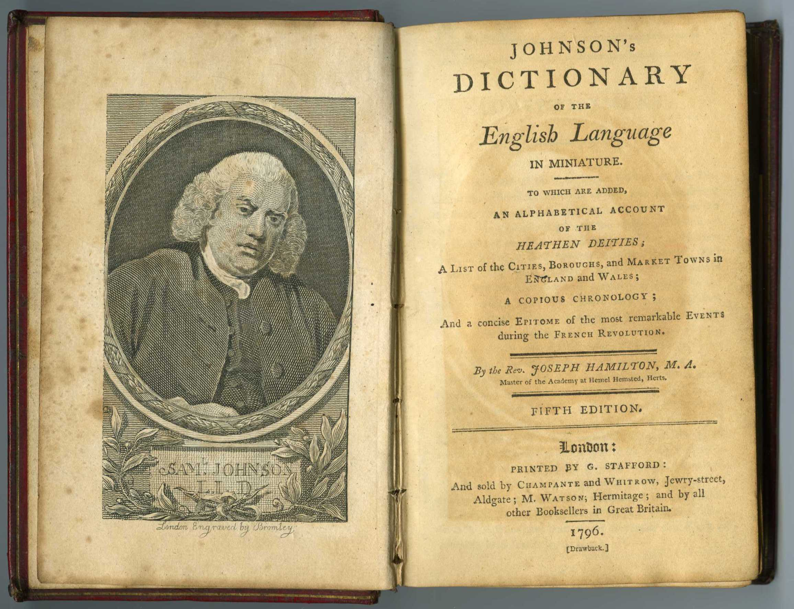
Prolegomena
Lexicography →
1600
Trésor de la langue Française (Jean Nicot; 1606)
Vocabolario della lingua italiana (Agnolo Monosini; 1612)
1620
1640
1660
1680
1700
http://gallica.bnf.fr/ark:/12148/bpt6k50808z
1720
1740
Dictionary of the English Language (Samuel Johnson; 1755)
www.lessicografia.it/pagina.jsp?ediz=1&vol=1&pag=1&tipo=1
1760
1780
https://archive.org/details/nighantuniruktao00yaskuoft
1800

Slide 10
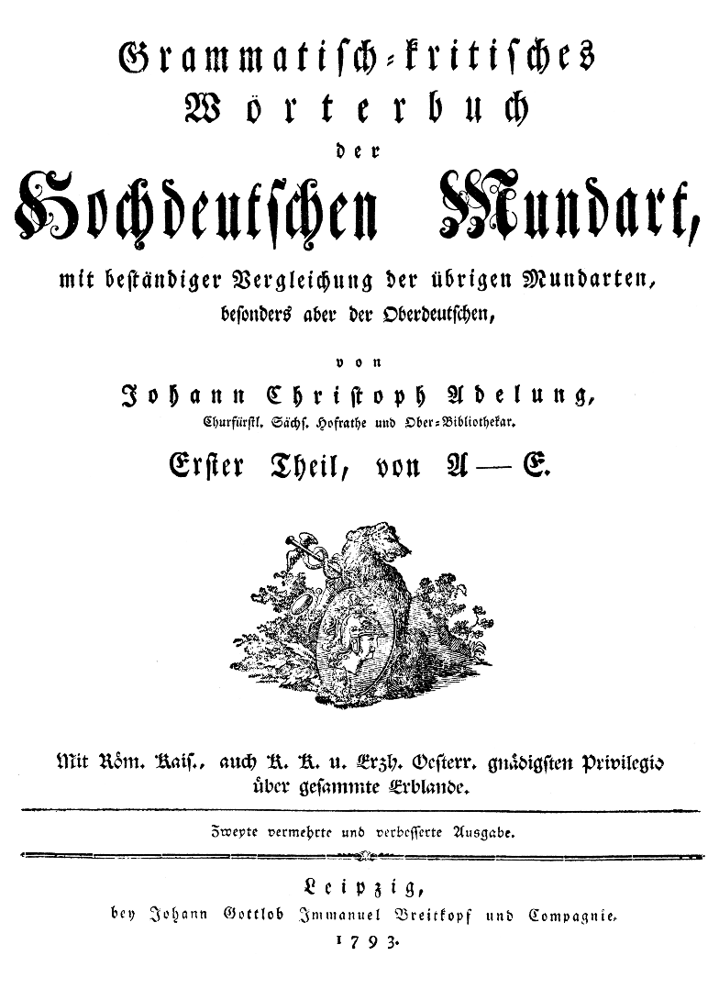
Prolegomena
Lexicography →
1600
Trésor de la langue Française (Jean Nicot; 1606)
Vocabolario della lingua italiana (Agnolo Monosini; 1612)
1620
1640
1660
1680
1700
http://gallica.bnf.fr/ark:/12148/bpt6k50808z
1720
1740
Dictionary of the English Language (Samuel Johnson; 1755)
www.lessicografia.it/pagina.jsp?ediz=1&vol=1&pag=1&tipo=1
1760
1780
https://archive.org/details/nighantuniruktao00yaskuoft
Grammatisch-kritisches Wörterbuch der Hochdeutschen Mundart
(Johann Christoph Adelung; 1781)
1800
http://www.zeno.org/Adelung-1793/K/adelung-1793-00-0000

Slide 11
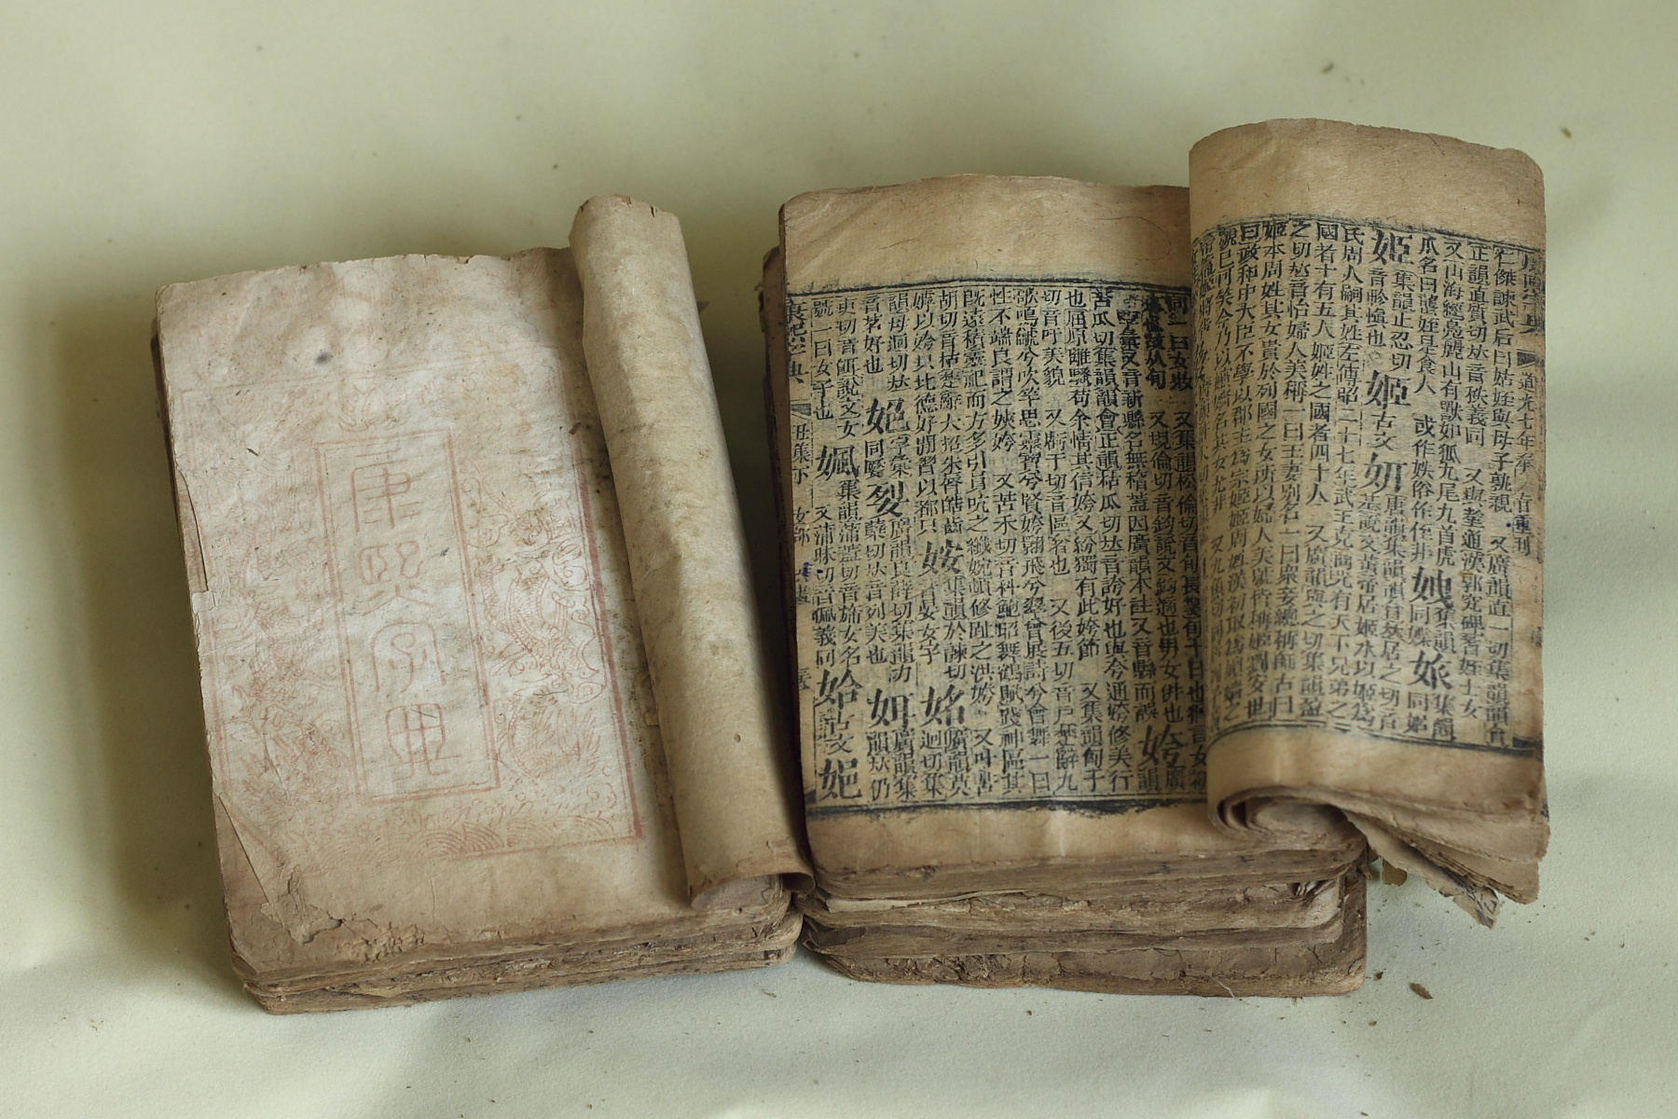
Prolegomena
Lexicography →
1600
1620
1640
1660
1680
1700
Kangxi zidian (1716)
1720
1740
1760
1780
1800
https://commons.wikimedia.org/wiki/File:Kangxi_Dictionary_1827.JPG

Slide 12
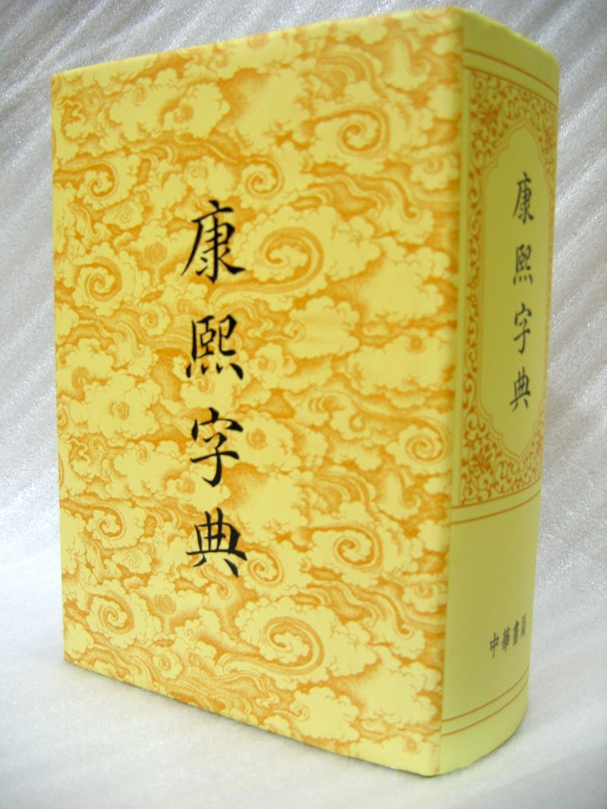
Prolegomena
Lexicography →
1600
1620
1640
1660
1680
1700
Kangxi zidian (1716)
1720
1740
1760
1780
1800
https://en.wikipedia.org/wiki/Kangxi_Dictionary#/media/File:K%27ang_Hsi_Dictionary.jpg

Slide 13
Prolegomena
Lexicography → eLexicography
Digital methods, data, tools
Data acquisition and representation of lexical knowledge
Production and publication
Born-digital dictionaries
Introspection and interviews → empirical methods
2000
2005
2010

Slide 14
Prolegomena
Lexicography → eLexicography
Digital Corpus of Cuneiform Lexical Texts
(http://oracc.museum.upenn.edu/dcclt/index.html)
Internet Archive
(https://archive.org/details/nighantuniruktao00yaskuoft)
Chinese Text Project (http://ctext.org/er-ya)
Lessicografia della Crusca in Rete (www.lessicografia.it)

Slide 15
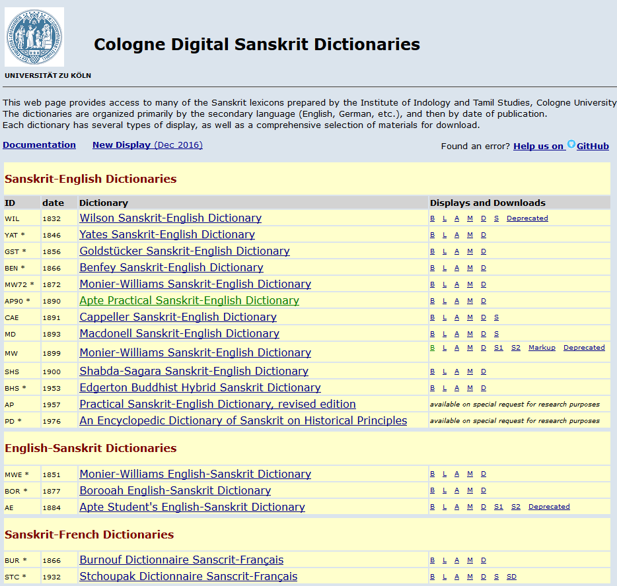
Prolegomena
Lexicography → eLexicography
Cologne Digital Sanskrit Dictionaries
(http://www.sanskrit-lexicon.uni-koeln.de/)

Slide 16
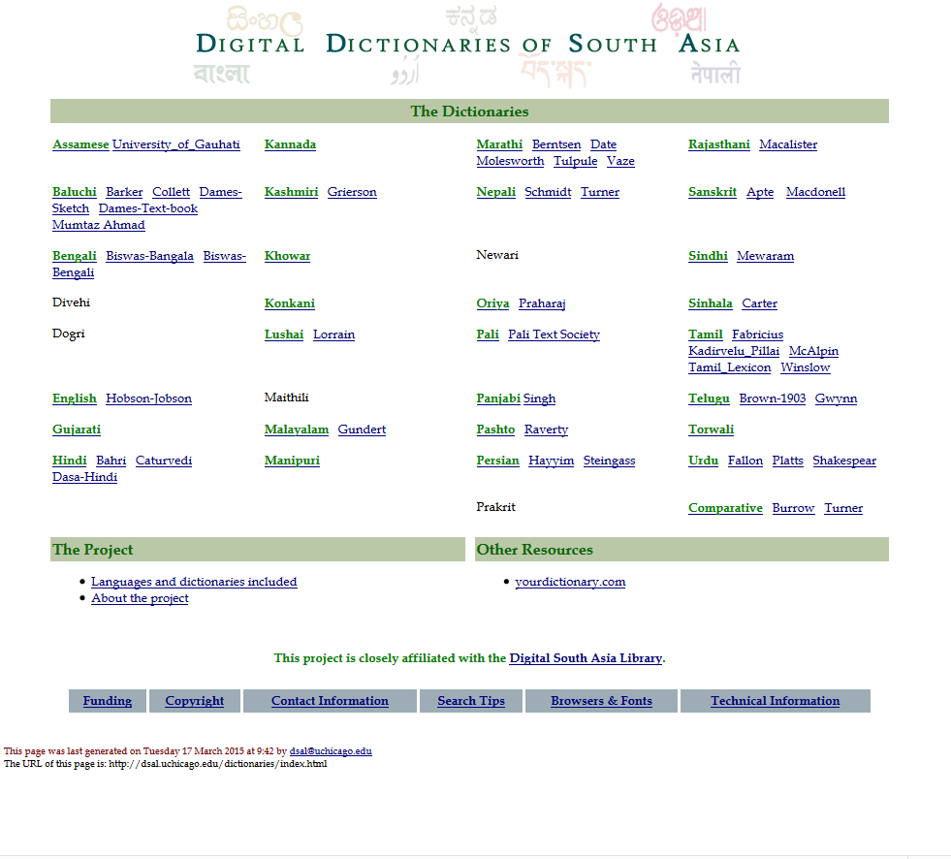
Prolegomena
Lexicography → eLexicography
Digital Dictionaries of South Asia
(http://dsal.uchicago.edu/dictionaries/)

Slide 17
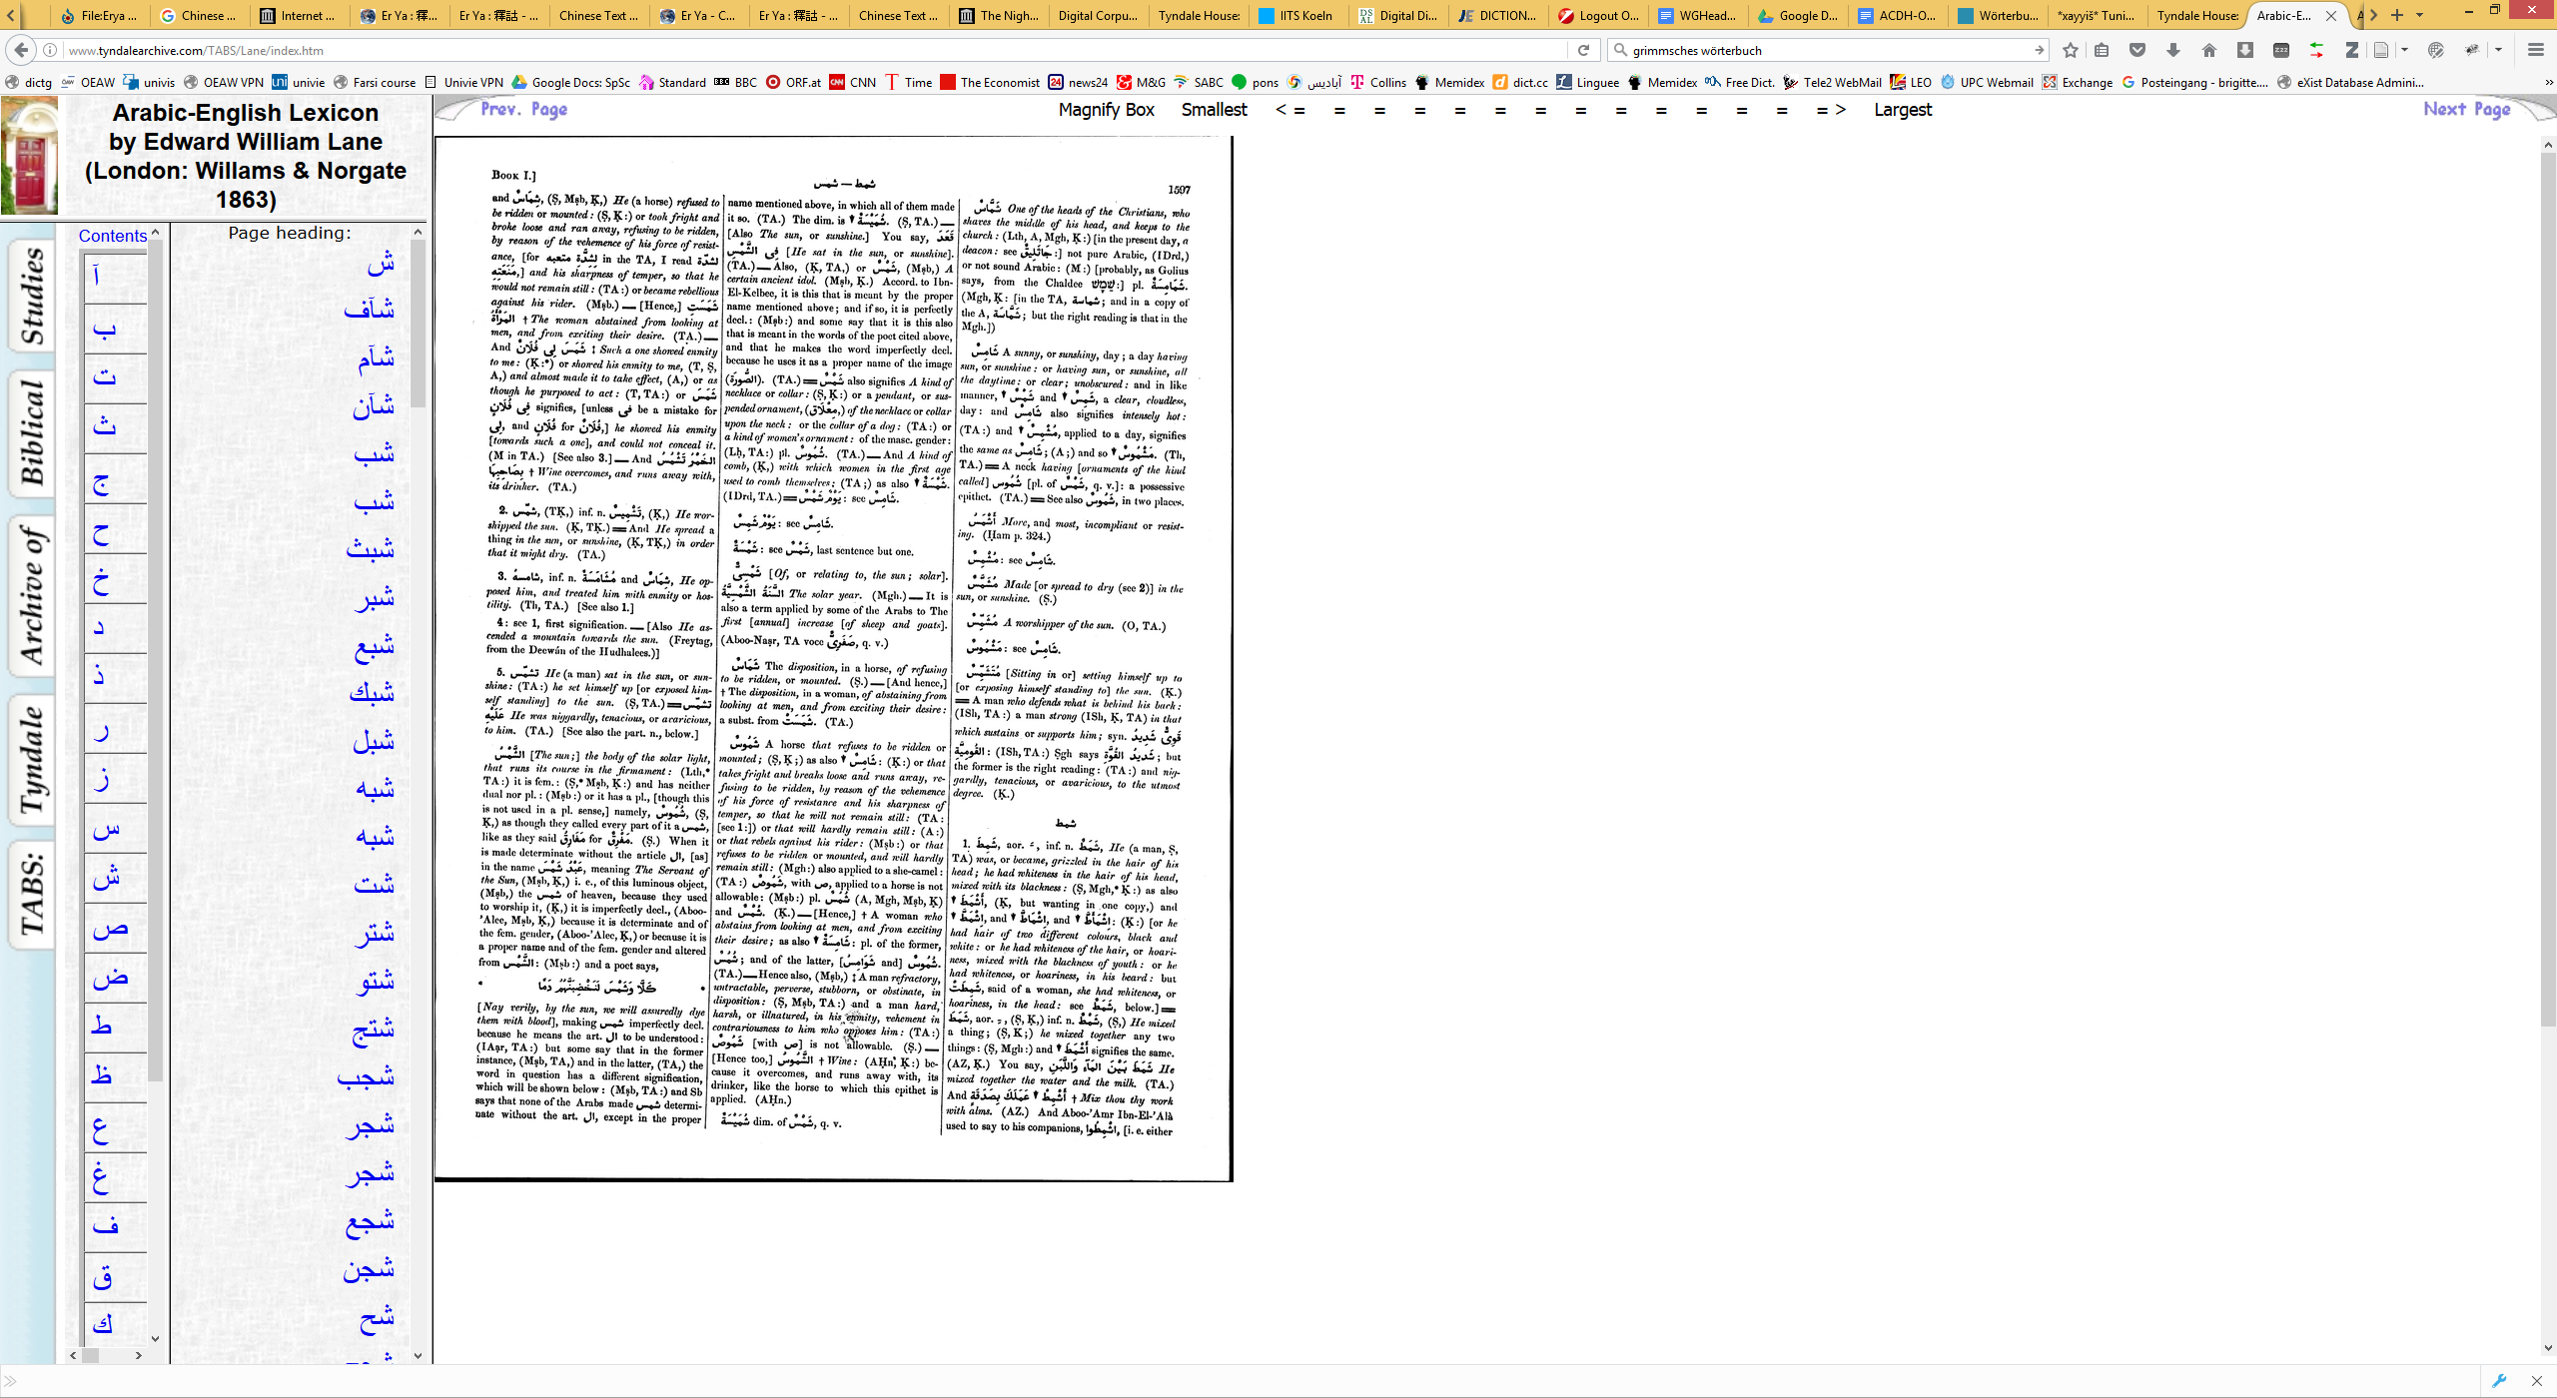
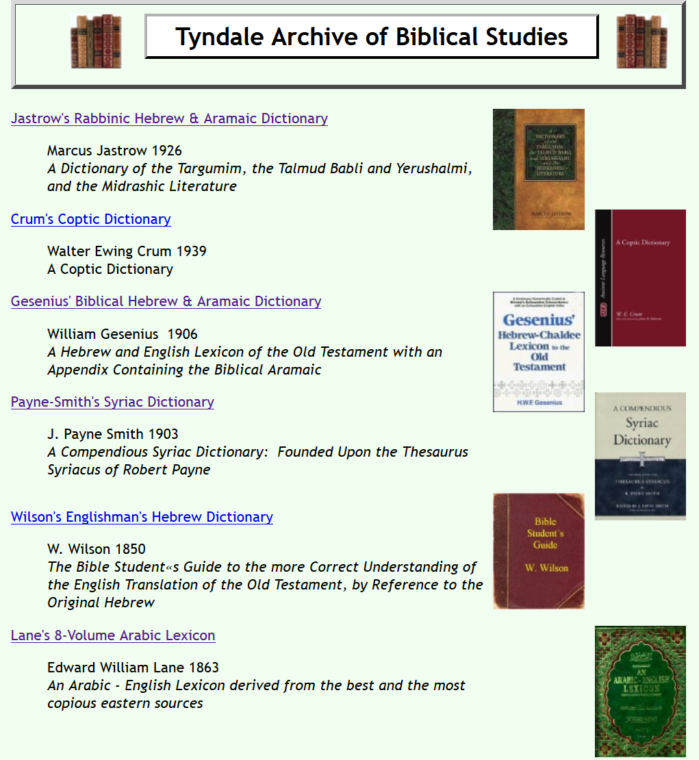
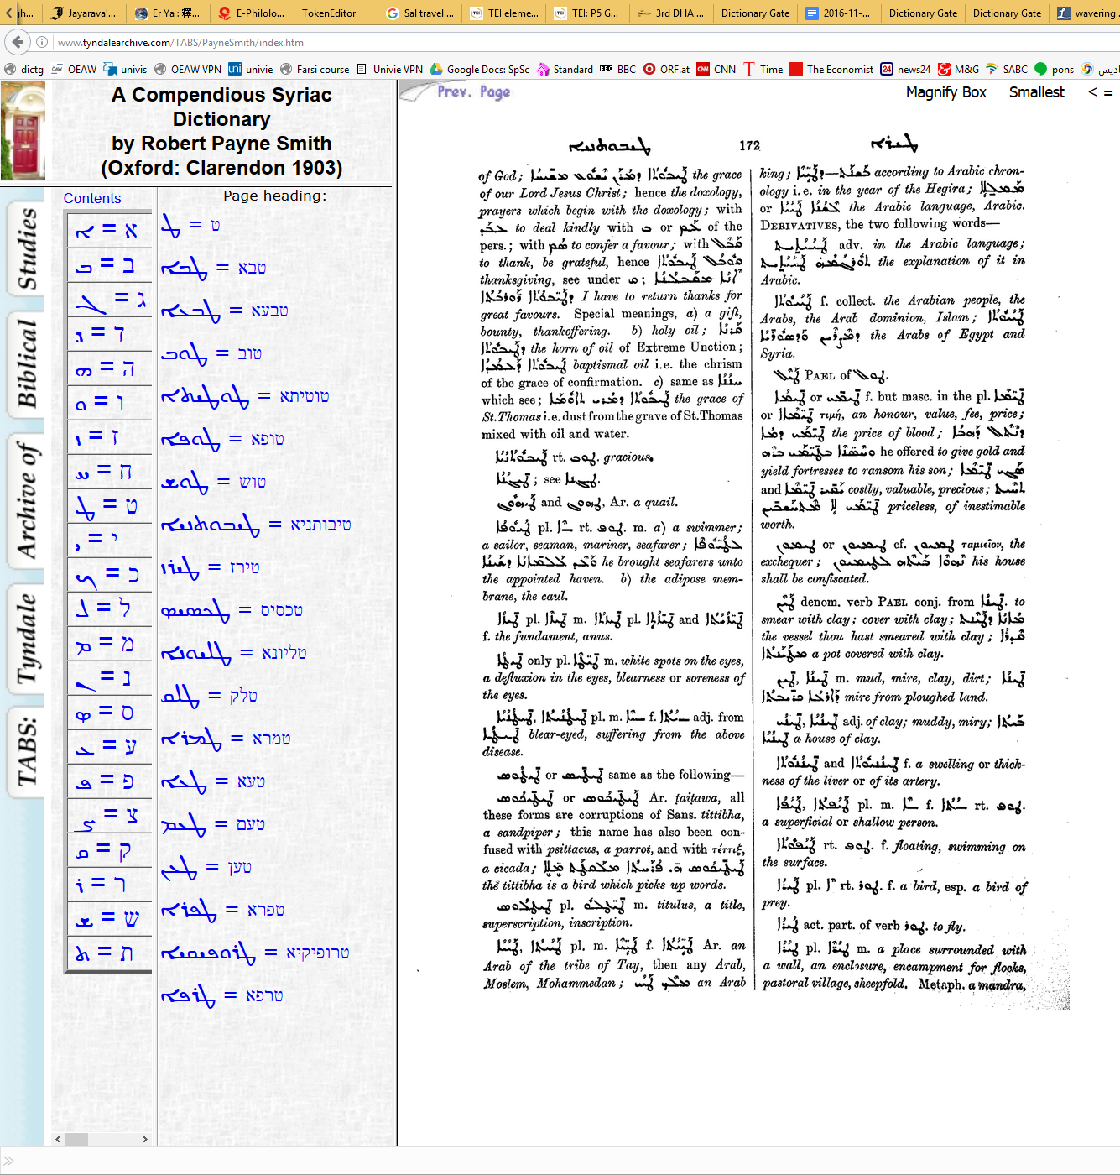
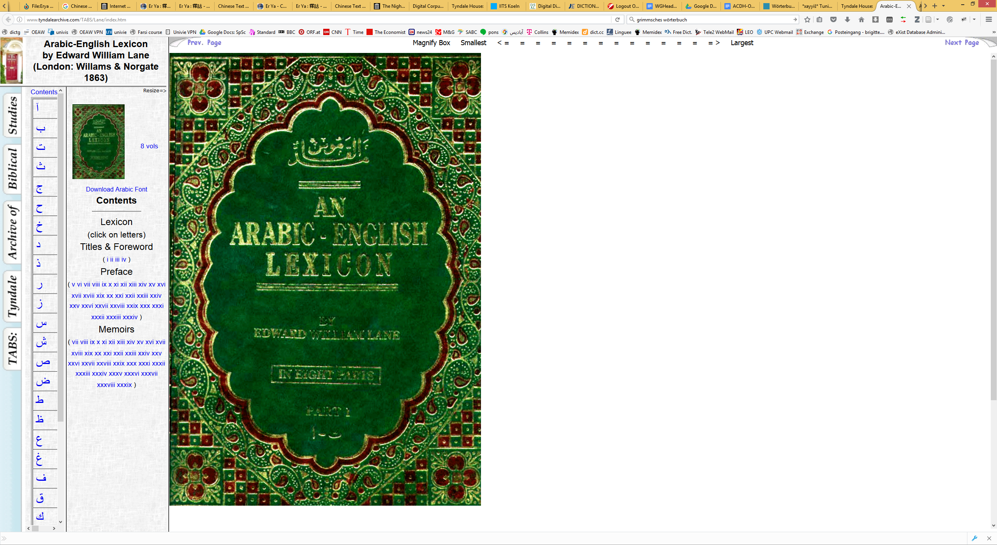
Prolegomena
Lexicography → eLexicography
Tyndale Archive of Biblical Studies
(www.tyndalearchive.com/TABS/index.htm)

Slide 18
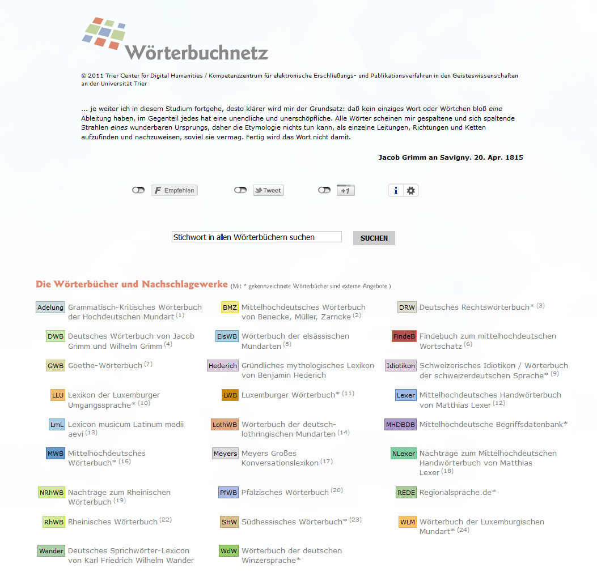
Prolegomena
Lexicography → eLexicography
Wörterbuchnetz
(http://woerterbuchnetz.de/)

Slide 19
Prolegomena
Institutional Setting
Austrian Centre for Digital Humanities (Austrian Academy of Sciences)
Research + Service
Empowering research
Humanities computing → Digital Humanities

Slide 20
Prolegomena
Institutional Setting
Austrian Centre for Digital Humanities (Austrian Academy of Sciences)
Institute for Near Eastern Studies (University of Vienna)
Focus on contemporary language
Long tradition in Arabic dialectology
Curriculum with 4 Arabic dialects

Slide 21
Prolegomena
Institutional Setting: VICAV
Vienna Corpus of Arabic Varieties
Research environment for scholars pursuing comparative interests in the study of Arabic spoken varieties
Pooling digital language resources
Bibliography
Language profiles
Feature lists
(Annotated) sample texts
Corpora
Dictionaries (!= glossaries)
https://vicav.acdh.oeaw.ac.at

Slide 22
Prolegomena
VICAV: Vienna Corpus of Arabic Varieties
Pooling digital language resources
Arabic Research Tools
Learning Materials
Paratexts (Documentation)
VICAV Encoding Guidelines
VLE Guide
How to use the website
https://vicav.acdh.oeaw.ac.at

Slide 23
Prolegomena
VICAV: Vienna Corpus of Arabic Varieties
Linguistic research
Teaching
Text technology
Standards
Openness

Slide 24
Prolegomena
Related Endeavours
CorpAfroAs
CORVAM Speech corpus of Maghrebi varieties
Tunisiya
SemArch - Semitisches Tonarchiv
https://vicav.acdh.oeaw.ac.at/#map=[biblMarkers,_vicavDicts_,]&1=[textQuery,vicavOverview_corpora_spoken,ARABIC%20TOOLS%20(Corpora%20-%20Spoken%20Varieties),open]

Slide 25
Prolegomena
TUNICO (2014-1016)

Slide 26
Prolegomena
TUNICO (2014-1016)
Linguistic Dynamics in the Greater Tunis Area: A Corpus-based Approach
Objectives
exploration of a contemporary Arabic variety (poorly documented so far)
Production of a corpus of spoken youth language
Compilation of a diachronic dictionary of Tunisian Arabic
Text technology + variational linguistics
Grant of the Austrian Science Fund (P 25706)
2 Arabic language scholars, 1 technician
https://tunico.acdh.oeaw.ac.at

Slide 27
Prolegomena
TUNICO: Corpus
Spoken youth language (dialogues, narratives):
Uncommon approach in Arabic dialectology:
Dialectological interests in language of older people --> older forms of particular varieties
Focus on modern language, contemporary usage and lexical Neologisms
https://tunico.acdh.oeaw.ac.at

Slide 28
Prolegomena
TUNICO: Corpus
30 hours of dialogues and narrative interviews
24 texts
Number of male and female speakers in recordings is balanced.
142.317 tokens: 94.652 w-tags and 47.665 pc-tags
Linking instead of lemmatising
https://tunico.acdh.oeaw.ac.at

Slide 29
Prolegomena
TUNICO: Corpus: Linguistic Research
Overabundance in the Arabic Dialect of Tunis: a Diachronic Study of Plural Formation (Gabsi, Dallaji)
Forms and Functions of the Diminutive in Tunis Arabic
Presentatives
Question markers
Direct object marker
Relative clauses
Conditional clauses
https://tunico.acdh.oeaw.ac.at

Slide 30
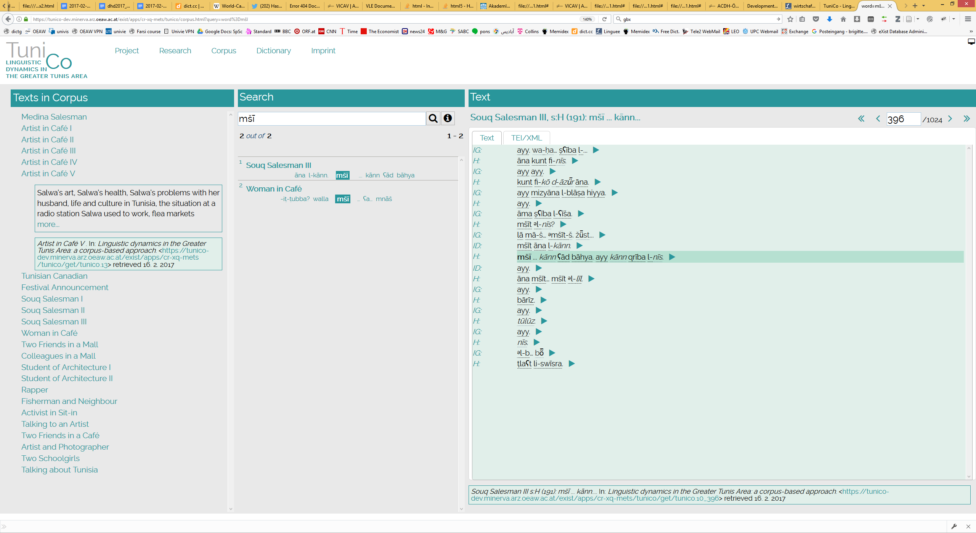

Slide 31
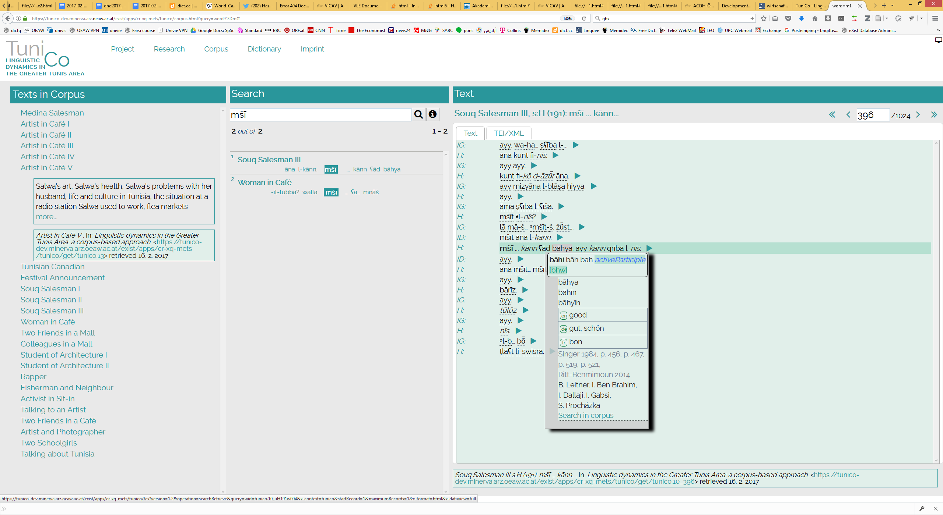

Slide 32
Prolegomena
TUNICO: Corpus
Statistics

Slide 33
Prolegomena
TUNICENT (2019-2022)
Tunisia’s terra incognita: A Linguistic Investigation into the Arabic Varieties of Northwestern and Central Tunisia (Austrian Science Fund P 31647)

Slide 34
Scholarly Background
Linguistics
Diglossia (Triglossia)
Particular form of bilingualism
Acrolect: Modern Standard Arabic
Basilect: a great number of spoken varieties

Slide 35
Scholarly Background
Linguistics
Eastern vs. Western
aktib - niktib vs. niktib - niktibu
Bedouin vs. sedentary
interdentals > postdental stops
verb modifiers in imperf. (-/+)
Form IV (+/-)
frequency of analytical gen. structures
Religious affiliation

Slide 36
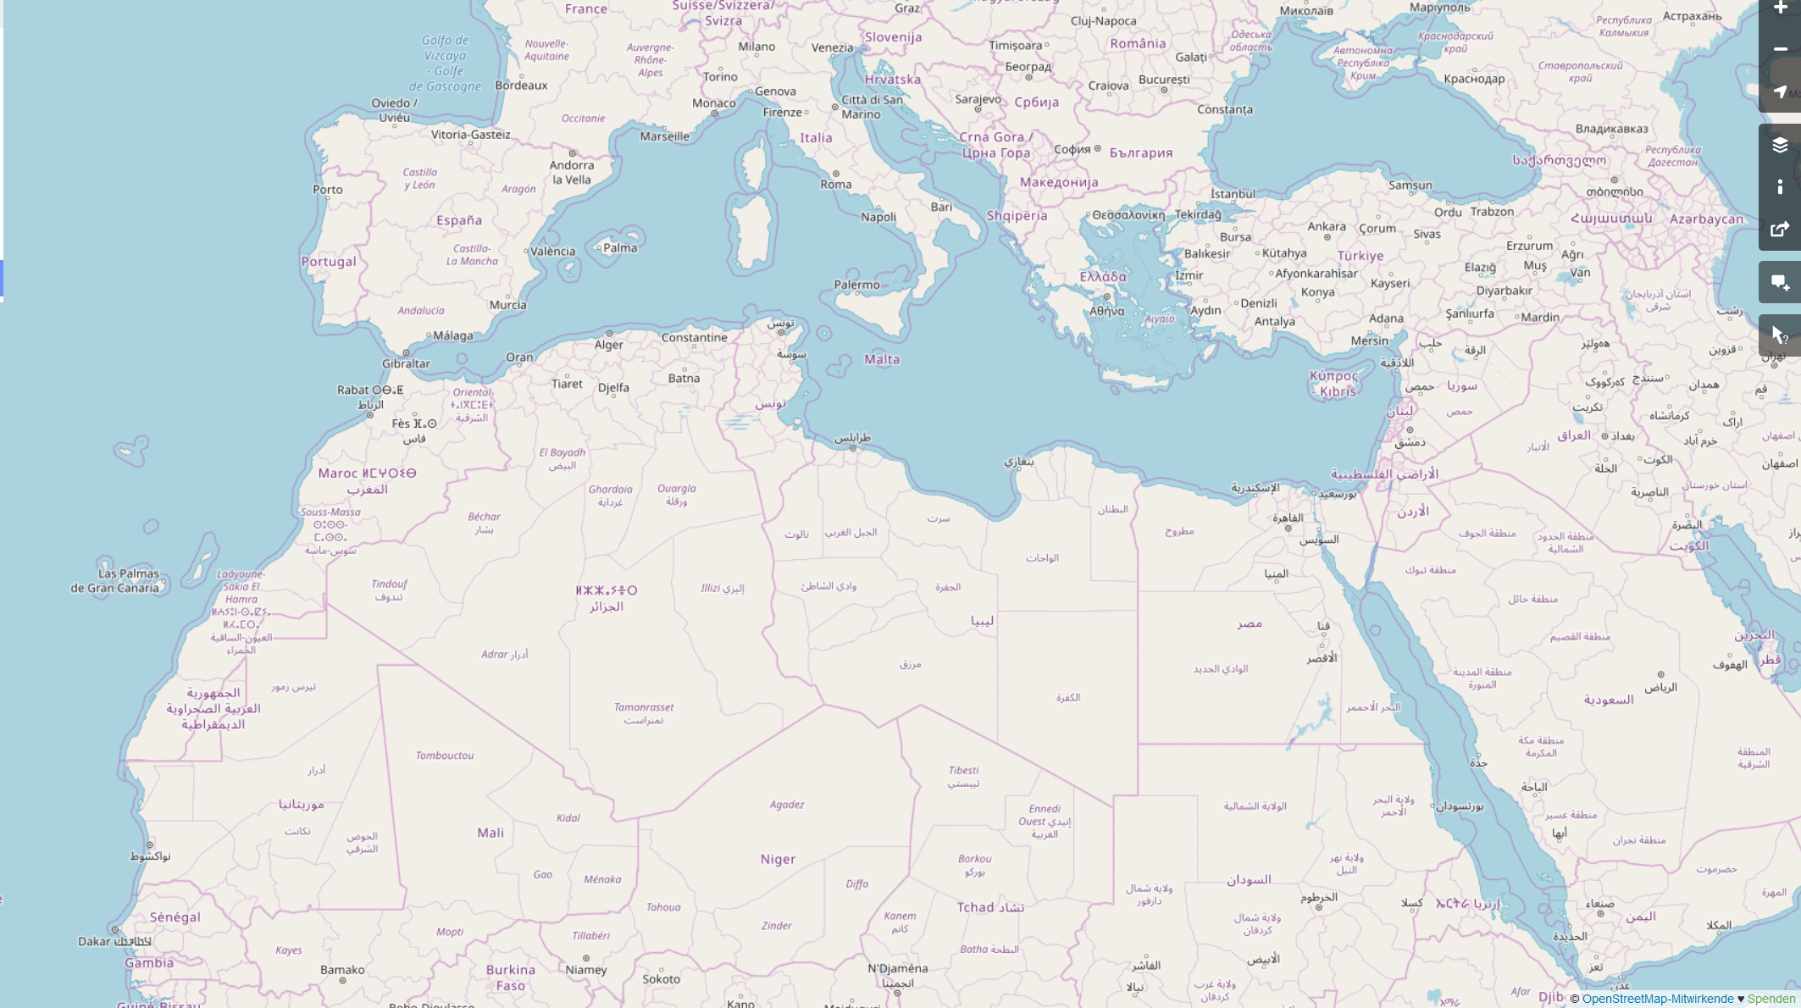
mā(ḏā) turīd?
š-tḥibb?
Xi trid?
šu beddak?
šnu bġīti?
ši-trīd?
šen tebbi?
ʕāwiz ʔēh?
ʔēš tibġa?
š-tabbi?
dāyir šinu?
ʔēš tašti?

Slide 37
VICAV Dictionaries
“Family of dictionaries”
Dictionaries != glossaries
Small dictionaries
Uniform dictionary structure (TEI P5)
Unified transcription system (~DMG)

Slide 38
VICAV Dictionaries
Existing
(Morocco - Rabat)
Tunisia - Tunis
Egypt - Cairo
Syria - Damascus
MSA
In the make
Shawi
Baghdad
Khuzistan
…

Slide 39
VICAV Dictionaries
Purpose and Significance
Comparatistic research
Didactic purposes
Experimental lexicography
Few other scholarly projects in this field
Lughatuna: The Living Arabic Project
Verbes de l’arabe égyptien: Dictionnaire contextuel raisonné des verbes du dialecte égyptien (parler du Caire)
Freely available data

Slide 40
VICAV Dictionaries
Corpus – Dictionary Interface
Corpus → Dictionary
Enrichment of dictionary (new lemmata, senses, statistical information)
Dictionary → Corpus
Annotation of corpus (VLE, token editor)
CORPUS
Dictionary

Slide 41
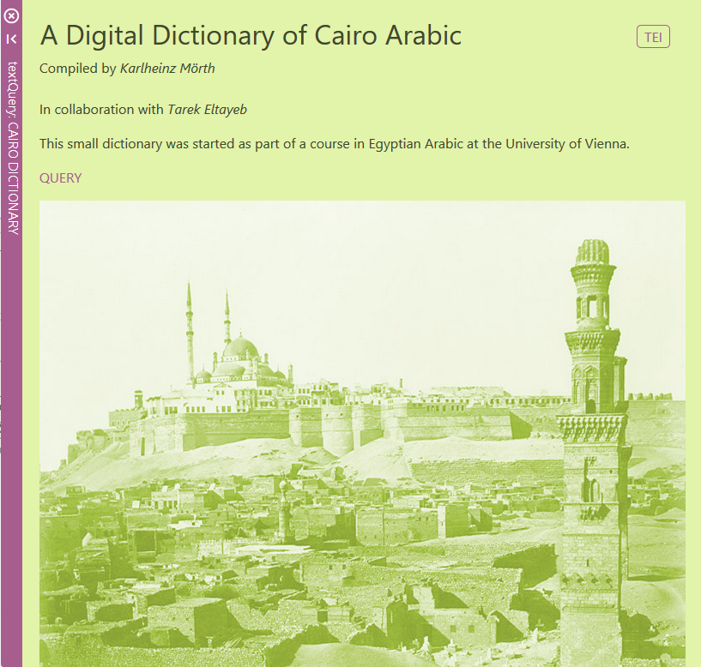
VICAV Dictionaries
Egyptian-English

Slide 42
VICAV Dictionaries
Egyptian-English
Based on
Course materials
Lexicographic analysis of the Egyptian vernacular Arabic Wikipedia
lexicostatistic data for a written manifestation of vernacular Arabic
graphematic variation
language change
Omar Siam: Ein digitales Wörterbuch der 200 häufigsten Wörter der Wikipedia in ägyptischer Umgangssprache - Corpusbasierte Methoden zur lexikalischen Analyse nichtstandardisierter Sprache. (http://othes.univie.ac.at/26036/)

Slide 43
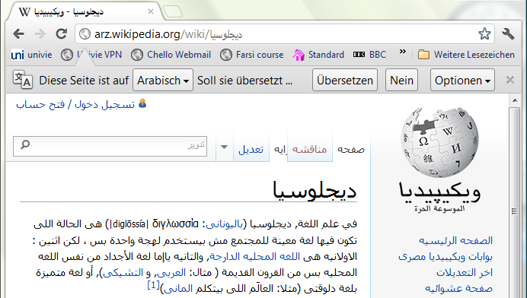

Slide 44
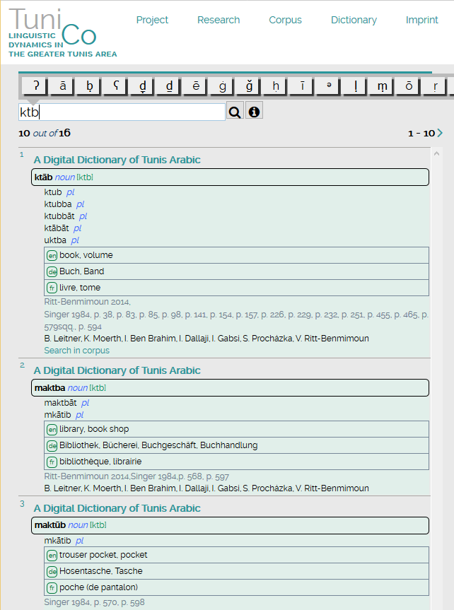
VICAV Dictionaries
TUNICO Dictionary
https://tunico.acdh.oeaw.ac.at/dictionary.html

Slide 45
VICAV Dictionaries
TUNICO Dictionary
Micro-diachronic and machine-readable
~8000 entries
Incorporation of
contemporary data from a digital corpus
various historical sources (e.g. Stumme, H.)
Information added is kept traceable to its origin

Slide 46
VICAV Dictionaries
TUNICO Dictionary
No comprehensive dictionary of the Arabic dialect of Tunis
Basis: data taken from didactic materials
3 other main sources
Newly created corpus
Interviews
Historical publications

Slide 47
VICAV Dictionaries
TUNICO Dictionary: Historical Sources
800-page grammar of the Medina of Tunis by Hans-Rudolf Singer (1984):
Evaluation of data, integration of excerpted lexicographic data into dictionary
Verification and completion of collected data with other historical resources
Diachronic dimension helps to understand processes in the development of the lexicon
Material gathered will allow analysis of recent developments (migration of parents from rural areas, influence by other Arabic varieties, influence of revolution, foreign elements)

Slide 48
VICAV Dictionaries
TUNICO Dictionary: Historical Sources
Additional sources:
Nicolas, A. (1911). Dictionnaire français-arabe
Beaussier, M. (2006). Dictionnaire pratique arabe-français (arabe maghrébin)
Quéméneur, J. (1961). “Notes sur quelques vocables du parler Tunisien”
Quéméneur, J. (1962). “Glossaire de dialectal”
Abdellatif, K. (2010). Dictionnaire «le Karmous» du Tunisien
Marçais, W. , Guîga, A. (1958-61). Textes arabes de Takroûna. II: Glossaire

Slide 49
VICAV Dictionaries
Damascus Arabic
Based on 2 vol. textbook
Target languages:
English – German – Spanish

Slide 50
VICAV Dictionaries
Modern Standard Arabic
Initial data from a university course

Slide 51
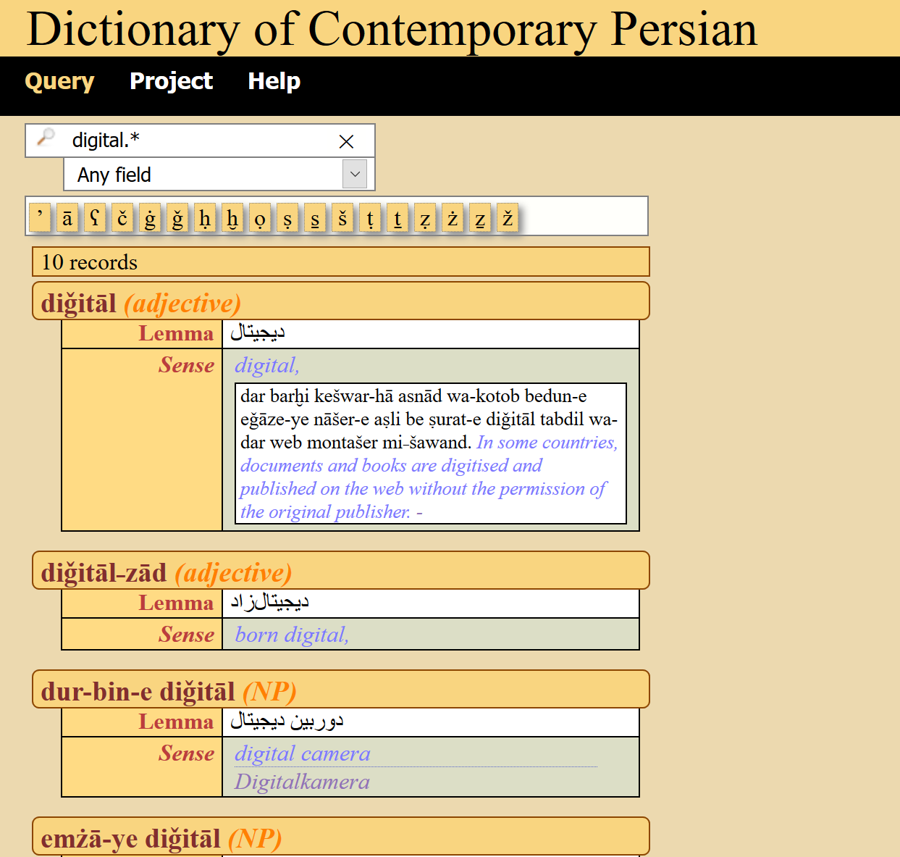
VICAV Dictionaries
Persian-English
Modern language
Wikipedia
Web corpora
https://basex.acdh-dev.oeaw.ac.at/pes_eng_dict/index.html

Slide 52
VICAV Dictionaries
Dagaare-English-Cantonese
Gur branch of the Niger-Congo language family
West Africa
Adams Bodomo (1915)
https://dagaare.acdh.oeaw.ac.at/

Slide 53
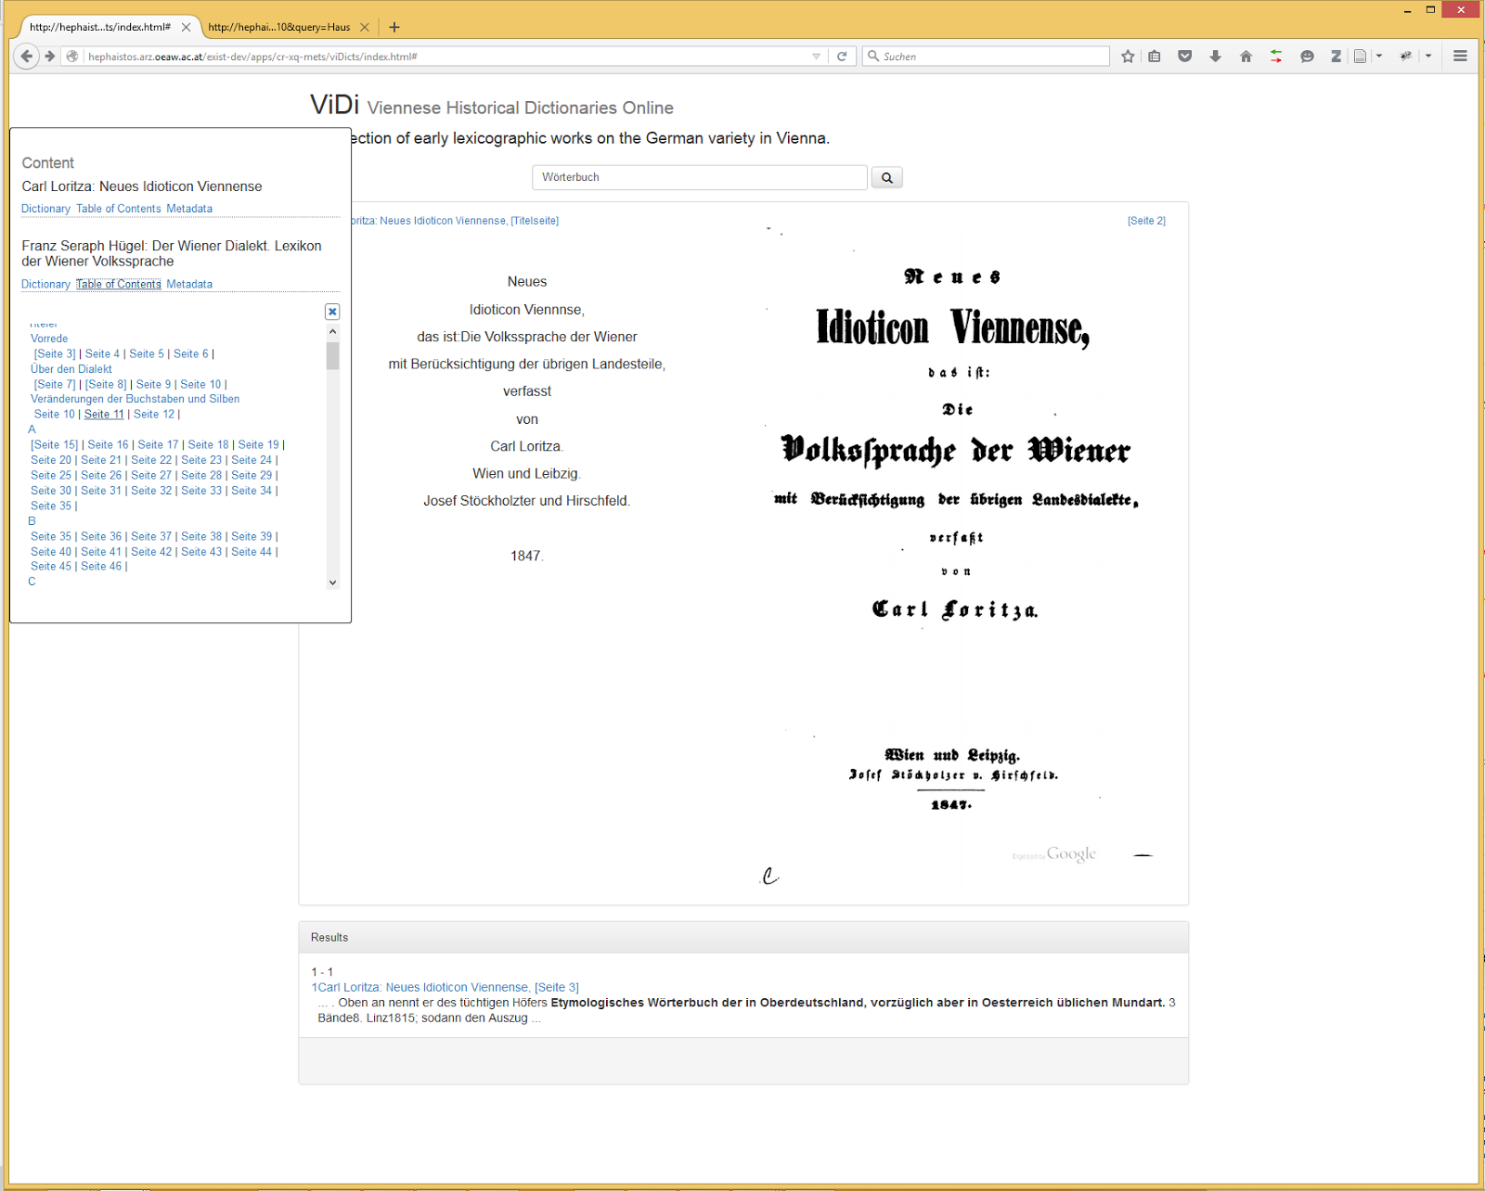
VICAV Dictionaries
VIDI: Viennese Historical Dictionaries
Collection of early lexicographic works on the German variety of Vienna
Early beta version
Text + facsimiles
http://acdh.oeaw.ac.at/vidi

Slide 54
VICAV Dictionaries
The Collaborative Austrian Youth Language Dictionary
Compilation of existing as well as new word creations
Collection of dialectal/regional expressions
Resource for developing further research questions

Slide 55
VICAV Dictionaries
Genesis Rabbah
Digital Dictionary of Loanwords in the Midrash Genesis Rabbah
Austrian Science Fund (2018-2021; P 30785)

Slide 56
The VICAV Toolbox
Components
Viennese Lexicographic Editor (VLE)
WEB Application
VICAV 3.0
Independent Dictionary Interfaces
Interoperability Mechanisms

Slide 57
The VICAV Toolbox
Viennese Lexicographic Editor
XML editor with functionalities typically needed in compiling lexicographic data
Web-based standalone application
Designed to process standard-based lexicographic and terminological data such as TEI, LMF, TBX or RDF.
Freely configurable visualisation (via XSLT)
Validation
Versioning
Data is stored in BaseX
Freely available and easy to setup

Slide 58
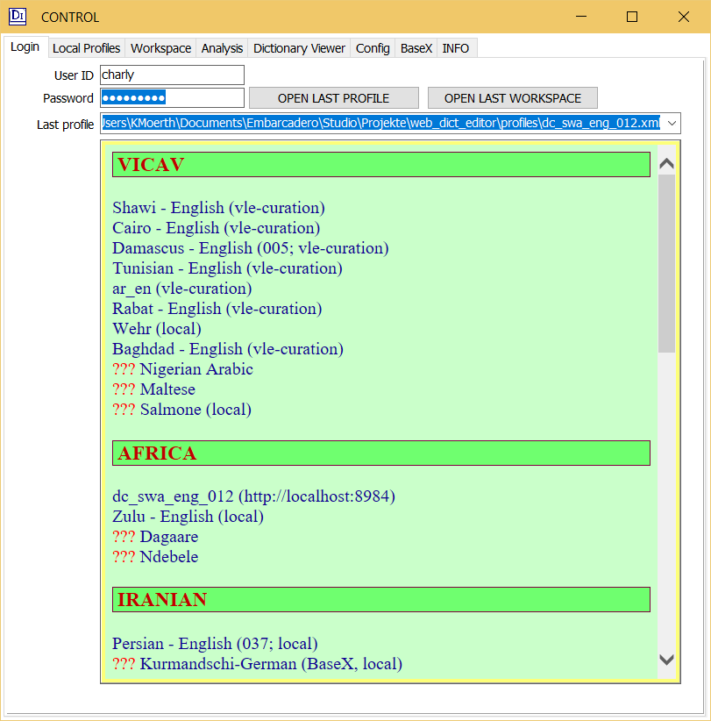
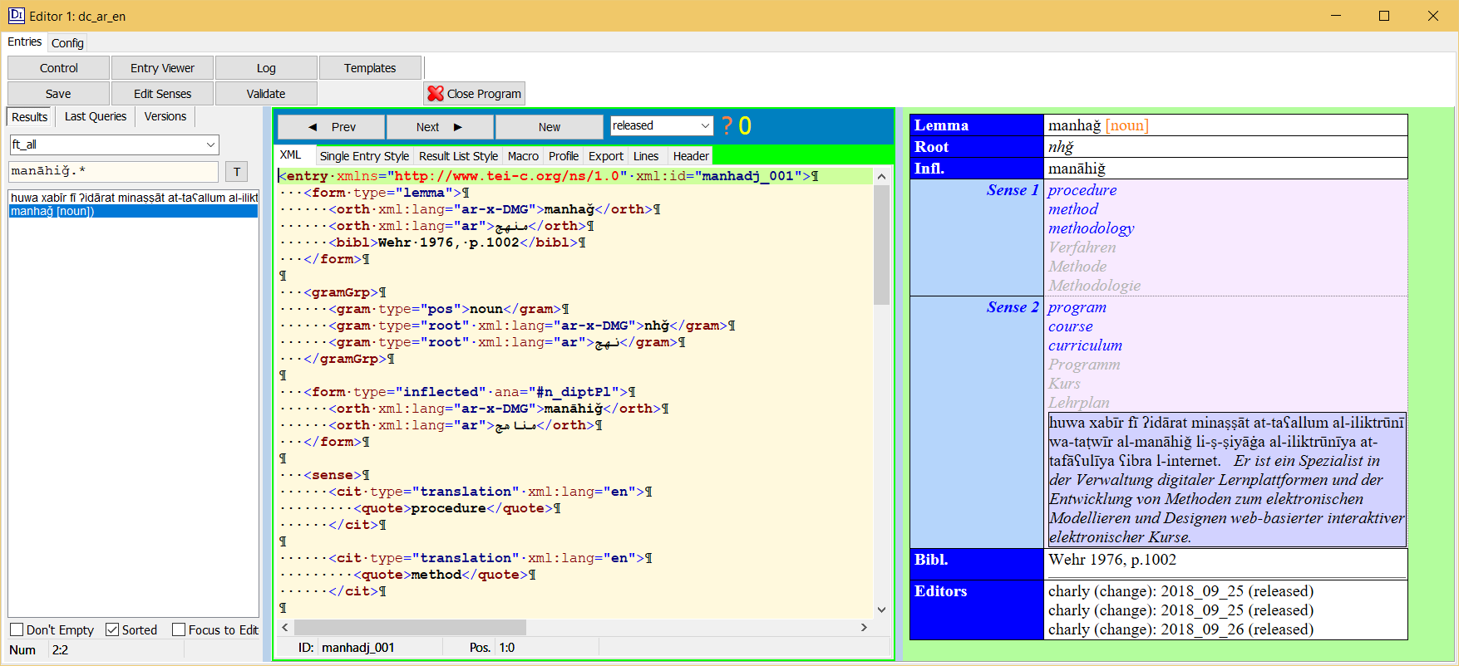
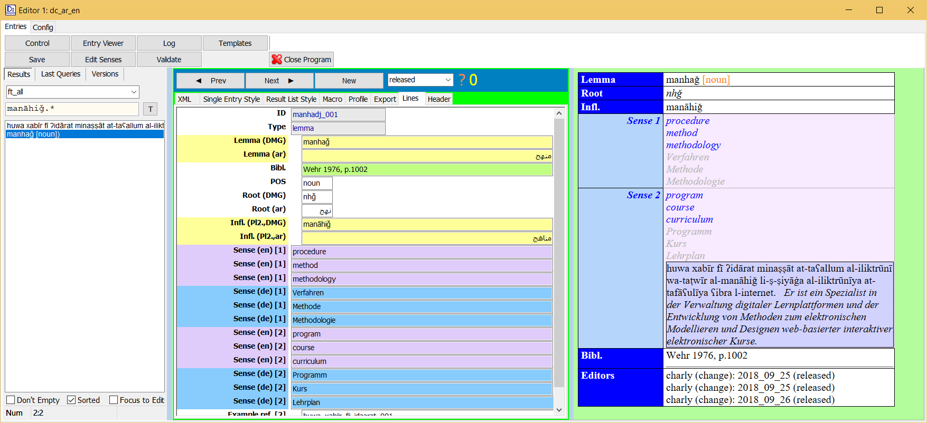
The VICAV Toolbox
Viennese Lexicographic Editor (VLE)

Slide 59
The VICAV Toolbox
VLE: tokenEditor

Slide 60
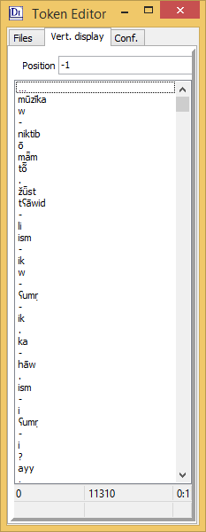
The VICAV Toolbox
VLE: tokenEditor

Slide 61
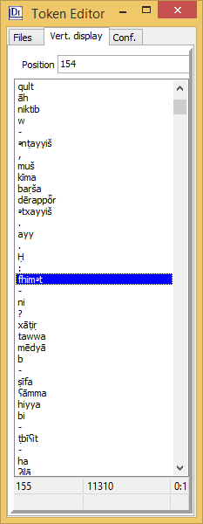
The VICAV Toolbox
VLE: tokenEditor

Slide 62
The VICAV Toolbox
VLE: tokenEditor

Slide 63
The VICAV Toolbox
VLE: tokenEditor

Slide 64
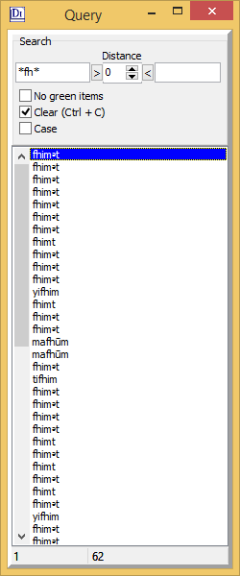
The VICAV Toolbox
VLE: tokenEditor

Slide 65
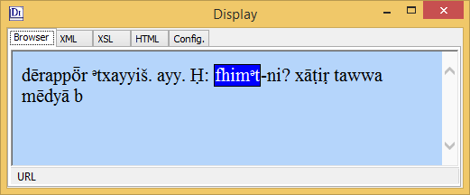
The VICAV Toolbox
VLE: tokenEditor

Slide 66
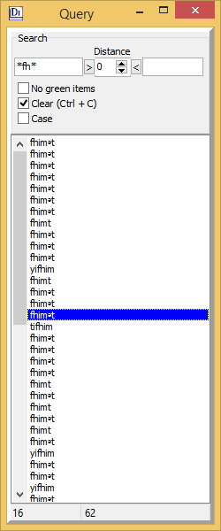
The VICAV Toolbox
VLE: tokenEditor
Edit list

Slide 67
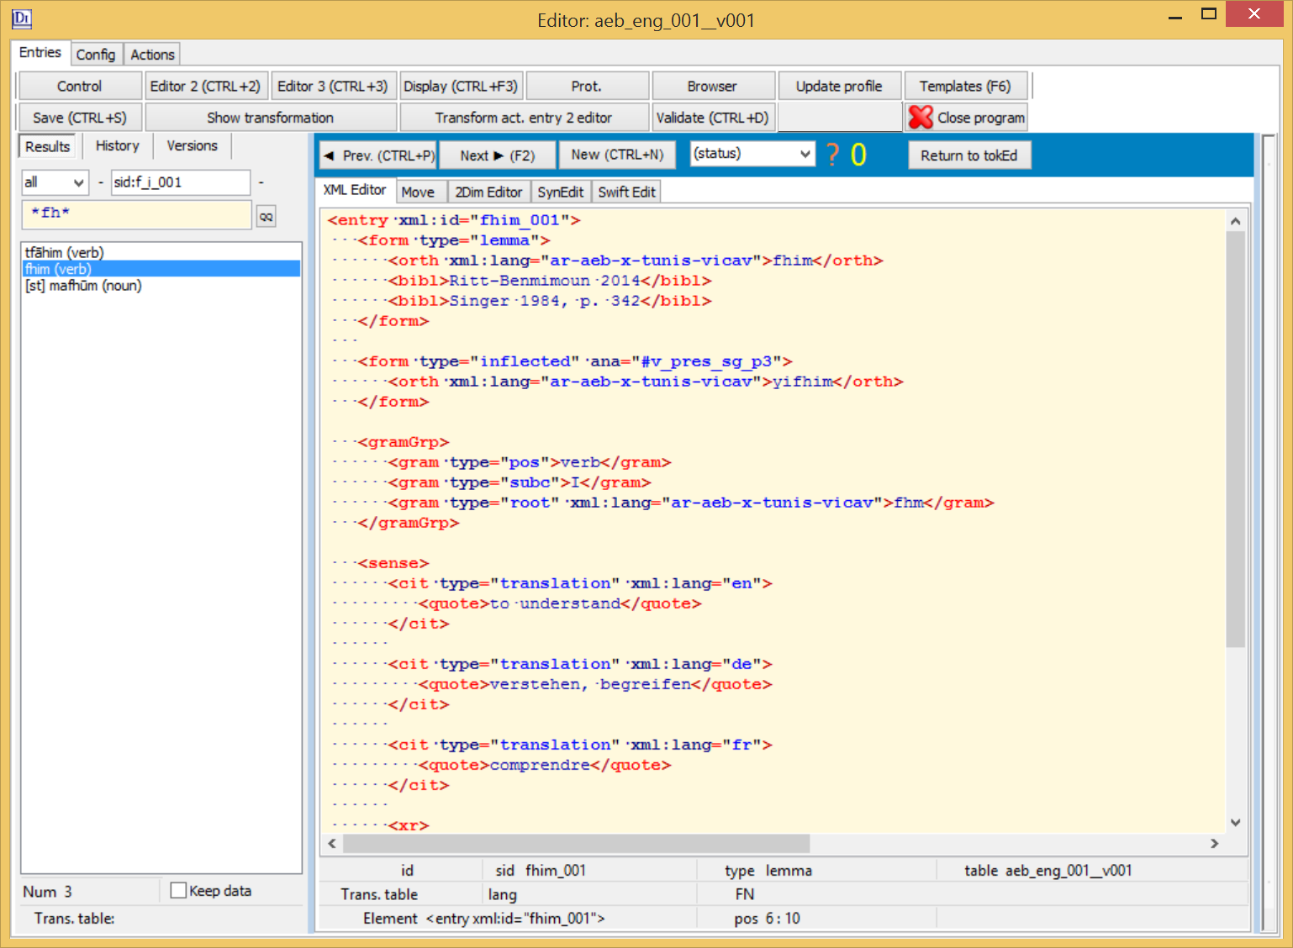
The VICAV Toolbox
VLE: tokenEditor

Slide 68
The VICAV Toolbox
VLE: tokenEditor

Slide 69
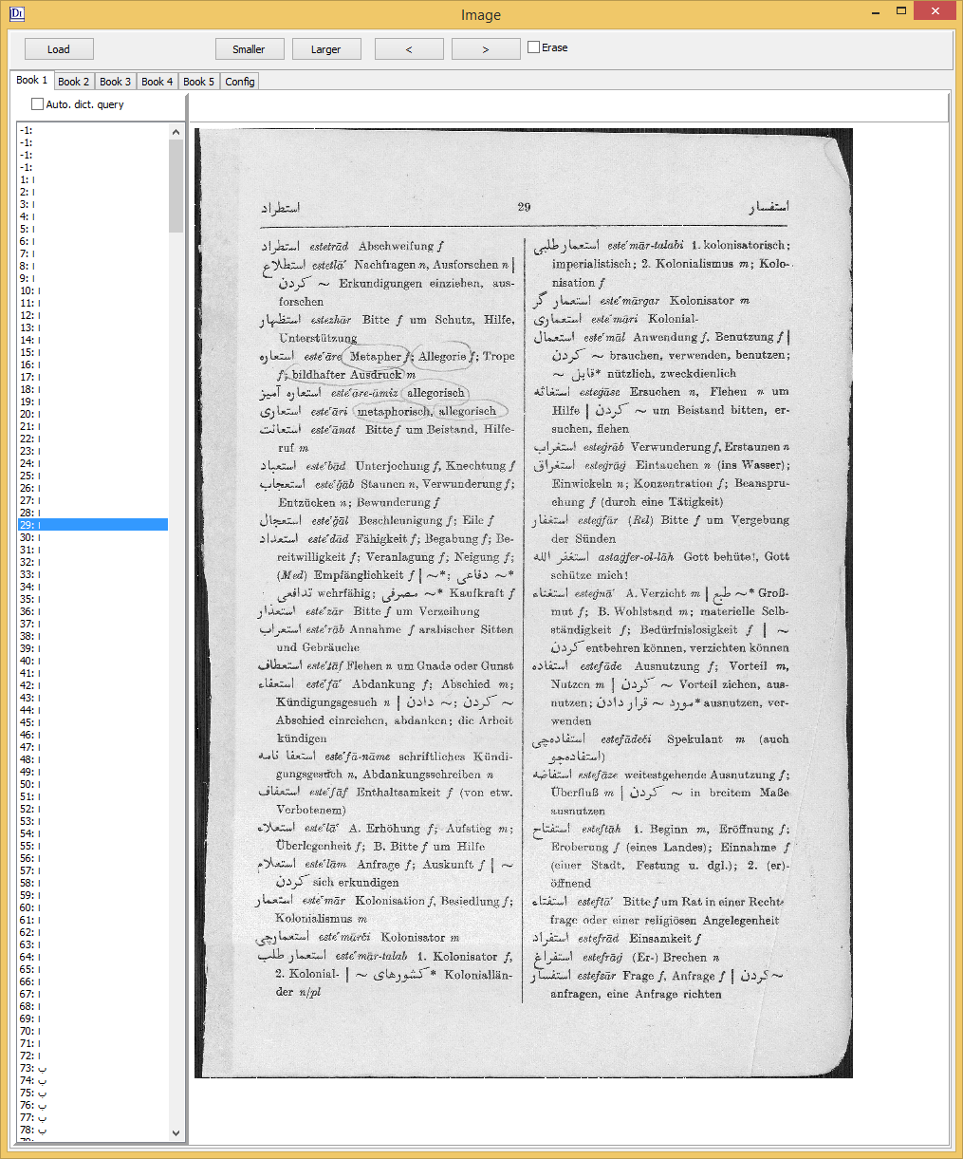
The VICAV Toolbox
VLE: bookViewer

Slide 70
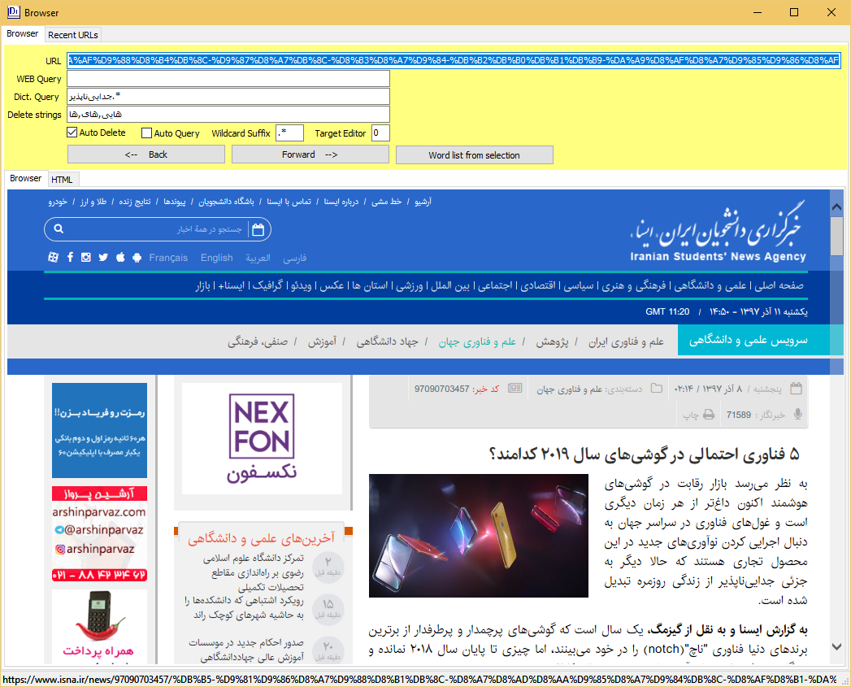
The VICAV Toolbox
VLE: webBrowser

Slide 71
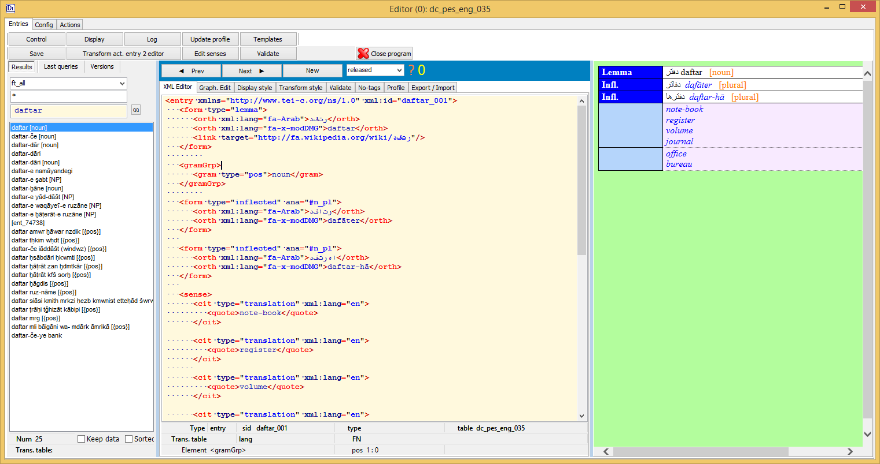
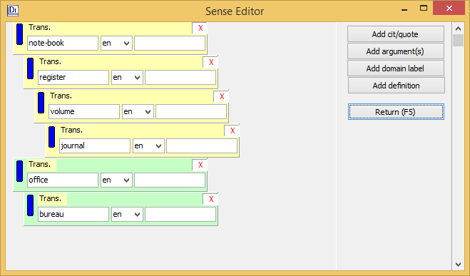
The VICAV Toolbox
VLE: senseEditor

Slide 72
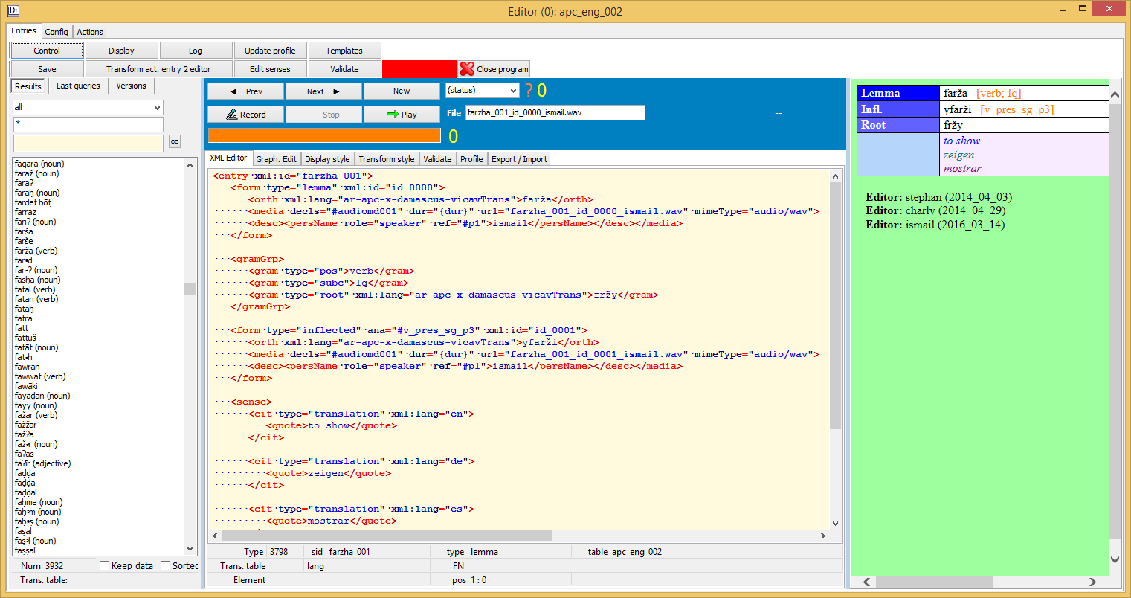
The VICAV Toolbox
VLE: Sound Recorder

Slide 73
The VICAV Toolbox
VLE: Application Builder

Slide 74
The VICAV Toolbox
Frontend
VICAV
VICAV 3.0
Dual approach
Visualisation of data on an active map
Random access through menus/queries
Textual information is displayed on fixed panels

Slide 75
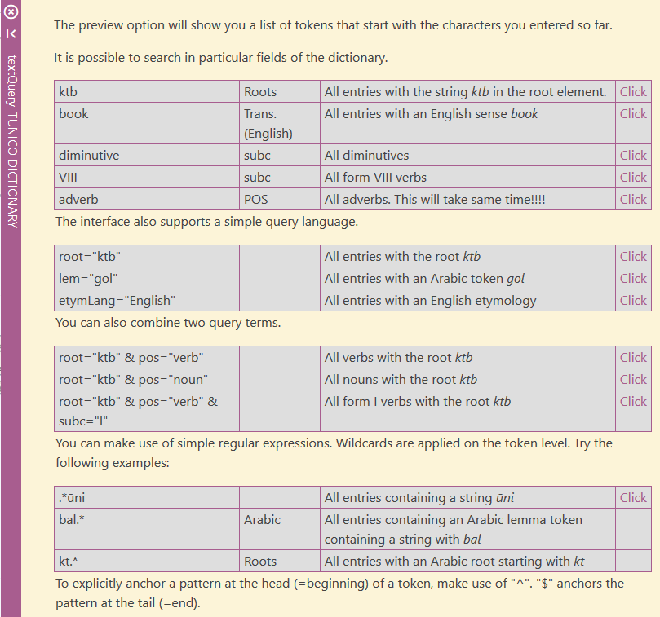
The VICAV Toolbox
Dictionary Frontend
Word completion
Query examples

Slide 76
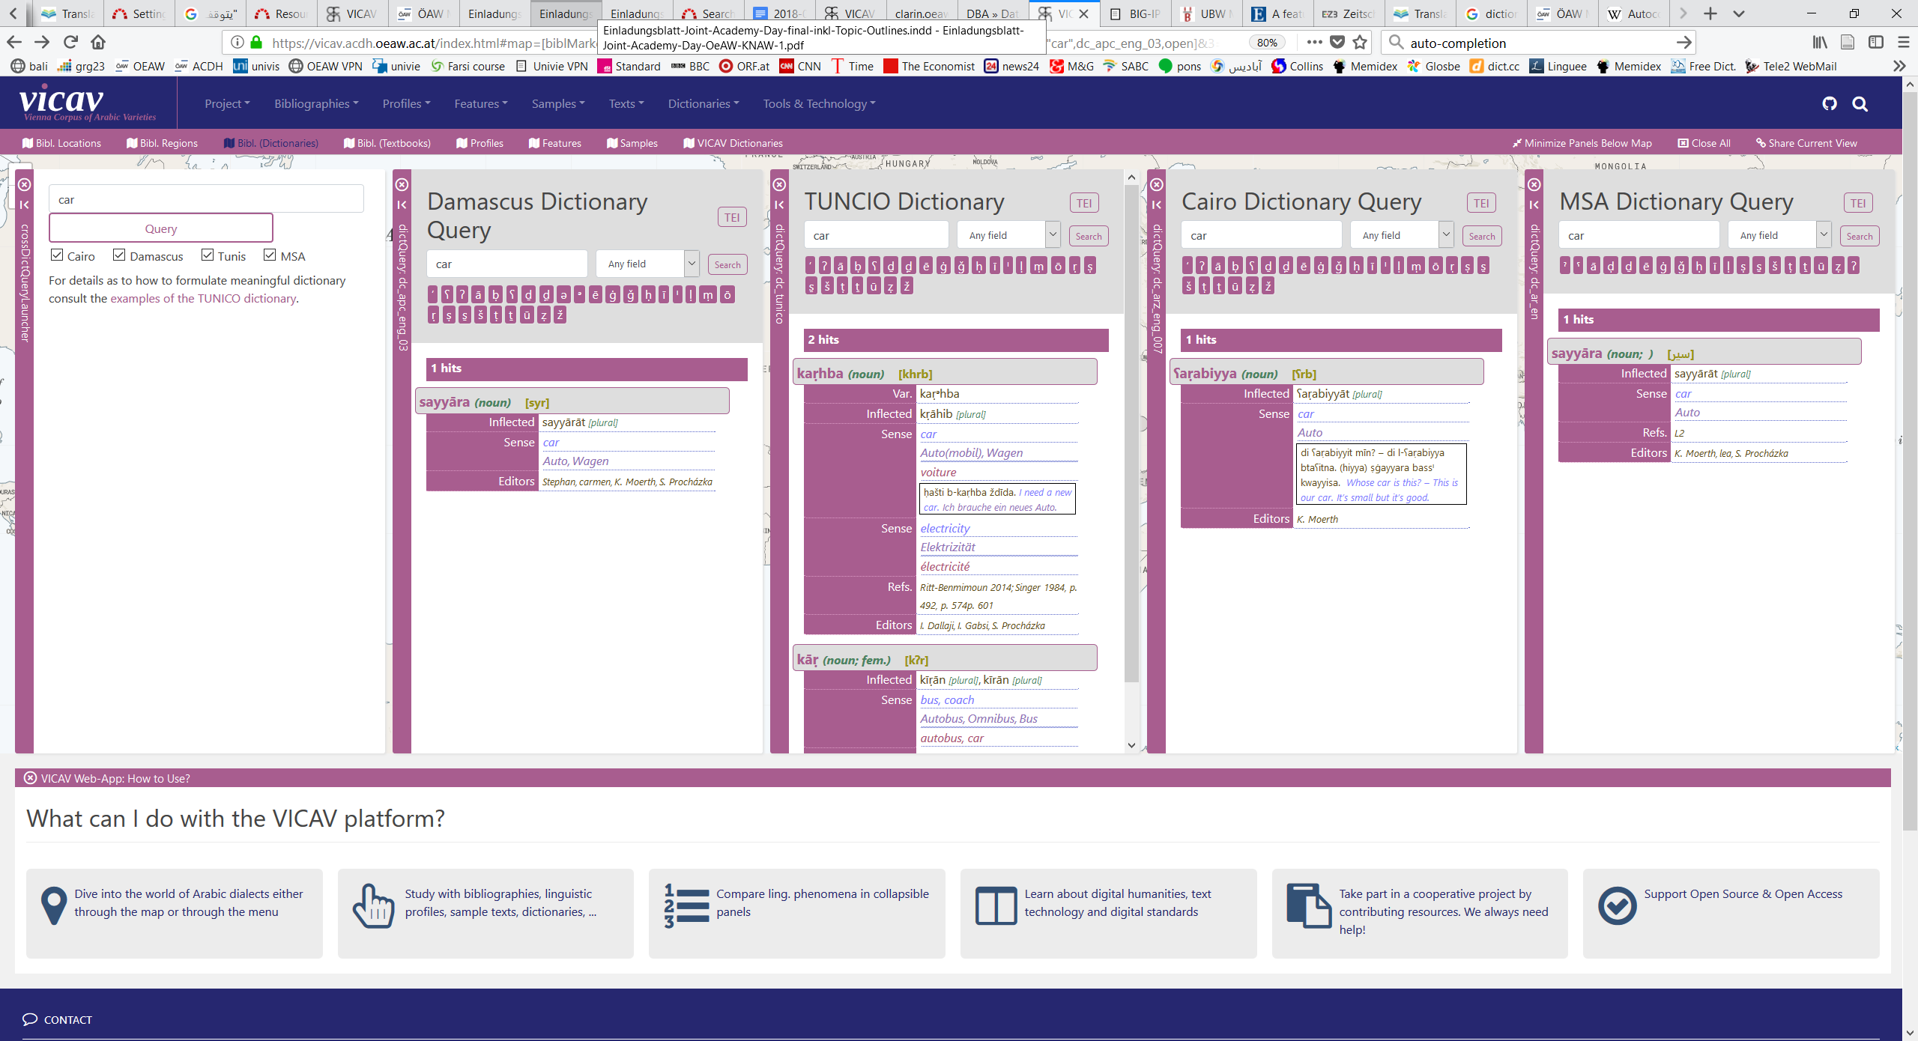
The VICAV Toolbox
Dictionary Frontend
Word completion
Query examples
Cross-dictionary query

Slide 77
The VICAV Toolbox
Technologies and Tools
X-Technologies
HTML
JS (jQuery, Leaflet)
CSS
BaseX
ZOTERO
VLE

Slide 78
The VICAV Toolbox
Technologies and Tools: BaseX
BaseX (Pro)
Easy to install and deploy
Fast
Can deal with large amounts of data
Rest interface
XQuery 3.0 + 3.1
BaseX (Contra)
Less flexible when querying mixed content

Slide 79
The VICAV Toolbox
Standards + Formats
TEI (P5)
Used for all textual data
Dictionary module
Zotero RDF

Slide 80
The VICAV Toolbox
TEI Dictionary Module
TEI dictionary module to encode digitised print dictionaries: a fairly common standard procedure in digital humanities
Easy to impose in the creation of digitally born dictionaries
Recent Developments: TEI Lex-0

Slide 81
The VICAV Toolbox
ACDH Dictionary Schema
entry
case, def, etym, form, gramGrp, sense, usg, xr
gram
entryFree, superEntry
hom, dictScrap
tns, number, mood, per

Slide 82
The VICAV Toolbox
ACDH Dictionary Schema
...
<form type="inflected">
<gramGrp>
<pos value="verb"/>
<tns value="present"/>
<number value="singular"/>
<mood value="indicative"/>
<per value="2"/>
</gramGrp>
<orth>gehst</orth>
</form>
...
<form type="inflected" ana="#v_pres_ind_sg_p2">
<orth>gehst</orth>
</form>
...
...
<form type="inflected">
<gramGrp>
<gram type="pos">verb</gram>
<gram type="tense">present</gram>
<gram type="number">singular</gram>
<gram value="mood">indicative</gram>
<gram type="person">2</gram>
</gramGrp>
<orth>gehst</orth>
</form>
...
<form type="inflected" ana="#v_pres_ind_sg_p2">
<orth>gehst</orth>
</form>
...

Slide 83
The VICAV Toolbox
Modelling Issues: Semitic Roots et sim.
...
<form type="lemma">
<orth>sāfar</orth>
</form>
<gramGrp>
<gram type="pos">verb</gram>
<gram type="root">sfr</gram>
<gram type="derivedVerbClass">III</gram>
</gramGrp>
...
XXX

Slide 84
The VICAV Toolbox
Modelling Issues: Identifying Ling. Varieties
ISO 639
IETF language tags (BCP 47)
Glottolog codes
Linguasphere Observatory

Slide 85
The VICAV Toolbox
Modelling Issues: Identifying Ling. Varieties
...
<form type="inflected">
<orth xml:lang="ar-arz-x-cairo-vicav">kitāb</orth>
</form>
...
XXX

Slide 86
The VICAV Toolbox
Modelling Issues: Arguments
...
<form>
<orth>médire</orth>
</form>
<gramGrp>
<pos>v</pos>
<subc>t ind</subc>
<colloc type="prep">de</colloc>
</gramGrp>
...
XXX

Slide 87
The VICAV Toolbox
Modelling Issues: Arguments
<entry xml:id="ihtamm_001"> <form type="lemma"> <orth xml:lang="ar-arz-x-cairo-vicavTrans">ihtamm</orth></form> …
<sense>
<gramGrp>
<gram type="argument" xml:lang="ar-arz-x-cairo-vicavTrans">bi-</gram>
</gramGrp>
<cit type="translation" xml:lang="en">
<quote>to be interested (in)</quote>
</cit>
</sense>
...
XXX

Slide 88
The VICAV Toolbox
Modelling Issues: Examples
<cit type="example" xml:id="ex_bititkallim_001" > <quote xml:lang="ar-arz-x-cairo-vicavTrans"> bititkallim ʕarabi? – šwayya bass.</quote> <cit type="translation" xml:lang="en"> <quote>Do you speak Arabic? – Just, a little.</quote> </cit> </cit>

Slide 89
The VICAV Toolbox
Modelling Issues: Examples
<cit type="example" xml:id="ex_bititkallim_001" > <quote xml:lang="ar-arz-x-cairo-arabic"> بتتکلم عربی؟ شویة بس٠ </quote> <quote xml:lang="ar-arz-x-cairo-vicavTrans"> bititkallim ʕarabi? – šwayya bass.</quote> <cit type="translation" xml:lang="en"> <quote>Do you speak Arabic? – Just, a little.</quote> </cit> </cit>

Slide 90
The VICAV Toolbox
Modelling Issues: Examples
...
<cit type="example" xml:lang="amanzi_ayabanda_01">
<quote>Amanzi ayabanda.</quote>
<cit type="translation" xml:lang="en">
<quote>The water is cold.</quote>
</cit>
</cit>
...
<sense>
<cit type="translation" xml:lang="en">
<quote>water</quote></cit>
<ptr type="example" target="#amanzi_ayabanda_01"/>
</sense>
...

Slide 91
The VICAV Toolbox
Modelling Issues: Production Metadata
…
<fs type="change">
<f name="who">
<symbol value="charly"/>
</f>
<f name="when">
<symbol value="2016-03-15"/>
</f>
</fs>
…
XXX

Slide 92
The VICAV Toolbox
Modelling Issues: Production Metadata
<entry xml:id="mashcal_001"> <form type="lemma"> <orth xml:lang="ar-arz-x-cairo-vicav">mašʕal</orth> <orth xml:lang="ar-arz-x-cairo-arabic">مشعل</orth>
<fs type="corpFreq"> <f name="corpus" fVal="#wikiMasri"/> <f name="frequency"><numeric value="6"/></f> <f name="rank"><numeric value="2456"/></f> </fs> </form>
...
XXX

Slide 93
The VICAV Toolbox
Modelling Issues: Production Metadata
<entry xml:id="mashcal_001"> <form type="lemma">
<orth xml:lang="ar-arz-x-cairo-vicav">mašʕal</orth> <orth xml:lang="ar-arz-x-cairo-arabic">مشعل</orth> <acdh:statisticalInfo> <acdh:dataSource type="digitalCorpus"> <ref target="#wikiMasri"/> </acdh:dataSource>
<acdh:retrievalMethod> <acdh:query type="CQP">lemma="مشعل"</acdh:query> <acdh:evalMode>manual</acdh:evalMode> </acdh:retrievalMethod>
<measure type="lemmaNumber“>6</measure> <measure type="rank">2456</measure> ...
XXX

Slide 94
Where to from here?
Harmonisation of dictionaries
More data
Enlargement of existing dictionaries
More varieties
??? Web-based dictionary editor ???

Slide 95
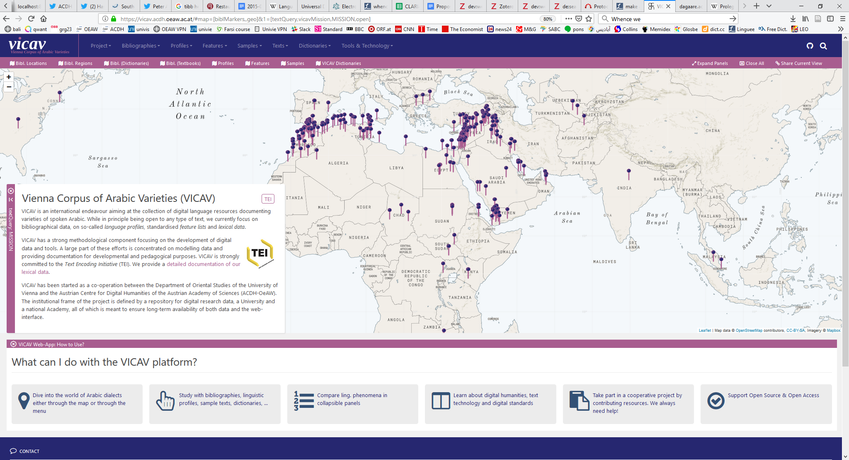
Where to from here?
https://vicav.acdh.oeaw.ac.at

Slide 96
Dank u voor uw aandacht!
Thank you for your attention!
Danke für Ihre Aufmerksamkeit!
Merci pour votre attention!
感谢您的聆听!
Ďakujem za vašu pozornosť!
Gracias por su atención
Ngiyabonga ukulalela kwenu!
Grazie per l’attenzione!
Спасибо за внимание!
Asante sana kwa kunisikiliza!
!وشكرا لكم على اهتمامكم

