Slide 1
Modelling Diatopic Variation in TEI
The Case of the VICAV Dictionaries
Karlheinz Mörth, Daniel Schopper
DGFS 2020, Hamburg – Dictionary Articles and Corpora – a Research Laboratory for Linguistic Diversity, 5.3.2020

Slide 2
Preliminiaries
VICAV (Vienna Corpus of Arabic Varieties)
… is a platform to support researchers in variational linguistics (focus on diatopic questions),
… has a focus on digital language resources for spoken Arabic varieties,
… serves as a testbed for methodological experiments on relevant standards and tools, and
… combines a map-based approach with traditional navigational / search tools.

Slide 3
Framework
Institute of Oriental Studies (University of Vienna)
Austrian Centre for Digital Humanities (AAS)
Faculty of Philological and Cultural Studies (University of Vienna)
Linguistic dynamics in the Greater Tunis Area: a corpus-based approach (TUNICO; FWF P-25706)
The linguistic terra incognita of Tunesia (TUNOCENT; FWF P-31647)

Slide 4
Scholarly Background
Diglossic (Triglossic) situation
Special form of multilingualism
Functional complementarity of varieties
Acrolect: Modern Standard Arabic
Basilects: a great number of spoken varieties

Slide 5
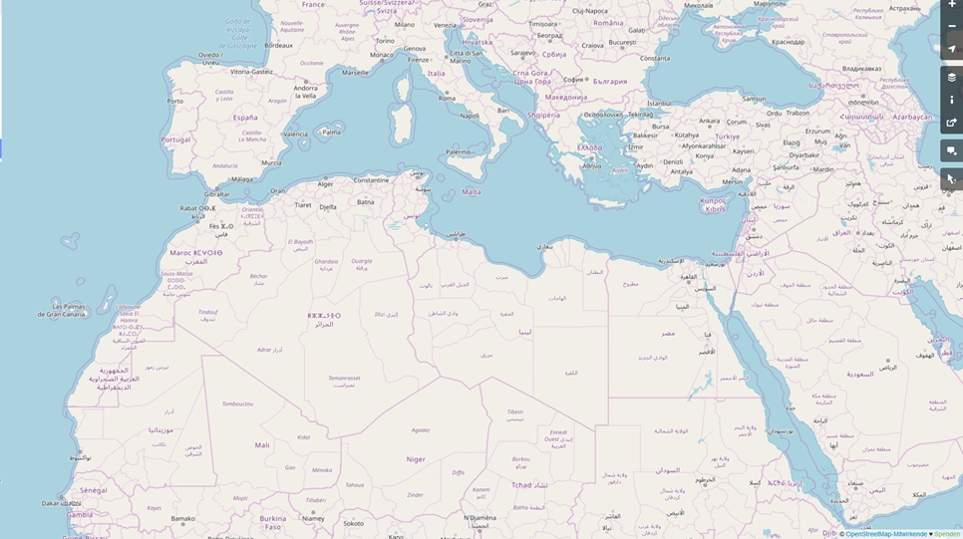
mā(ḏā) turīd?
š-tḥibb?
xi trid?
šu beddak?
ši-trīd?
šnu bġīti?
šen tebbi?
ʕāwiz ʔēh?
ʔēš tibġa?
š-tabbi?
dāyir šinu?
ʔēš tašti?

Slide 6
Perspectives
Linguistic research
Teaching
Text technology
Standards
Openness
Specific kinds of data needed
Notes:
lack of freely available resources / dispersed resources
different usage profiles to be covered

Slide 7
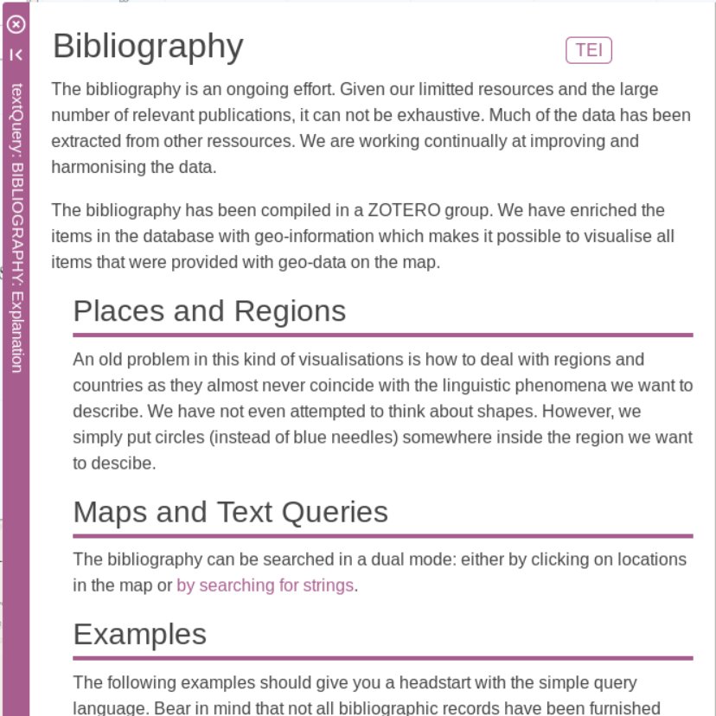
Bibliography
Collection of research literature and learning material
4127 records
Collaborative effort
AIDA Conferences

Slide 8
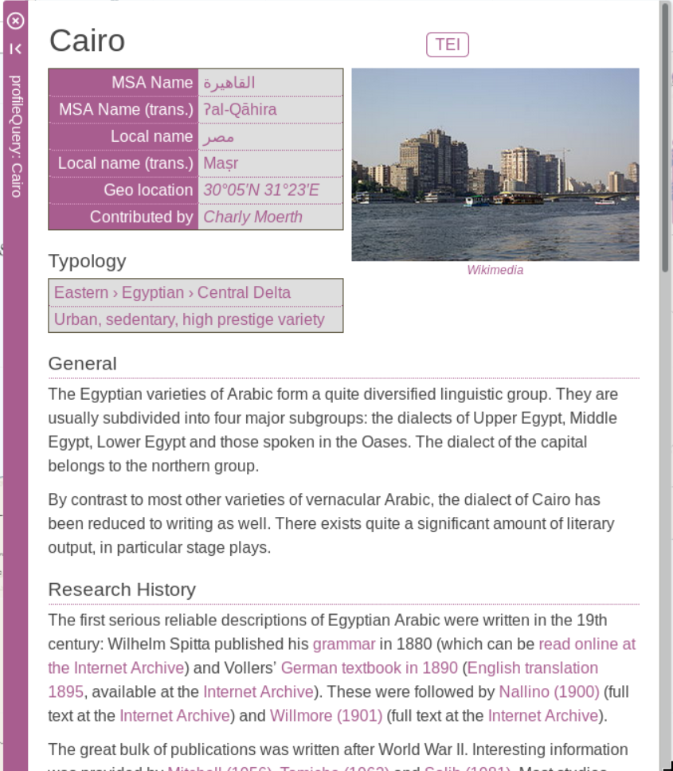
Language Profiles
Short sketches of particular varieties
Research History
Information about available resources: grammatical descriptions, textbooks, dictionaries, etc.
Information complementary to similar efforts (e.g. EALL)
Notes:
EALL = Encyclopedia of Arabic Language and Linguistics

Slide 9
Feature Lists
Sentence pairs in English and Arabic that are meant to exemplify selected salient linguistic features
Focus has been put on morphology and lexis
Reflect the common practice in the community
Extensible

Slide 10
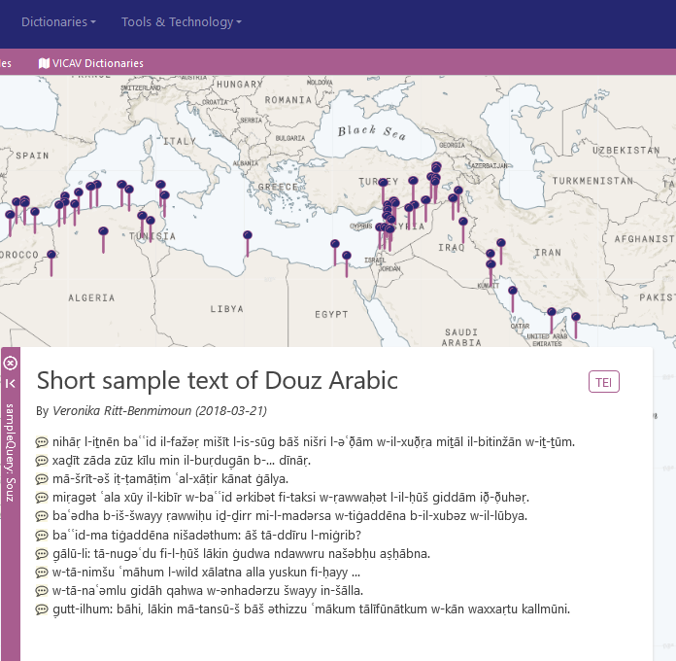
Annotated Sample Texts
Short, linguistically annotated sample texts with aligned translations

Slide 11
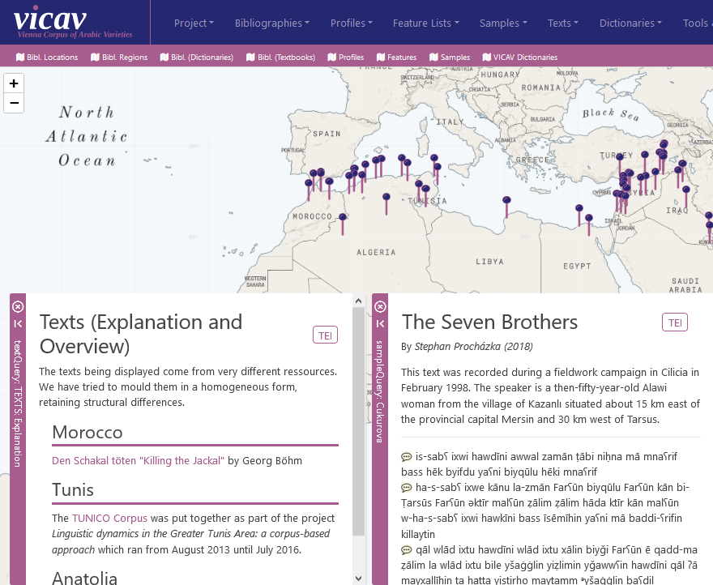
Transcripts of spoken language
Currently this is the smallest part of the project.
Goal is to
cover more regions
provide more texts
Production is very time-consuming.

Slide 12
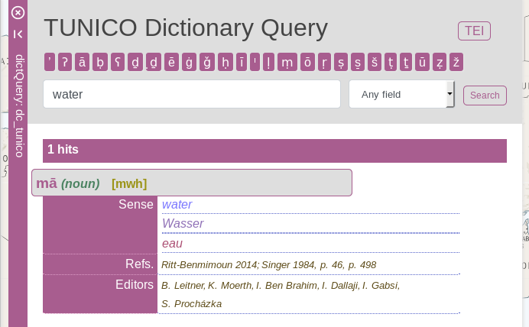
Dictionaries
Digital-born data
Human-oriented
5 published dictionaries so far
Tunis
Damascus
Cairo
Baghdad
MSA
Target languages
English
German
Spanish (in selected dictionaries)

Slide 13
Dictionaries
Didactic purposes
Comparative research
Dictionaries (!= glossaries)

Slide 14
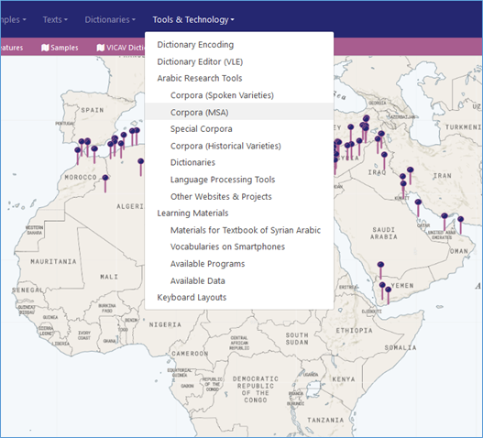
Paratexts
Documentation
Tools
Digital Language Resources

Slide 15
Dictionaries
Bibliography
Language Profiles
Feature Lists
Paratexts
Sample Texts

Slide 16
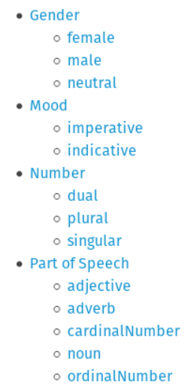
Dictionaries
Bibliography
Language Profiles
Feature Lists
Paratexts
Sample Texts

Slide 17
VICAV Feature (Value) Library
<form type="inflected" ana="fvLib:v_pres_sg_p3"> <orth xml:lang="ar-acm-x-baghdad-vicav">yǝʔṭaʕ</orth> </form>

Slide 18
VICAV Feature (Value) Library
<fvLib n="verbal forms"> <fs xml:id="v_pres_ind_sg_p1" feats="vf:pos.verb vf:tns.pres vf:mood.ind vf:num.sg vf:pers.1"/> <fs xml:id="v_pres_ind_sg_p2" feats="vf:pos.verb vf:tns.pres vf:mood.ind vf:num.sg vf:pers.2"/> <fs xml:id="v_pres_ind_sg_p3" feats="vf:pos.verb vf:tns.pres vf:mood.ind vf:num.sg vf:pers.3"/> <fs xml:id="v_pres_ind_pl_p1" feats="vf:pos.verb vf:tns.pres vf:mood.ind vf:num.pl vf:pers.1"/> <fs xml:id="v_pres_ind_pl_p2" feats="vf:pos.verb vf:tns.pres vf:mood.ind vf:num.pl vf:pers.2"/> <fs xml:id="v_pres_ind_pl_p3" feats="vf:pos.verb vf:tns.pres vf:mood.ind vf:num.pl vf:pers.3"/> … </fvLib>
<fvLib n="verbal forms"> <fs xml:id="v_pres_ind_sg_p1" feats="vf:pos.verb vf:tns.pres vf:mood.ind vf:num.sg vf:pers.1"/> <fs xml:id="v_pres_ind_sg_p2" feats="vf:pos.verb vf:tns.pres vf:mood.ind vf:num.sg vf:pers.2"/> <fs xml:id="v_pres_ind_sg_p3" feats="vf:pos.verb vf:tns.pres vf:mood.ind vf:num.sg vf:pers.3"/> <fs xml:id="v_pres_ind_pl_p1" feats="vf:pos.verb vf:tns.pres vf:mood.ind vf:num.pl vf:pers.1"/> <fs xml:id="v_pres_ind_pl_p2" feats="vf:pos.verb vf:tns.pres vf:mood.ind vf:num.pl vf:pers.2"/> <fs xml:id="v_pres_ind_pl_p3" feats="vf:pos.verb vf:tns.pres vf:mood.ind vf:num.pl vf:pers.3"/> … </fvLib>
<fLib n="pos"> <f xml:id="pos.verb" name="v"><symbol value="verb"/></f> … </fLib>
<fLib n="tense"> <f xml:id="tns.pres" name="presentTense"><symbol value="present"/></f> … </fLib>
<fLib n="mood"> <f xml:id="mood.ind" name="indicative"><symbol value="indicative"/></f> … </fLib>
<fLib n="number"> <f xml:id="num.pl" name="number"><symbol value="plural"/></f> … </fLib>
<fLib n="person"> <f xml:id="pers.3" name="person"><symbol value="3rd"/></f> … </fLib>
<fLib n="pos"> <f xml:id="pos.verb" name="v"><symbol value="verb"/></f> … </fLib>
<fLib n="tense"> <f xml:id="tns.pres" name="presentTense"><symbol value="present"/></f> … </fLib>
<fLib n="mood"> <f xml:id="mood.ind" name="indicative"><symbol value="indicative"/></f> … </fLib>
<fLib n="number"> <f xml:id="num.pl" name="number"><symbol value="plural"/></f> … </fLib>
<fLib n="person"> <f xml:id="pers.3" name="person"><symbol value="3rd"/></f> … </fLib>

Slide 19
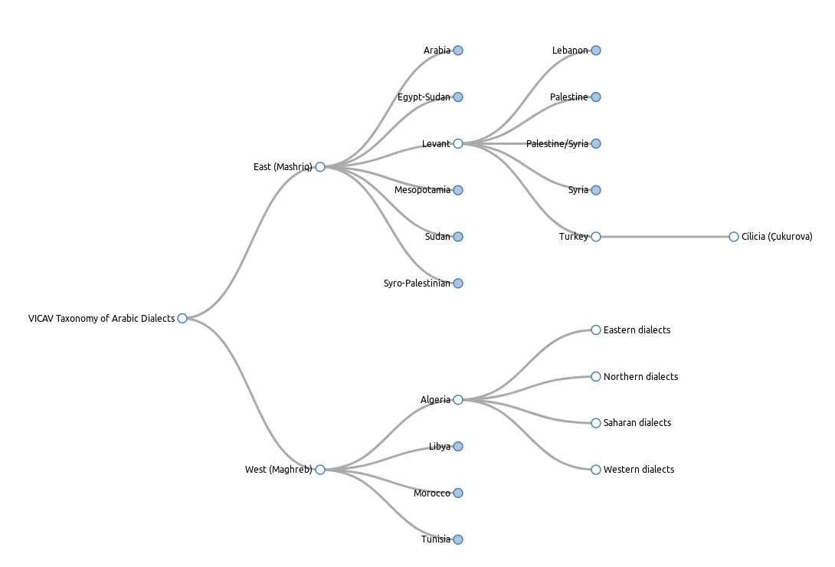
Vocabularies
Controlled vocabularies are / also represented in SKOS
Reusability across resources, projects and technologies
Currently:
Typology of dialects
Morphosyntactic Features
Basic semantic inventory
(<placeList>)

Slide 20
ODD Structure
for each resource type a dedicated ODD with type-specific Schematron checks
document-internal consistency (alignment of translations, <entry> → <cit type="example">)
external referential integrity (e.g. bibliography, feature library)
Pre-processing: SKOS → <constraintSpec>

Slide 21
Workflow
(Bibliography)
(Language Profiles, Sample Texts, Feature Lists, Paratexts)
curation
(Dictionaries)

Slide 22
Text technology / the VICAV toolset
for data curation and processing:
Easily available standard tools (Office, oXygen, ZOTERO)
Viennese Lexicographic Editor (VLE)
vigolo adds geo-references to bibliography
vi_tok tokenises feature lists and texts
ling_annot is used to annotate feature lists and texts
Vocabs Editor (https://vocabseditor.acdh.oeaw.ac.at) to edit SKOS vocabularies

Slide 23
Text technology / the VICAV toolset
for data curation and processing:
Easily available standard tools (Office, oXygen, ZOTERO)
Viennese Lexicographic Editor (VLE)
vigolo adds geo-references to bibliography
vi_tok tokenises feature lists and texts
ling_annot is used to annotate feature lists and texts
Vocabs Editor (https://vocabseditor.acdh.oeaw.ac.at) to edit SKOS vocabularies

Slide 24
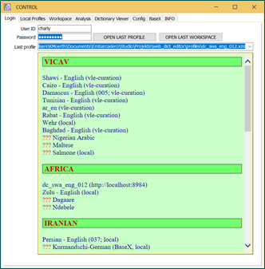
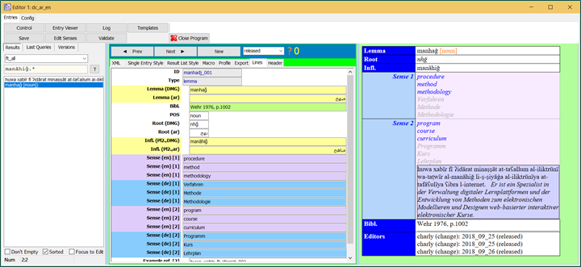
Text technology / the VICAV toolset
VLE – Viennese Lexicographic Editor
XML editor
Standalone application with web-based backend
Designed to process standard-based lexicographic and terminological data such as TEI, LMF, TBX or RDF-XML.
Freely configurable visualisation (via XSLT)
Validation
Versioning
Data is stored in BaseX
Freely available and easy to setup

Slide 25
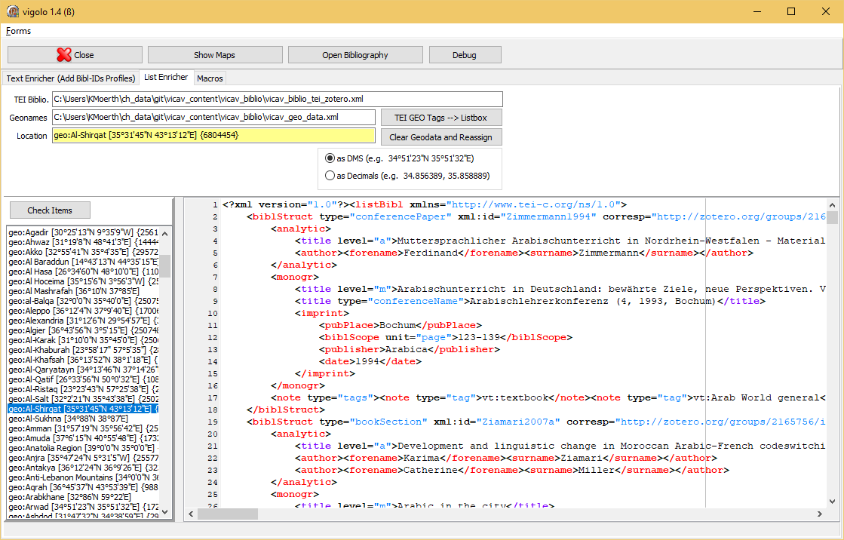
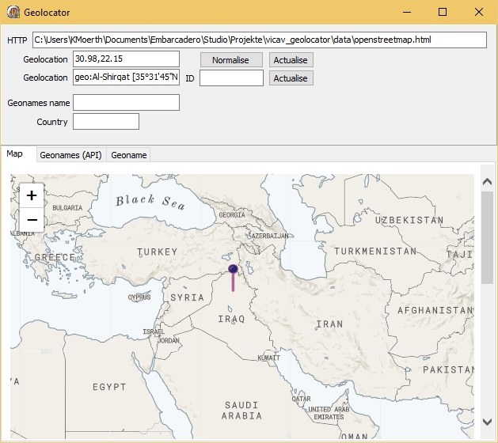
Text technology / the VICAV toolset
vigolo
Editor to apply geo-references

Slide 26
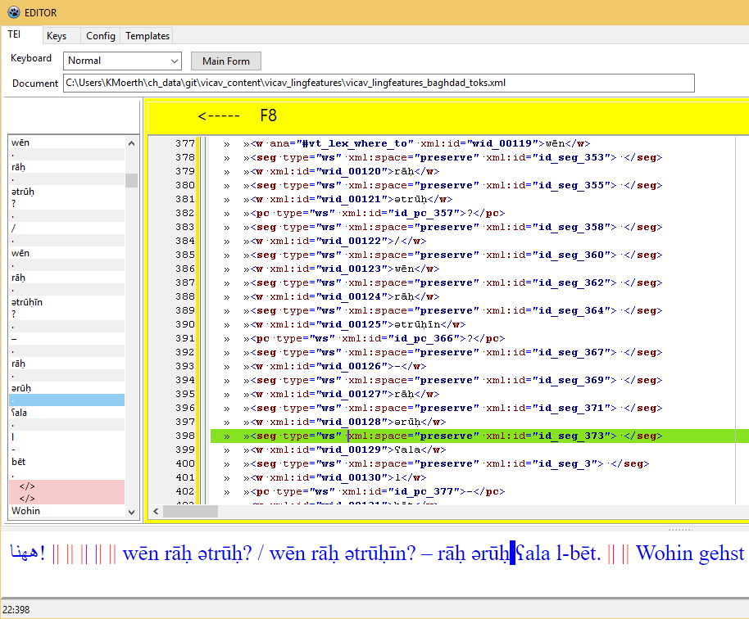
Text technology / the VICAV toolset
ling_annot
Allows manual editing of verticalised data

Slide 27
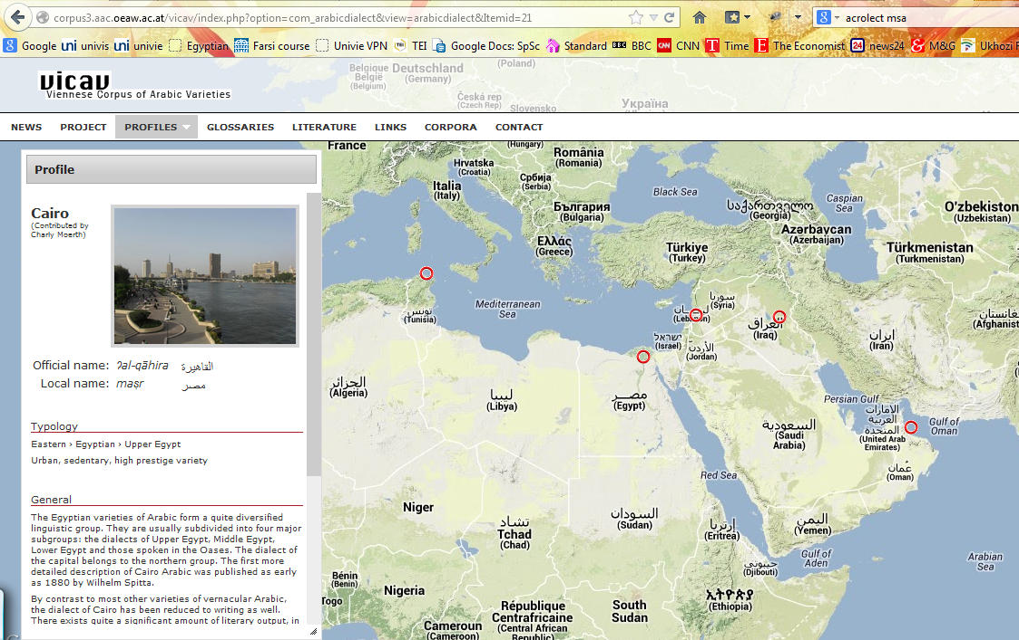
VICAV – the presentation layer
„expert tool“ – yet: usability is key esp. for
students
community contributions (a not-so-digital audience)
previous attempts
MySQL + PHP
Drupal frontend

Slide 28
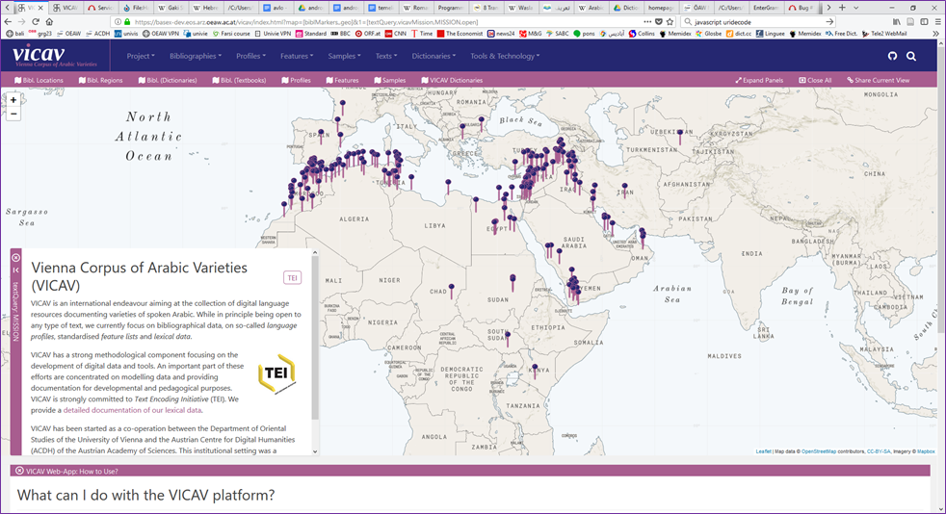
VICAV – the presentation layer
Dual approach
Visualisation of data on an active map
Random access through menus/queries
Textual information is displayed on fixed panels.
Citability via URLs

Slide 29
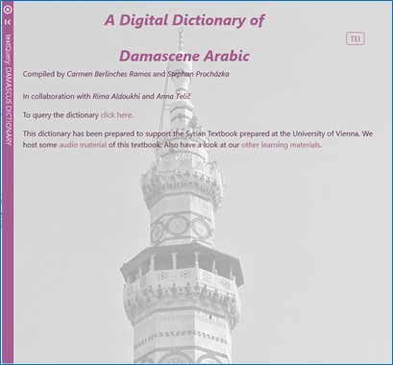
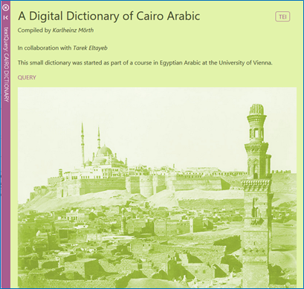
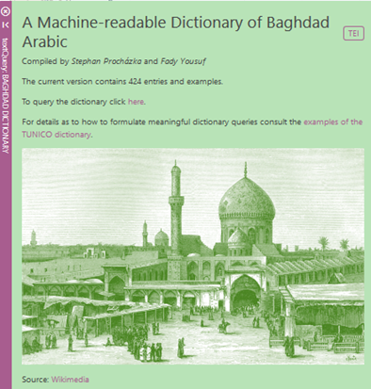
VICAV – the presentation layer
Dictionaries
Customised entry pages

Slide 30
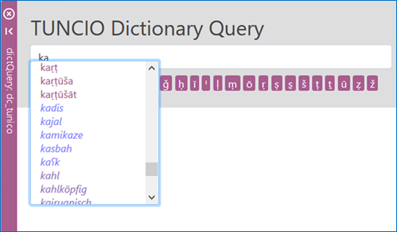
VICAV – the presentation layer
Dictionaries
Customised entry pages
Word completion

Slide 31
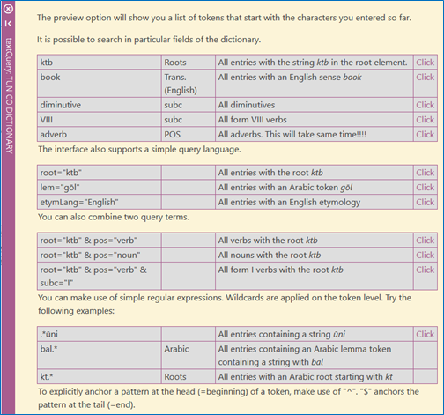
VICAV – the presentation layer
Dictionaries
Customised entry pages
Word completion
Query examples

Slide 32
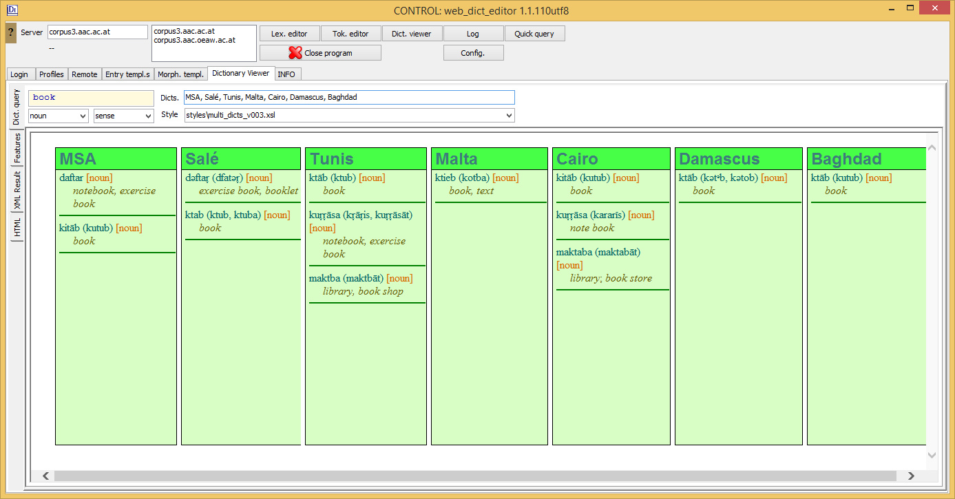
VICAV – the presentation layer
Dictionaries
Customised entry pages
Word completion
Query examples
Querying accross dictionaries

Slide 33
TUNICO Dictionary
Micro-diachronic and machine-readable
Up-to-date and easily accessible lexical information
Basis: data taken from didactic materials
Incorporation of multiple sources
Contemporary data from TUNICO Corpus
Interviews
Editors
Historical publications

Slide 34
TUNICO Dictionary
corpus → dictionary
enrichment of dictionary (new lemmata, senses, statistical information)
dictionary → corpus
annotation of corpus (VLE, token editor)
CORPUS
DICTIONARY

Slide 35
TUNOCENT Dictionary
TUNICO data
Additional corpus data
Various questionnaires from a large number of places

Slide 36
Modelling location
Geolocated data in bibliography
Abéché [13°49'45"N 20°49'57"E] {245785}
Abu Shusha [31°51'25"N 34°54'56"E] {295767}
Abu Snan [32°57'32"N 35°10'17"E] {295765}
Adana [37°0'6"N 35°19'44"E] {325363}
Aden [12°46'46"N 45°2'12"E] {415189}
Afak [32°3'51"N 45°14'51"E] {99738}
Agadir [30°25'13"N 9°35'9"W] {2561668}
Ahwaz [31°19'8"N 48°41'3"E] {144448}
Akko [32°55'41"N 35°4'35"E] {295721}
Al Baraddun [14°43'13"N 44°35'15"E] {30652}
Al Hasa [26°34'60"N 48°10'0"E] {110110}
Al Hoceima [35°15'6"N 3°56'3"W] {2558545}
Al Mashrafah [36°10'N 37°85'E]
al-Balqa [32°0'0"N 35°40'0"E] {250751}
Aleppo [36°12'4"N 37°9'40"E] {170063}
Alexandria [31°12'6"N 29°54'57"E] {361058}
Algier [36°43'56"N 3°5'15"E] {2507480}
Al-Karak [31°10'0"N 35°45'0"E] {250625}
Al-Khaburah [23°58'17" 57°5'35"] {289199}
Al-Khafsah [36°13'52"N 38°1'18"E] {168422}
Al-Qaryatayn [34°13'46"N 37°14'26"E] {173361}
Al-Qatif [26°33'56"N 50°0'32"E] {108927}
Al-Ristaq [23°23'43"N 57°25'38"E] {289012}
Al-Salt [32°2'21"N 35°43'38"E] {250258}
Al-Shirqat [35°31'45"N 43°13'12"E] {6804454}
Al-Sukhna [34°88'N 38°87'E]
Amman [31°57'19"N 35°56'42"E] {250441}
Amuda [37°6'15"N 40°55'48"E] {173230}
Anatolia Region [39°0'0"N 35°0'0"E] {323835}

Slide 37
Encoding location: language labels
ISO 639-1:2002 – ISO 639-5:2008
Glottolog (Max Planck Institute for the Science of Human History in Jena)
Linguasphere Register
BCP 47
ISO 639 (ling. varieties)
ISO 15924 (representation of names of scripts)
ISO 3166-1 (countries)
UN M.49 (Country or Area Codes for Statistical Use)

Slide 38
Encoding location: place names
<name type="city">Cairo</orth>
<placeName>Cairo</placeName>
<geogName>Cairo</geogName>

Slide 39
Encoding location: bcp47
<entry xml:id="kitaab_001">
<form type="lemma">
<orth xml:lang="ar-arz-x-cairo-vicav">kitāb</orth>
</form>
<gramGrp>
<gram type="pos">noun</gram>
<gram type="root" xml:lang="ar-arz-x-cairo-vicav">ktb</gram>
</gramGrp>
<sense>
<cit type="translation" xml:lang="en">
<quote>coldness</quote>
</cit>
<cit type="translation" xml:lang="de">
<quote>Kälte</quote>
</cit>
</sense>
</entry>

Slide 40
Encoding location: bcp47
<entry xml:id="kitaab_001">
<form type="lemma">
<orth xml:lang="ar-arz-x-cairo-vicav">kitāb</orth>
</form>
<gramGrp>
<gram type="pos">noun</gram>
<gram type="root" xml:lang="ar-arz-x-cairo-vicav">ktb</gram>
</gramGrp>
<sense>
<cit type="translation" xml:lang="en">
<quote>coldness</quote>
</cit>
<cit type="translation" xml:lang="de">
<quote>Kälte</quote>
</cit>
</sense>
</entry>

Slide 41
Encoding location: bcp47
<orth xml:lang="ar-arz-x-cairo-vicav">kitāb</orth>
Component | System | Meaning
ar | ISO 639-1 | Arabic
arz | ISO 639-3 | Egyptian Arabic
x | BCP 47 | Begin of private use area
cairo |  | Location
vicav |  | Transcription system of the VICAV Project (DMG)

Slide 42
Encoding location: TEI (P5)
<entry xml:id="kitaab_001">
<form type="lemma">
<orth xml:lang="ar-aeb">ḥažžām</orth>
<usg><placeName>Tunis</placeName></usg>
</form>
<form type="lemmaVariant" source="#beja3-45-m" >
<orth xml:lang="ar-aeb">ḥažžǟm</orth>
<usg><placeName ref="#beja"/></usg>
</form>
<gramGrp>
<gram type="pos">noun</gram>
<gram type="root" xml:lang="ar-arz-x-cairo-vicav">ḥǧm</gram>
</gramGrp>
<sense>
<cit type="translation" xml:lang="en">
<quote>hairdresser</quote>
</cit>
<cit type="translation" xml:lang="de">
<quote>Friseur</quote>
</cit>
</sense>
</entry>

Slide 43
Encoding location: TEI (P5)
<entry xml:id="kitaab_001">
<form type="lemma">
<orth xml:lang="ar-aeb">ḥažžām</orth>
<usg><placeName>Tunis</placeName></usg>
</form>
<form type="lemmaVariant" source="#beja3-45-m" >
<orth xml:lang="ar-aeb">ḥažžǟm</orth>
<usg><placeName ref="#beja"/></usg>
</form>
<gramGrp>
<gram type="pos">noun</gram>
<gram type="root" xml:lang="ar-arz-x-cairo-vicav">ḥǧm</gram>
</gramGrp>
<sense>
<cit type="translation" xml:lang="en">
<quote>hairdresser</quote>
</cit>
<cit type="translation" xml:lang="de">
<quote>Friseur</quote>
</cit>
</sense>
</entry>
<listPlace> <place type="geo" xml:id="beja"> <placeName xml:lang="en">Béja</placeName> <location> <geo>36°44'N 9°11'E</geo> </location> <idno type="geonames">2472774</idno> </place>
…
</listPlace>

Slide 44
Encoding informants
<entry xml:id="kitaab_001">
<form type="lemma">
<orth xml:lang="ar-aeb">ḥažžām</orth>
<usg><placeName>Tunis</placeName></usg>
</form>
<form type="lemmaVariant" source="#beja3-45-m">
<orth xml:lang="ar-aeb">ḥažžǟm</orth>
<usg><placeName ref="#beja"/></usg>
</form>
<gramGrp>
<gram type="pos">noun</gram>
<gram type="root" xml:lang="ar-arz-x-cairo-vicav">ḥǧm</gram>
</gramGrp>
<sense>
<cit type="translation" xml:lang="en">
<quote>hairdresser</quote>
</cit>
<cit type="translation" xml:lang="de">
<quote>Friseur</quote>
</cit>
</sense>
</entry>

Slide 45
Outlook
Data creation is ongoing
Interface

Slide 46
Credits (Technical team)
Credits (Linguists)
Asil Çetin
Dario Kampkaspar
Barbara Krautgartner
Daniel Schopper
Omar Siam
https://vicav.acdh.oeaw.ac.at/#map=&1=[textQuery, vicavContributors,CONTRIBUTORS,open]

Slide 47
Děkuji za pozornost!
Thank you for your attention!
Danke für Ihre Aufmerksamkeit!
!وشكرا لكم على اهتمامكم
Merci pour votre attention!
感谢您的聆听!
Dank u voor uw aandacht!
¡Gracias por su atención!
Ngiyabonga ukulalela kwenu!
Grazie per l’attenzione!
Спасибо за внимание!
Asante sana kwa kunisikiliza!

