Slide 1
The VICAV Dictionaries
Tools for Creating Lexical Data
Karlheinz Mörth
Austrian Centre for Digital Humanities
Austrian Academy of Sciences
DH Training Workshop, Berlin, 14.11.2019

Slide 2
Presentation
Institutional setting + projects
Scholarly background (linguistic issues + text technology)
The dictionaries
VICAV toolbox
Viennese Lexicographic Editor (VLE)
VICAV 3.0
Interoperability mechanisms
Where to from here?

Slide 3
Credits (Technical Team)
Asil Çetin
Barbara Krautgartner
Daniel Schopper
Omar Siam
Credits (Linguists)
https://vicav.acdh.oeaw.ac.at

Slide 4
Prolegomena
Institutional Setting
Austrian Centre for Digital Humanities (Austrian Academy of Sciences)
Research + Service
Empowering research
Humanities computing → Digital Humanities

Slide 5
Prolegomena
Institutional Setting
Austrian Centre for Digital Humanities (Austrian Academy of Sciences)
Institute for Near Eastern Studies (University of Vienna)
Focus on contemporary language
Long tradition in Arabic dialectology
Curriculum with 4 Arabic dialects

Slide 6
Prolegomena
Institutional Setting: VICAV
Vienna Corpus of Arabic Varieties
Research environment for scholars pursuing comparative interests in the study of Arabic spoken varieties
Pooling digital language resources
Bibliography
Language profiles
Feature lists
(Annotated) sample texts
Corpora
Dictionaries (!= glossaries)
https://vicav.acdh.oeaw.ac.at

Slide 7
Prolegomena
VICAV: Vienna Corpus of Arabic Varieties
Pooling digital language resources
Arabic Research Tools
Learning Materials
Paratexts (Documentation)
VICAV Encoding Guidelines
VLE Guide
How to use the website
https://vicav.acdh.oeaw.ac.at

Slide 8
Prolegomena
VICAV: Vienna Corpus of Arabic Varieties
Linguistic research
Teaching
Text technology
Standards
Openness

Slide 9
Prolegomena
Related Endeavours
CorpAfroAs
CORVAM Speech corpus of Maghrebi varieties
Tunisiya
SemArch - Semitisches Tonarchiv
https://vicav.acdh.oeaw.ac.at/#map=[biblMarkers,_vicavDicts_,]&1=[textQuery,vicavOverview_corpora_spoken,ARABIC%20TOOLS%20(Corpora%20-%20Spoken%20Varieties),open]

Slide 10
Prolegomena
TUNICO (2014-1016)

Slide 11
Prolegomena
TUNICO (2014-1016)
Linguistic Dynamics in the Greater Tunis Area: A Corpus-based Approach
Objectives
exploration of a contemporary Arabic variety (poorly documented so far)
Production of a corpus of spoken youth language
Compilation of a diachronic dictionary of Tunisian Arabic
Text technology + variational linguistics
Grant of the Austrian Science Fund (P 25706)
2 Arabic language scholars, 1 technician
https://tunico.acdh.oeaw.ac.at

Slide 12
Prolegomena
TUNICO: Corpus
Spoken youth language (dialogues, narratives):
Uncommon approach in Arabic dialectology:
Dialectological interests in language of older people --> older forms of particular varieties
Focus on modern language, contemporary usage and lexical Neologisms
https://tunico.acdh.oeaw.ac.at

Slide 13
Prolegomena
TUNICO: Corpus
30 hours of dialogues and narrative interviews
24 texts
Number of male and female speakers in recordings is balanced.
142.317 tokens: 94.652 w-tags and 47.665 pc-tags
Linking instead of lemmatising
https://tunico.acdh.oeaw.ac.at

Slide 14
Prolegomena
TUNICO: Corpus: Linguistic Research
Overabundance in the Arabic Dialect of Tunis: a Diachronic Study of Plural Formation (Gabsi, Dallaji)
Forms and Functions of the Diminutive in Tunis Arabic
Presentatives
Question markers
Direct object marker
Relative clauses
Conditional clauses
https://tunico.acdh.oeaw.ac.at

Slide 15
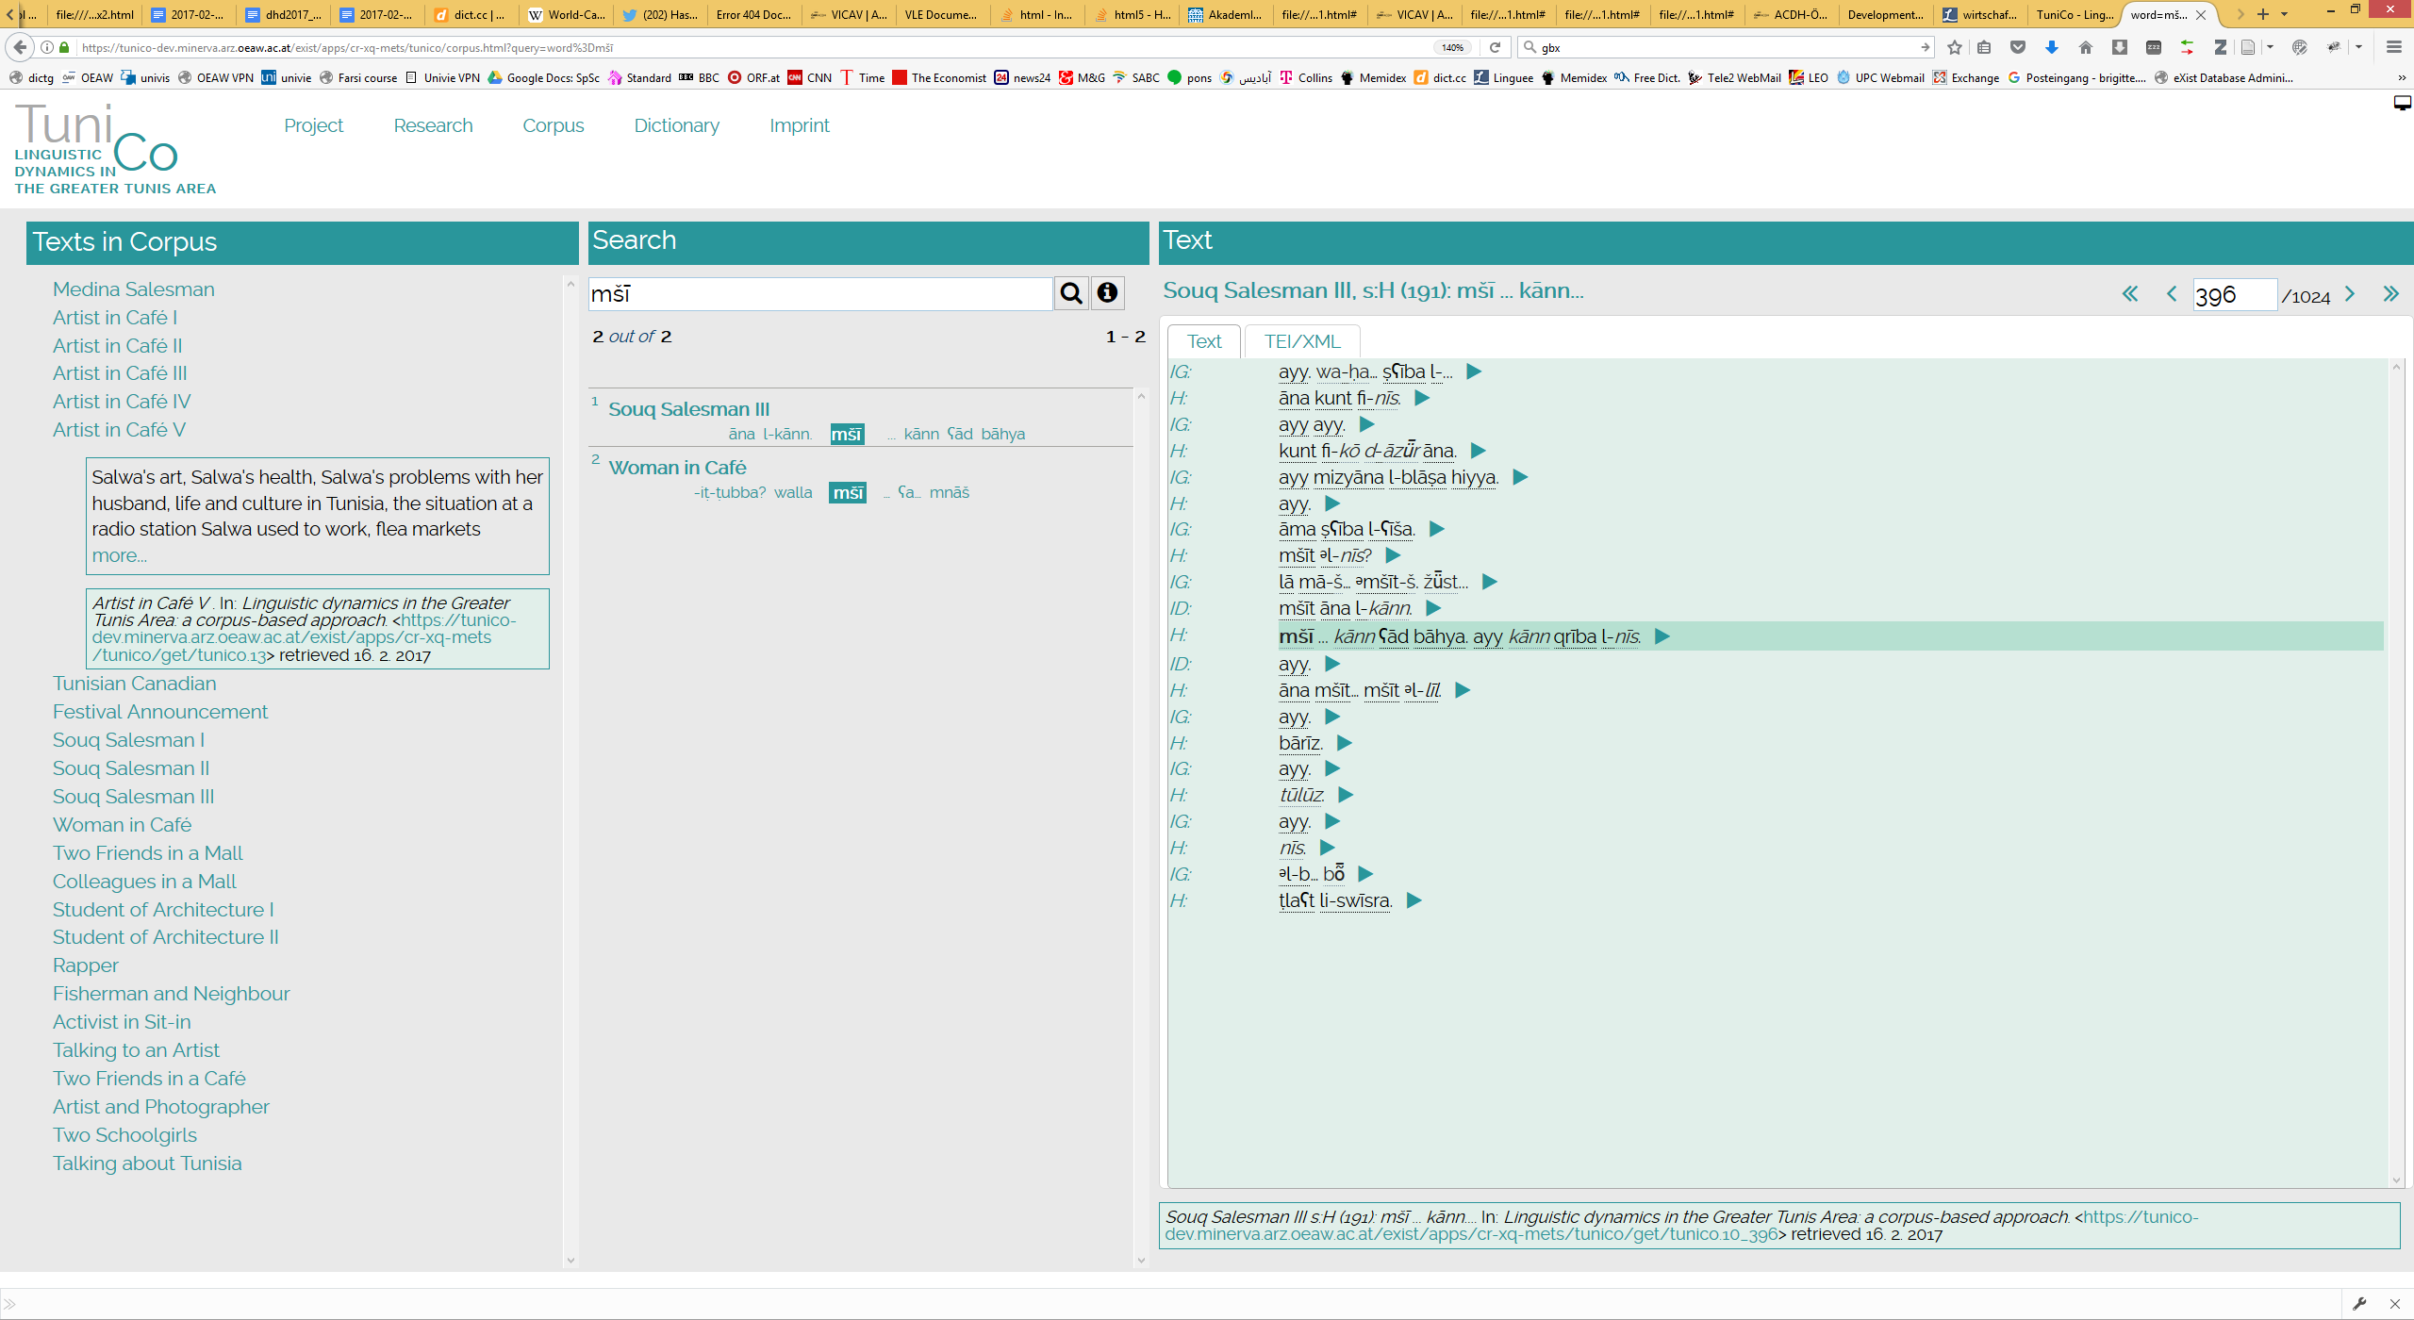

Slide 16
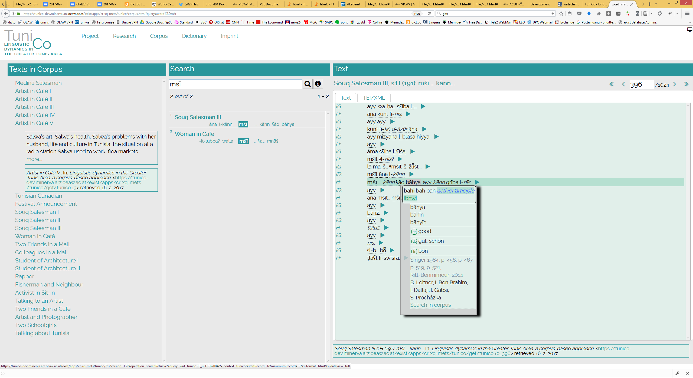

Slide 17
Prolegomena
TUNICO: Corpus
Statistics

Slide 18
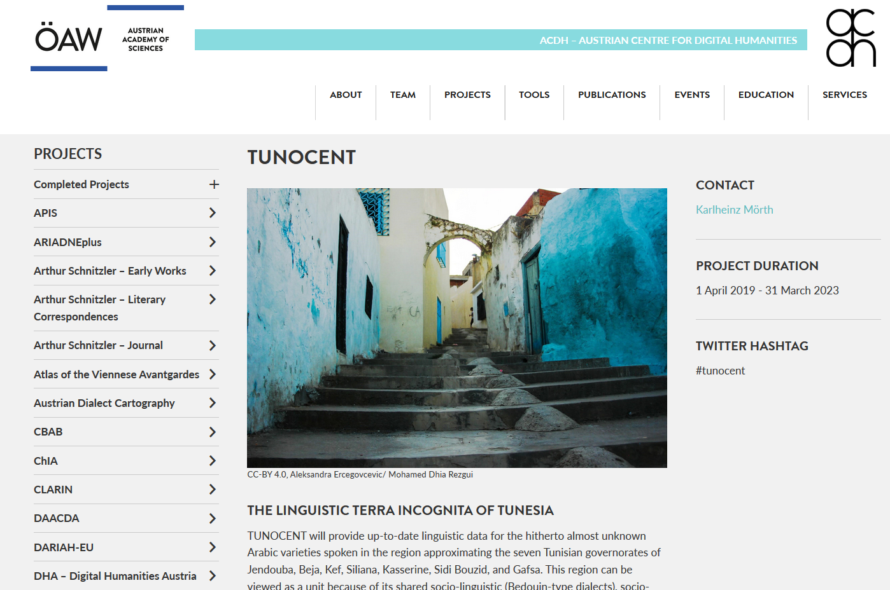
Prolegomena
TUNOCENT (2019-2022)
Tunisia’s terra incognita: A Linguistic Investigation into the Arabic Varieties of Northwestern and Central Tunisia (Austrian Science Fund P 31647)

Slide 19
Scholarly Background
Linguistics
Diglossia (Triglossia)
Particular form of bilingualism
Acrolect: Modern Standard Arabic
Basilect: a great number of spoken varieties

Slide 20
Scholarly Background
Linguistics
Eastern vs. Western
aktib - niktib vs. niktib - niktibu
Bedouin vs. sedentary
interdentals > postdental stops
verb modifiers in imperf. (-/+)
Form IV (+/-)
frequency of analytical gen. structures
Religious affiliation

Slide 21
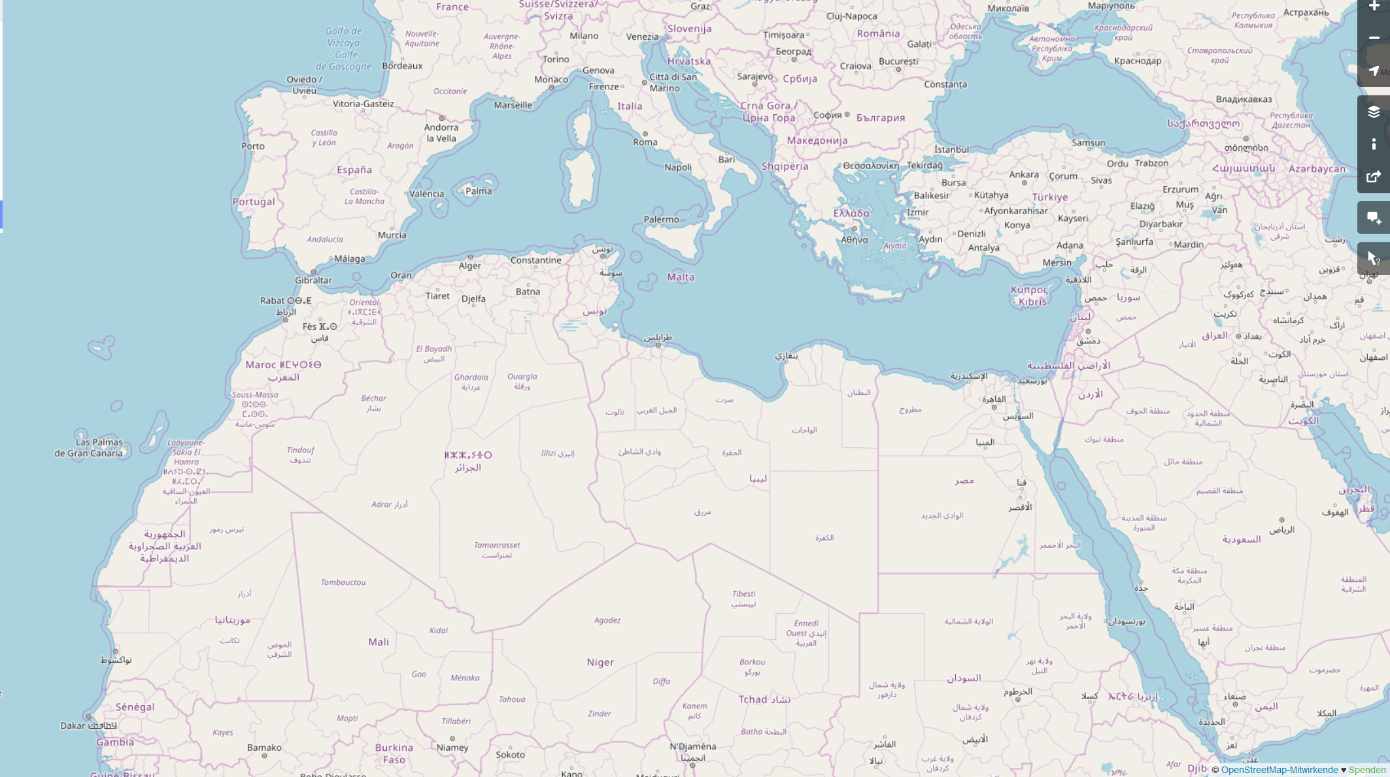
mā(ḏā) turīd?
š-tḥibb?
Xi trid?
šu beddak?
šnu bġīti?
ši-trīd?
šen tebbi?
ʕāwiz ʔēh?
ʔēš tibġa?
š-tabbi?
dāyir šinu?
ʔēš tašti?

Slide 22
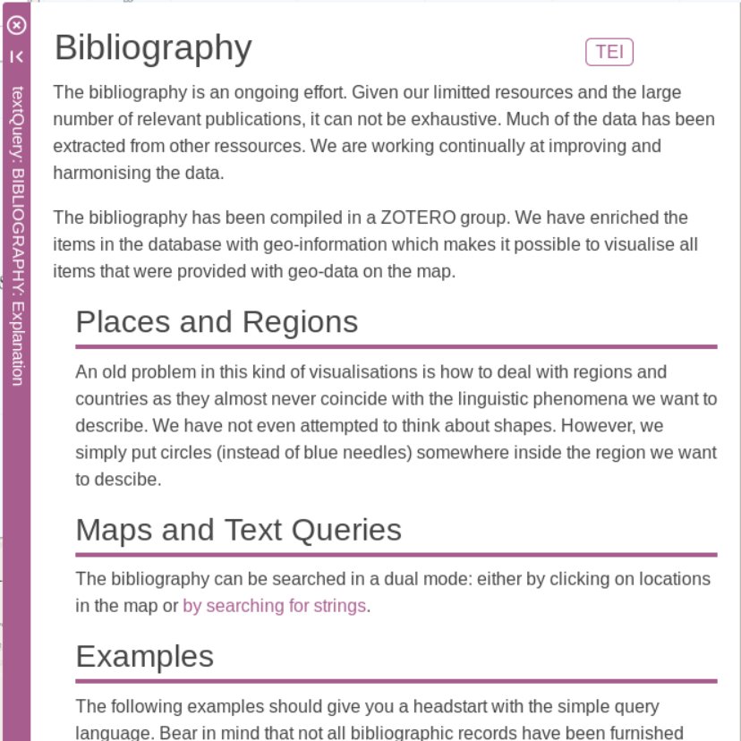
VICAV
Contents: Bibliographical Data
Collection of research literature and learning material
4127 records
Collaborative effort
AIDA Conferences

Slide 23
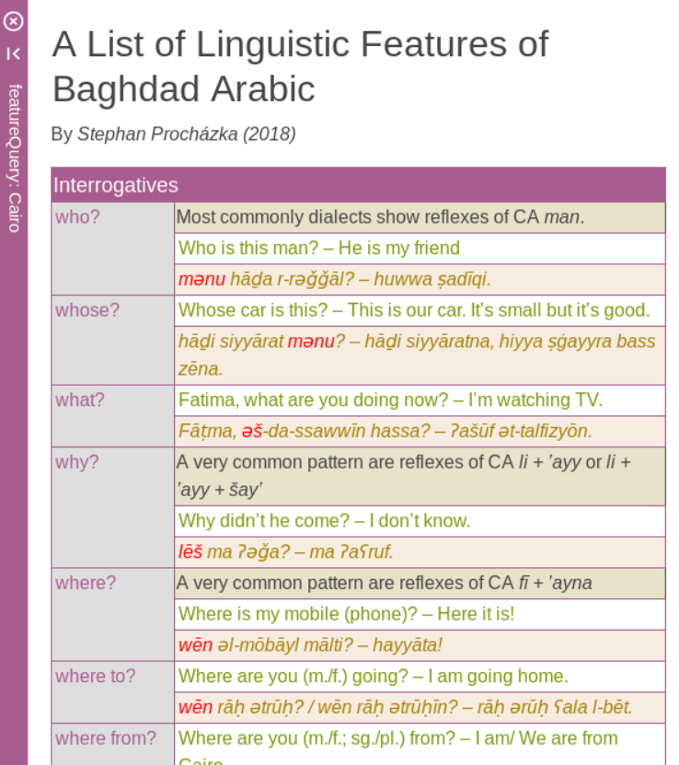
VICAV
Contents: Feature Lists
Sentence pairs in English and Arabic that are meant to exemplify selected salient linguistic features
Focus has been put on morphology and lexis
Reflect the common practice in the community
Extensible

Slide 24
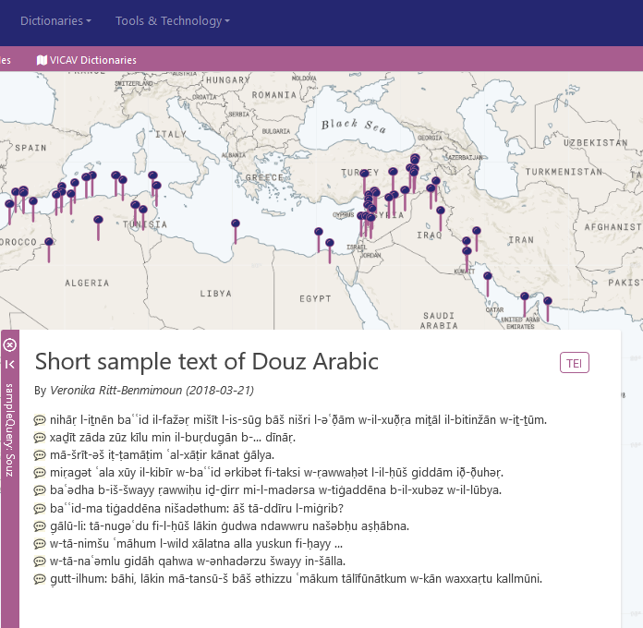
VICAV
Contents: Annotated Sample Texts
Short, linguistically annotated sample texts with aligned translations

Slide 25
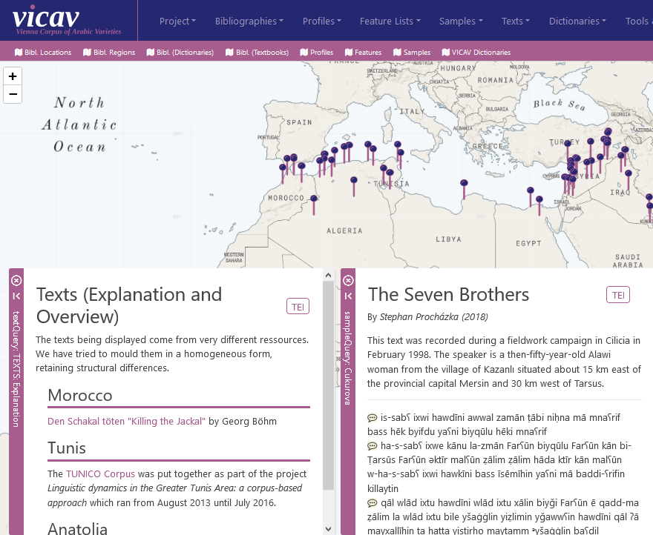
VICAV
Contents: Transcripts of Spoken Language
Currently this is the smallest part of the project.
Goal is to
cover more regions
provide more texts
Time-consuming production

Slide 26
VICAV Dictionaries
“Family of dictionaries”
Dictionaries != glossaries
Small dictionaries
Uniform dictionary structure (TEI P5)
Unified transcription system (~DMG)

Slide 27
VICAV Dictionaries
Purpose and Significance
Comparatistic research
Didactic purposes
Experimental lexicography
Few other scholarly projects in this field
Lughatuna: The Living Arabic Project
Verbes de l’arabe égyptien: Dictionnaire contextuel raisonné des verbes du dialecte égyptien (parler du Caire)
Freely available data

Slide 28
VICAV Dictionaries
Corpus – Dictionary Interface
Corpus → Dictionary
Enrichment of dictionary (new lemmata, senses, statistical information)
Dictionary → Corpus
Annotation of corpus (VLE, token editor)
CORPUS
Dictionary

Slide 29
VICAV Dictionaries
Existing
(Morocco - Rabat)
Tunisia - Tunis
Egypt - Cairo
Syria - Damascus
MSA
In the make
Shawi
Baghdad
Khuzistan
…

Slide 30
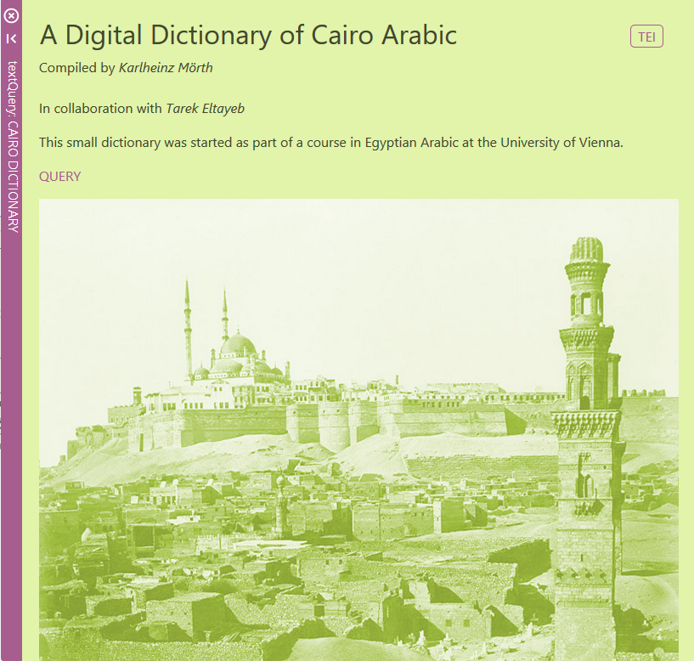
VICAV Dictionaries
Egyptian-English

Slide 31
VICAV Dictionaries
Egyptian-English
Based on
Course materials
Lexicographic analysis of the Egyptian vernacular Arabic Wikipedia
lexicostatistic data for a written manifestation of vernacular Arabic
graphematic variation
language change
Omar Siam: Ein digitales Wörterbuch der 200 häufigsten Wörter der Wikipedia in ägyptischer Umgangssprache - Corpusbasierte Methoden zur lexikalischen Analyse nichtstandardisierter Sprache. (http://othes.univie.ac.at/26036/)

Slide 32
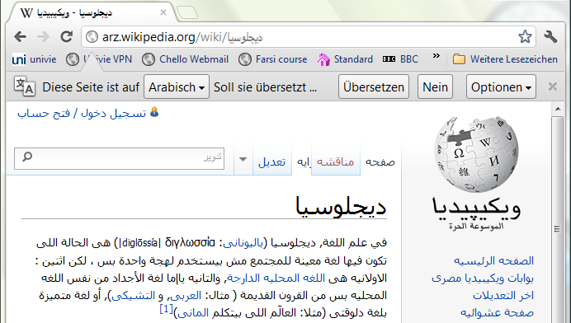

Slide 33
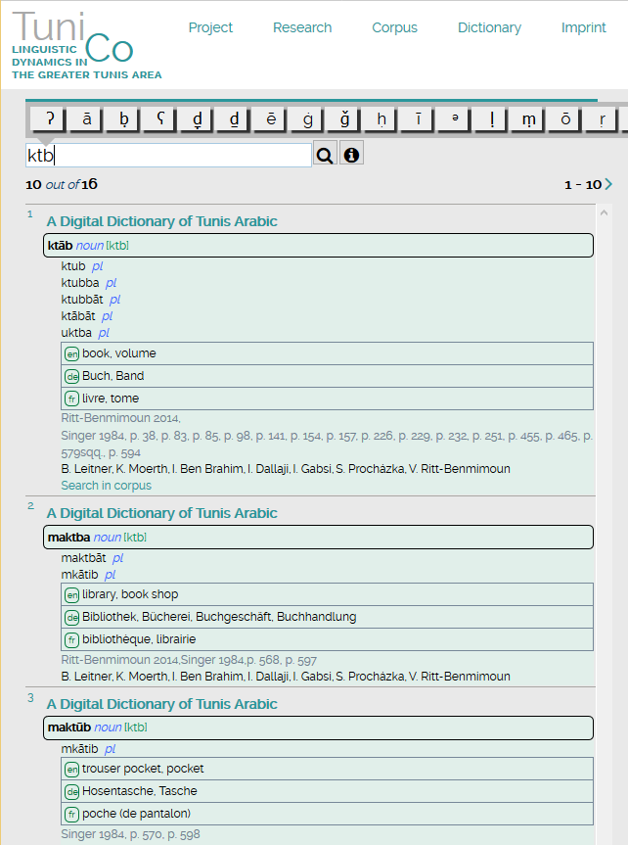
VICAV Dictionaries
TUNICO Dictionary
https://tunico.acdh.oeaw.ac.at/dictionary.html

Slide 34
VICAV Dictionaries
TUNICO Dictionary
Micro-diachronic and machine-readable
~8000 entries
Incorporation of
contemporary data from a digital corpus
various historical sources (e.g. Stumme, H.)
Information added is kept traceable to its origin

Slide 35
VICAV Dictionaries
TUNICO Dictionary
No comprehensive dictionary of the Arabic dialect of Tunis
Basis: data taken from didactic materials
3 other main sources
Newly created corpus
Interviews
Historical publications

Slide 36
VICAV Dictionaries
TUNICO Dictionary: Historical Sources
800-page grammar of the Medina of Tunis by Hans-Rudolf Singer (1984):
Evaluation of data, integration of excerpted lexicographic data into dictionary
Verification and completion of collected data with other historical resources
Diachronic dimension helps to understand processes in the development of the lexicon
Material gathered will allow analysis of recent developments (migration of parents from rural areas, influence by other Arabic varieties, influence of revolution, foreign elements)

Slide 37
VICAV Dictionaries
TUNICO Dictionary: Historical Sources
Additional sources:
Nicolas, A. (1911). Dictionnaire français-arabe
Beaussier, M. (2006). Dictionnaire pratique arabe-français (arabe maghrébin)
Quéméneur, J. (1961). “Notes sur quelques vocables du parler Tunisien”
Quéméneur, J. (1962). “Glossaire de dialectal”
Abdellatif, K. (2010). Dictionnaire «le Karmous» du Tunisien
Marçais, W. , Guîga, A. (1958-61). Textes arabes de Takroûna. II: Glossaire

Slide 38
VICAV Dictionaries
Damascus Arabic
Based on 2 vol. textbook
Target languages:
English – German – Spanish

Slide 39
VICAV Dictionaries
Modern Standard Arabic
Initial data from a university course

Slide 40
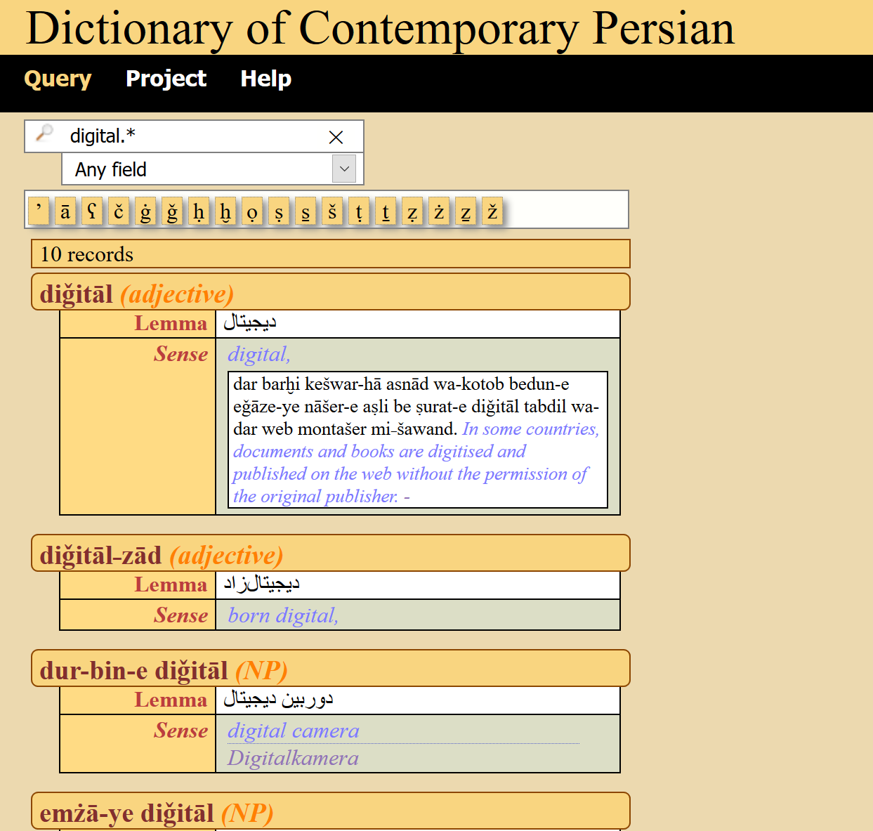
VICAV Dictionaries
Persian-English
Modern language
Wikipedia
Web corpora
https://basex.acdh-dev.oeaw.ac.at/pes_eng_dict/index.html

Slide 41
VICAV Dictionaries
Dagaare-English-Cantonese
Gur branch of the Niger-Congo language family
West Africa
Adams Bodomo (1995)
https://dagaare.acdh.oeaw.ac.at/

Slide 42
VICAV Dictionaries
Zulu-English Dictionary
Part of a new university teaching activity
https://zuludict.acdh-dev.oeaw.ac.at/

Slide 43
VICAV Dictionaries
Bantu Plants
Part of a new university teaching activity
https://basex.acdh-dev.oeaw.ac.at/bantu_plants/

Slide 44
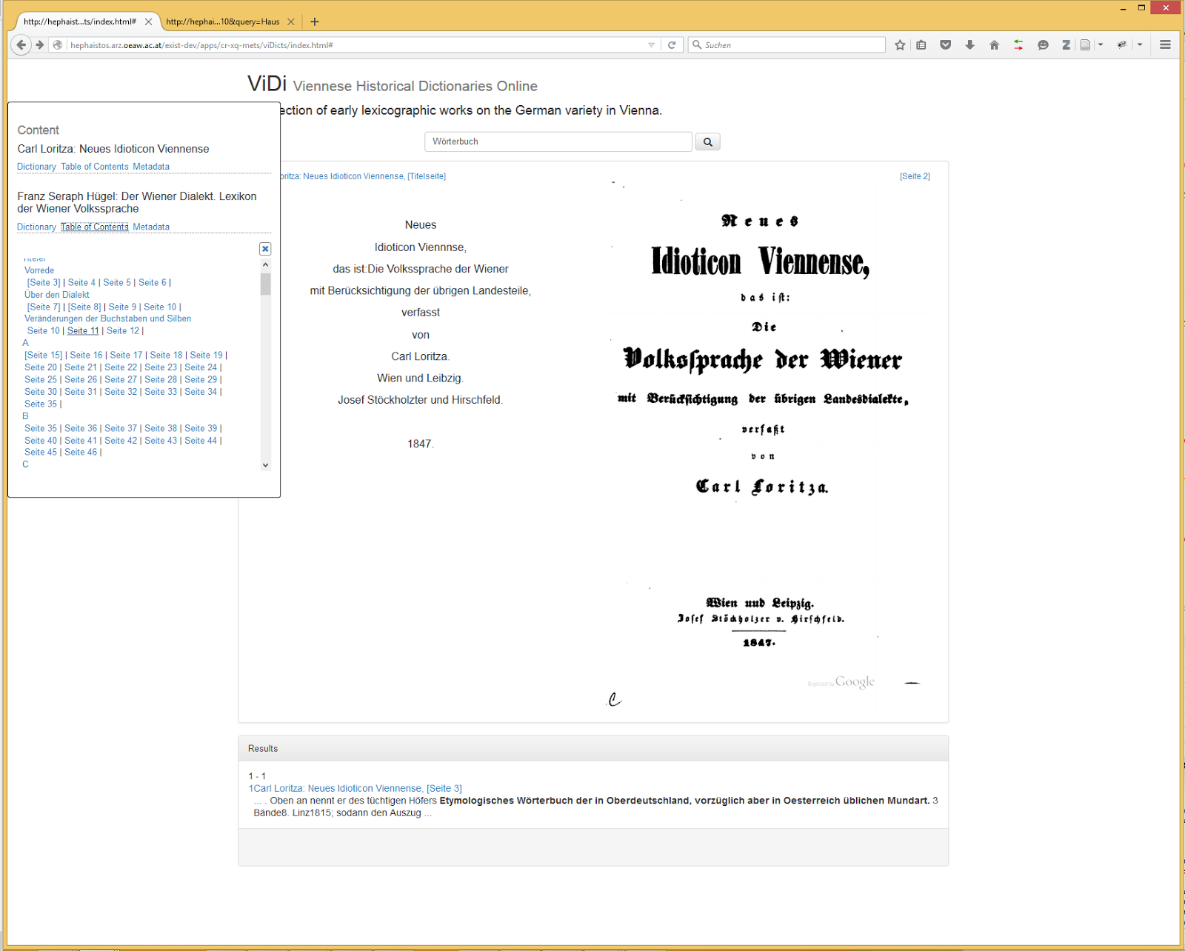
VICAV Dictionaries
VIDI: Viennese Historical Dictionaries
Collection of early lexicographic works on the German variety of Vienna
Early beta version
Text + facsimiles
http://acdh.oeaw.ac.at/vidi

Slide 45
VICAV Dictionaries
Genesis Rabbah
Digital Dictionary of Loanwords in the Midrash Genesis Rabbah
Austrian Science Fund (2018-2021; P 30785)

Slide 46
The VICAV Toolbox
Components
Standard tools: Office, oXygen, ZOTERO
Viennese Lexicographic Editor (VLE)
VIGOLO adds geo-references to bibliography
vi_tok tokenises feature lists and texts
ling_annot is used to annotate feature lists and texts
Vocabs Editor (https://vocabseditor.acdh.oeaw.ac.at) to edit SKOS vocabularies
VICAV 3.0
Independent Dictionary Interfaces
Interoperability Mechanisms

Slide 47
The VICAV Toolbox
Viennese Lexicographic Editor
XML editor with functionalities typically needed in compiling lexicographic data
Web-based standalone application
Designed to process standard-based lexicographic and terminological data such as TEI, LMF, TBX or RDF.
Freely configurable visualisation (via XSLT)
Validation
Versioning
Data is stored in BaseX
Freely available and easy to setup

Slide 48
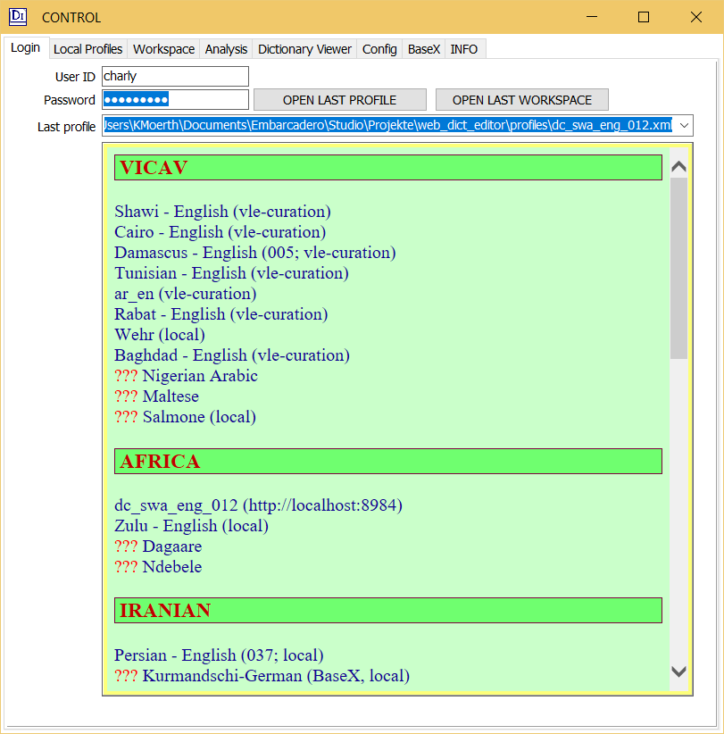
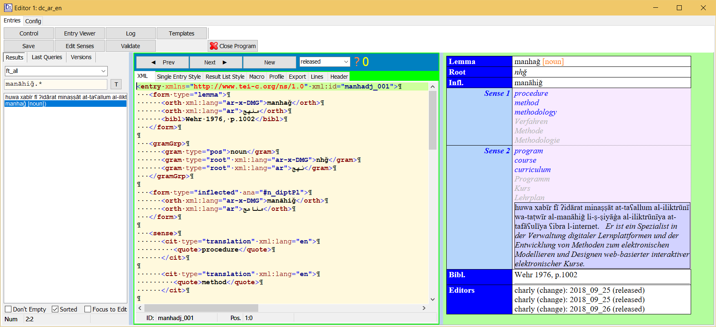
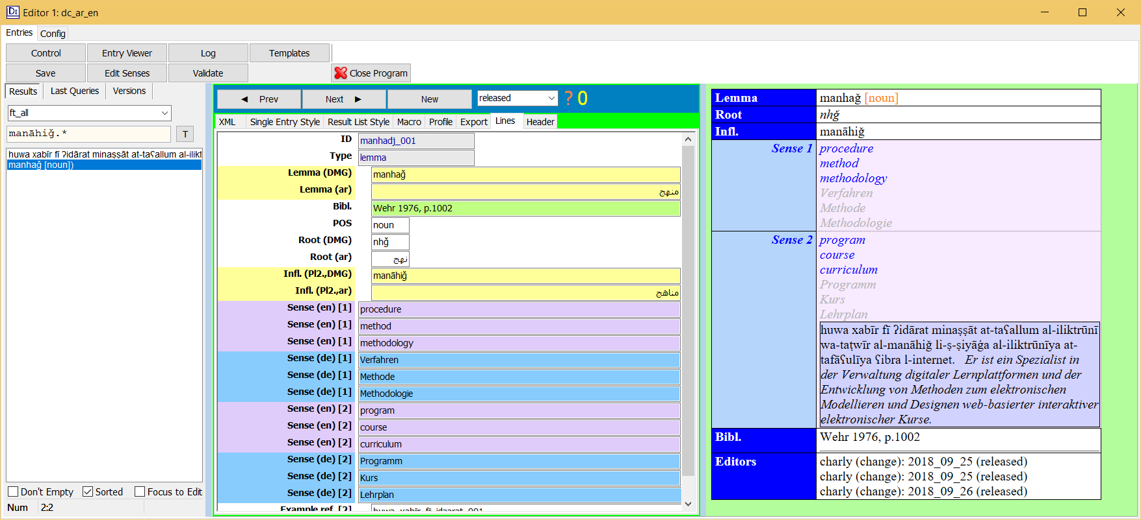
The VICAV Toolbox
Viennese Lexicographic Editor (VLE)

Slide 49
The VICAV Toolbox
VLE: tokenEditor

Slide 50
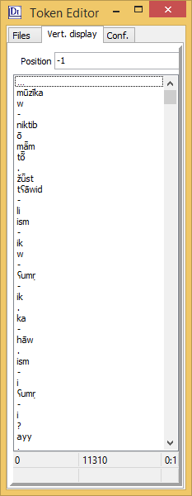
The VICAV Toolbox
VLE: tokenEditor

Slide 51
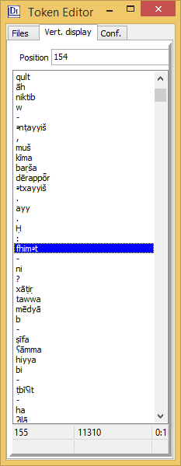
The VICAV Toolbox
VLE: tokenEditor

Slide 52
The VICAV Toolbox
VLE: tokenEditor

Slide 53
The VICAV Toolbox
VLE: tokenEditor

Slide 54
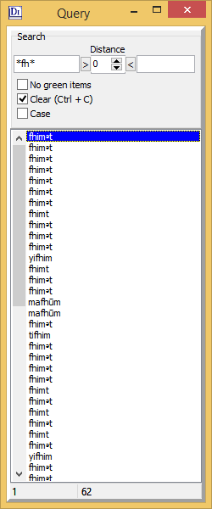
The VICAV Toolbox
VLE: tokenEditor

Slide 55
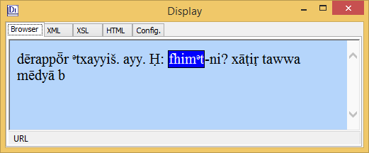
The VICAV Toolbox
VLE: tokenEditor

Slide 56
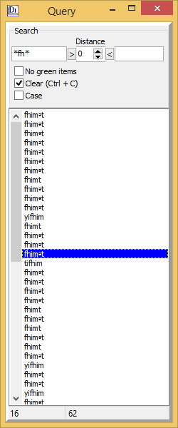
The VICAV Toolbox
VLE: tokenEditor
Edit list

Slide 57
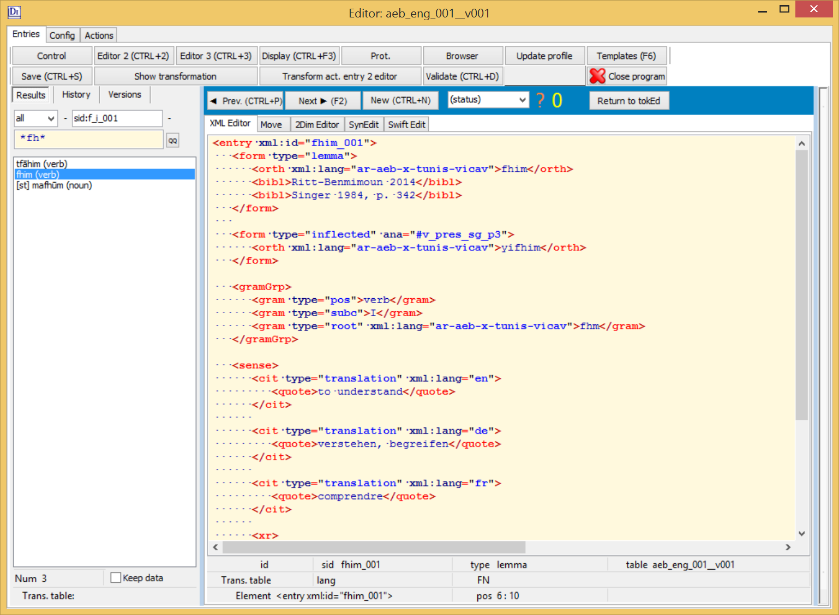
The VICAV Toolbox
VLE: tokenEditor

Slide 58
The VICAV Toolbox
VLE: tokenEditor

Slide 59
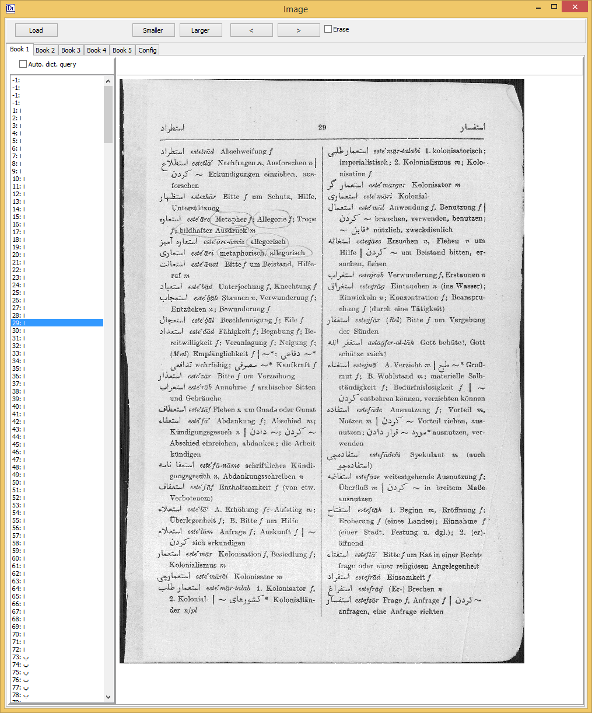
The VICAV Toolbox
VLE: bookViewer

Slide 60
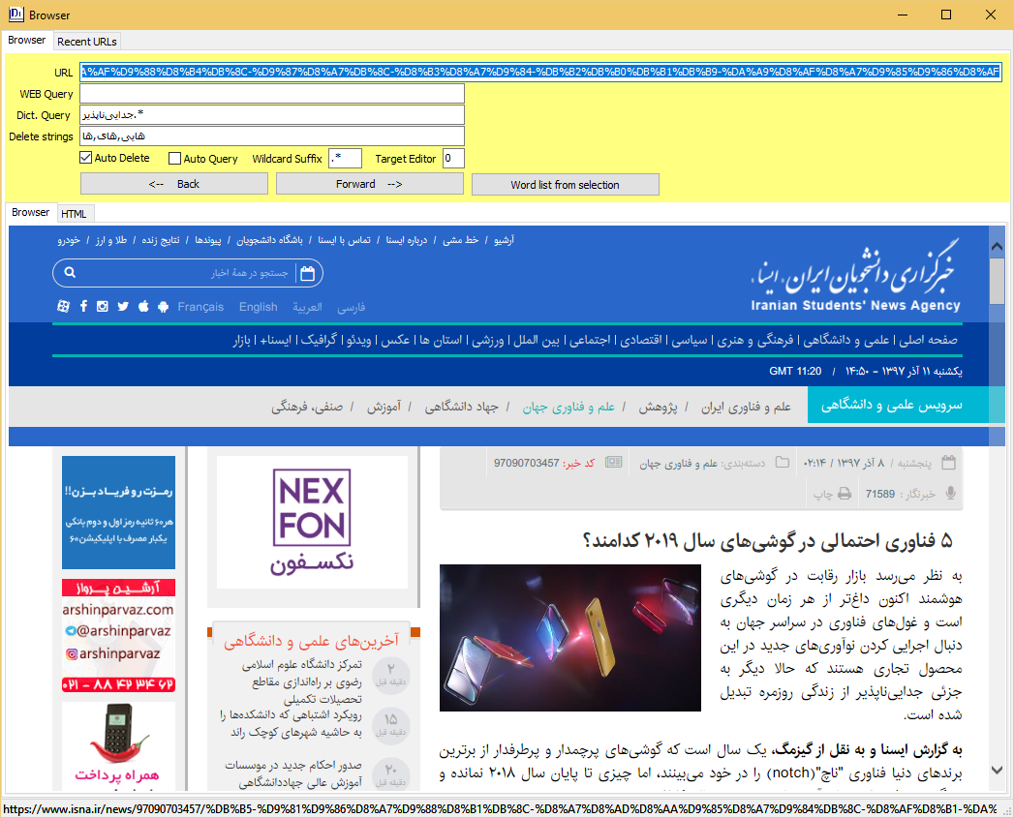
The VICAV Toolbox
VLE: integrated webBrowser

Slide 61
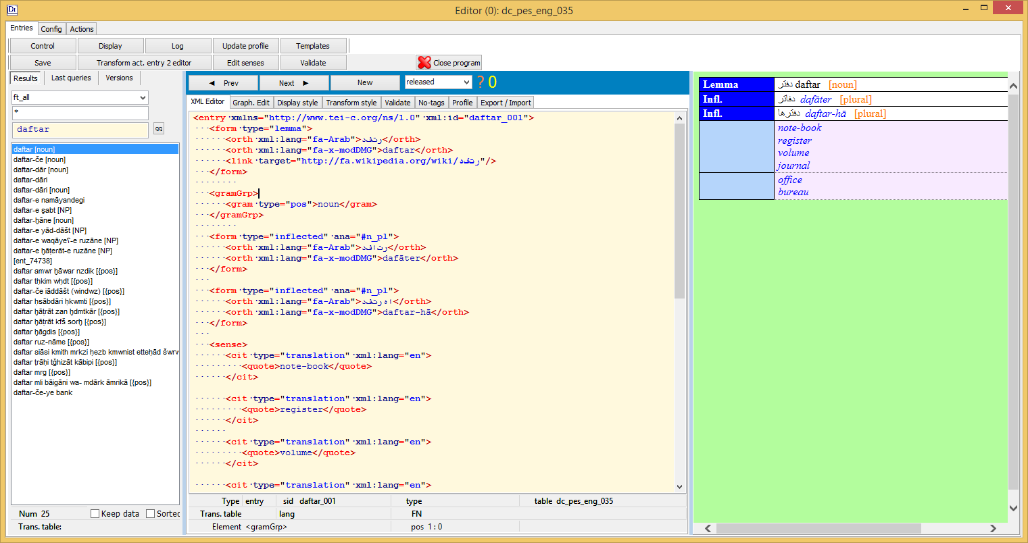
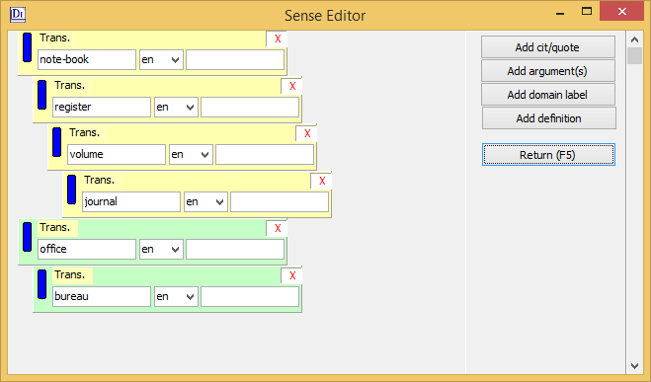
The VICAV Toolbox
VLE: senseEditor

Slide 62
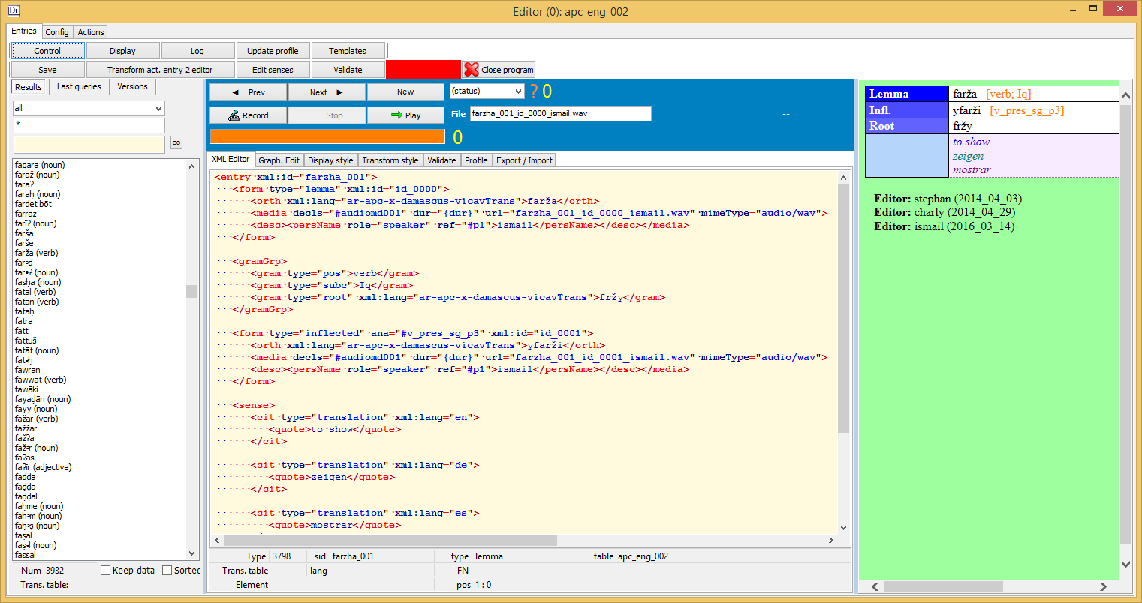
The VICAV Toolbox
VLE: Sound Recorder

Slide 63
The VICAV Toolbox
VLE: Application Builder

Slide 64
The VICAV Toolbox
The Presentation Layer
VICAV
VICAV 3.0
„expert tool“ – yet: usability is key esp. for
students
community contributions (a not-so-digital audience)
previous attempts: MySQL + PHP + Drupal frontend

Slide 65
The VICAV Toolbox
The Presentation Layer
Dual approach
Visualisation of data on an active map
Random access through menus/queries
Textual information is displayed on fixed panels
Citability via URLs

Slide 66
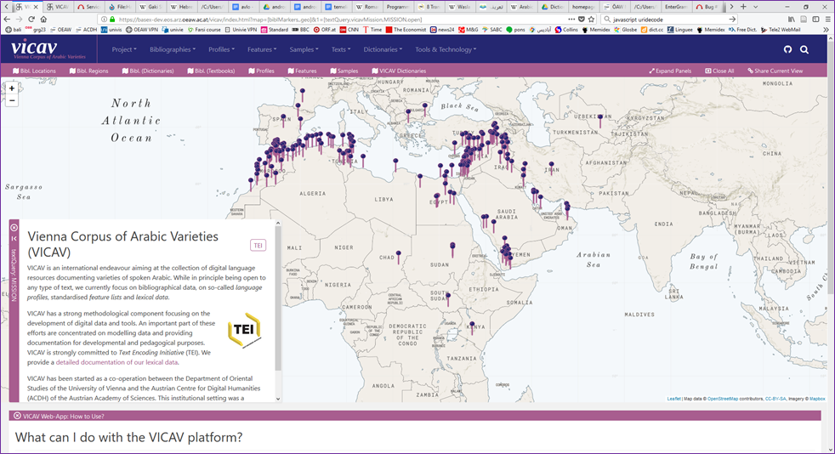
The VICAV Toolbox
The Presentation Layer
Dual approach
Visualisation of data on an active map
Random access through menus/queries
Textual information is displayed on fixed panels
Citability via URLs

Slide 67
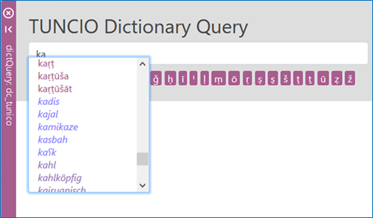
The VICAV Toolbox
Dictionary Frontend
Word completion

Slide 68
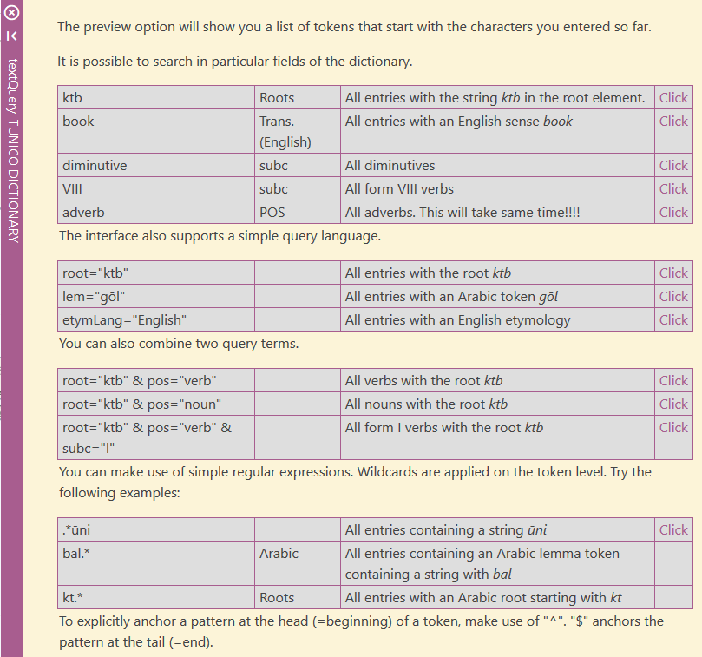
The VICAV Toolbox
Dictionary Frontend
Word completion
Query examples

Slide 69
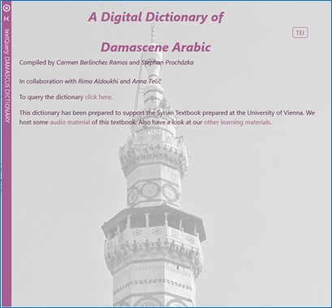
The VICAV Toolbox
Dictionary Frontend
Word completion
Query examples
Customisable entry pages

Slide 70
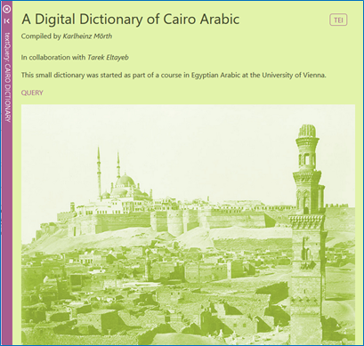
The VICAV Toolbox
Dictionary Frontend
Word completion
Query examples
Customisable entry pages

Slide 71
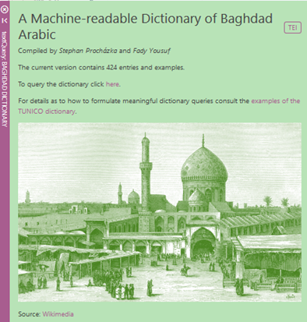
The VICAV Toolbox
Dictionary Frontend
Word completion
Query examples
Customisable entry pages

Slide 72
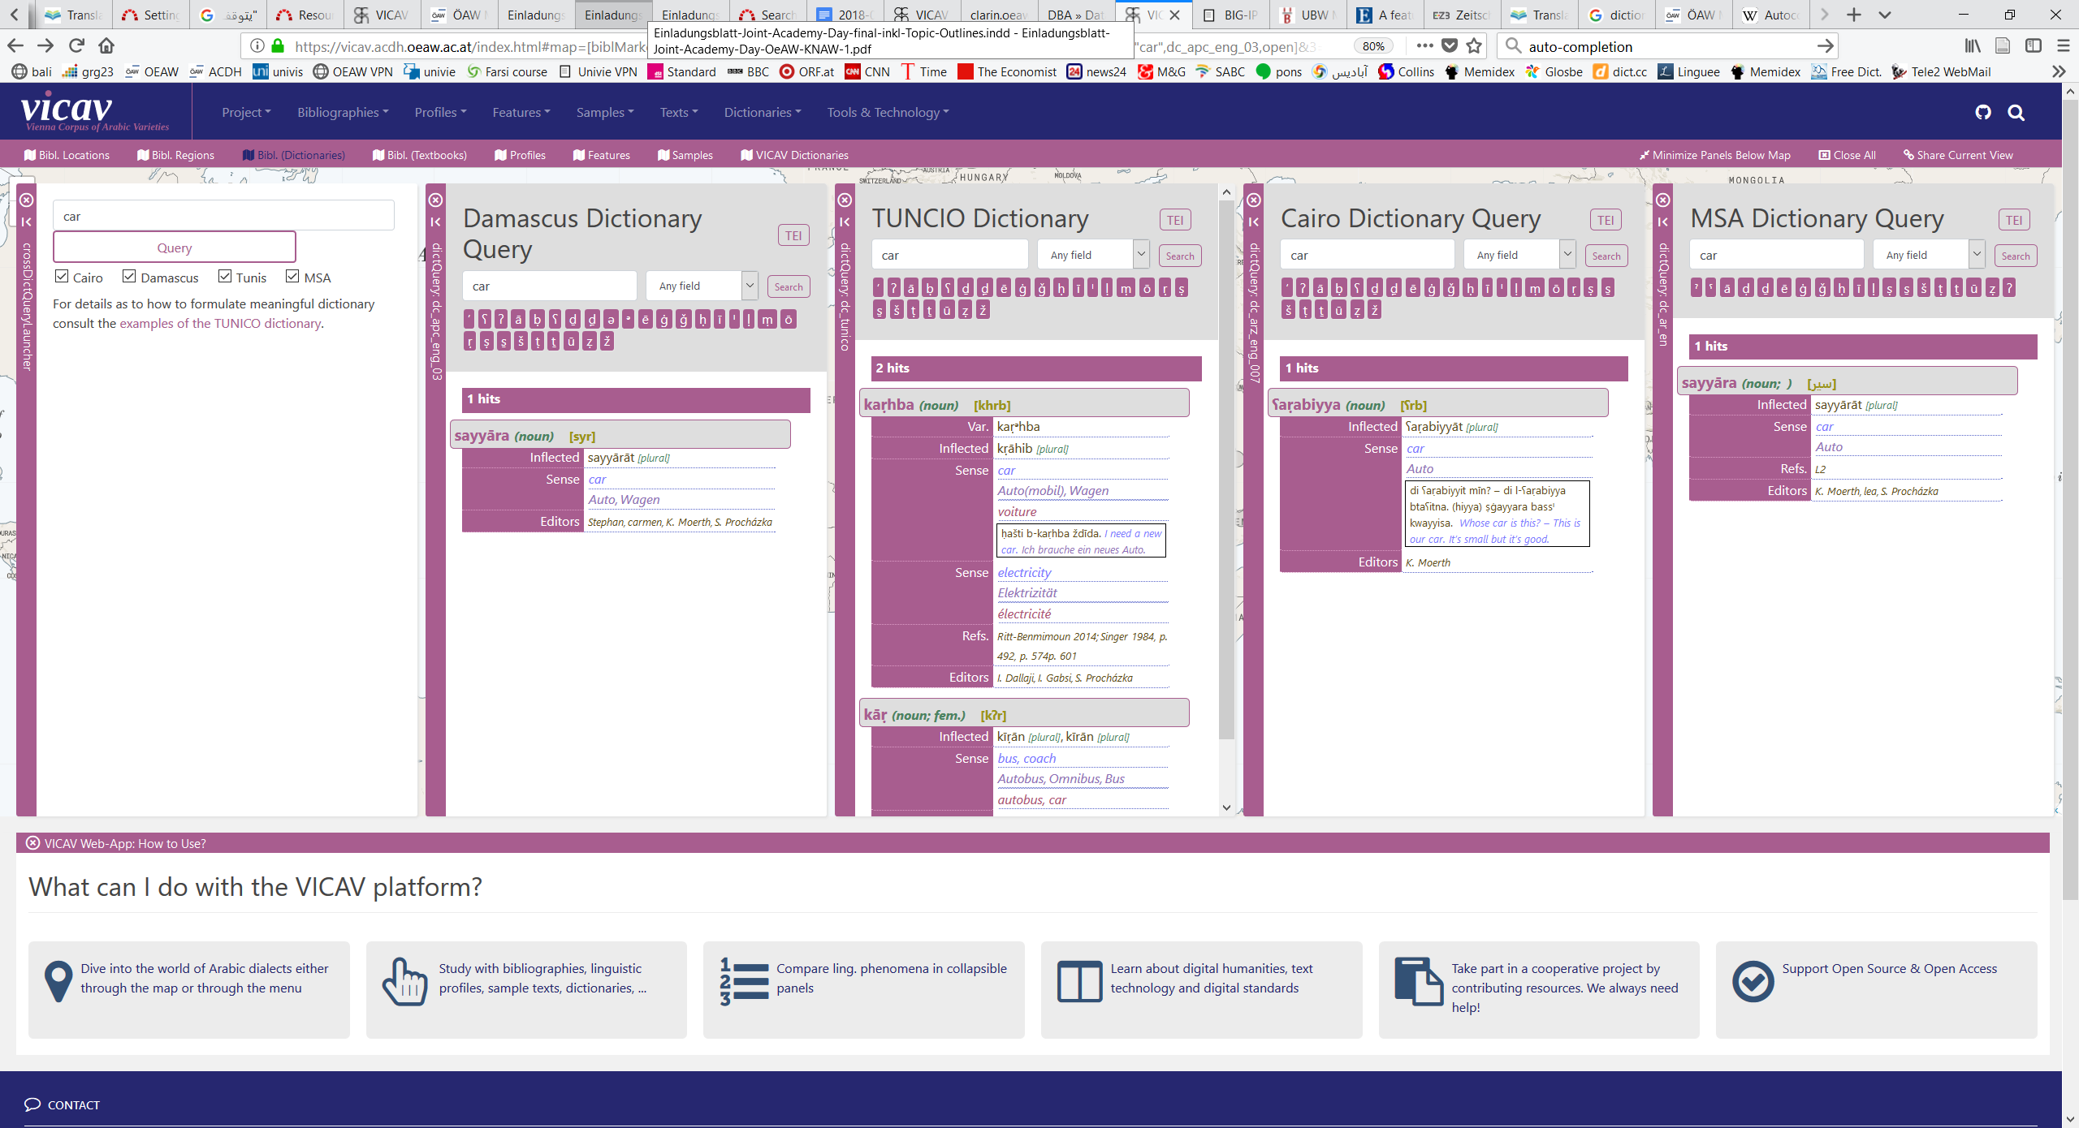
The VICAV Toolbox
Dictionary Frontend
Word completion
Query examples
Customisable entry pages
Cross-dictionary query

Slide 73
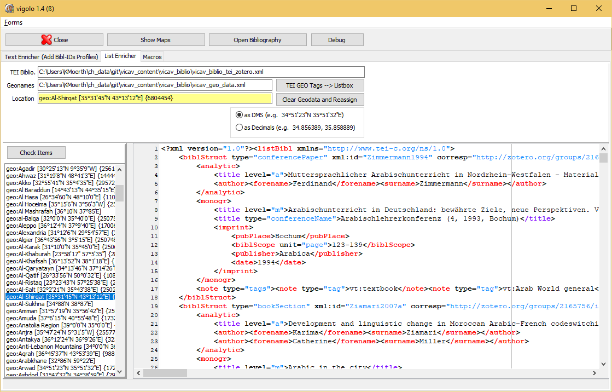
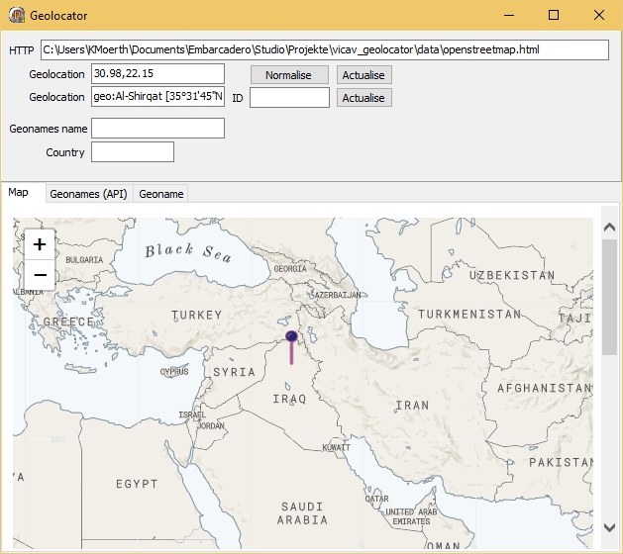
The VICAV Toolbox
VIGILO
Editor to apply geo-references

Slide 74
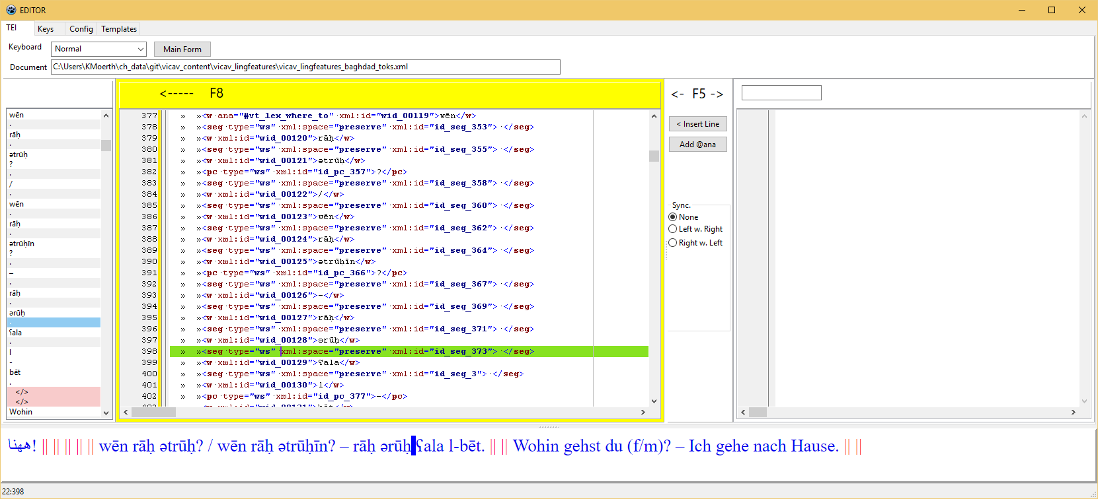
The VICAV Toolbox
ling_annot
Allows manual editing of verticalised data

Slide 75
The VICAV Toolbox
Technologies and Tools
X-Technologies
HTML
JS (jQuery, Leaflet)
CSS
BaseX

Slide 76
The VICAV Toolbox
Technologies and Tools: BaseX
BaseX (Pro)
Easy to install and deploy
Fast, also on large amounts of data
Rest interface
XQuery 3.0 + 3.1
very responsive developer community
application code lives on file system (easy update via git pull)
BaseX (Contra)
Less flexible for indexed full-text queries on mixed content

Slide 77
The VICAV Toolbox
Standards + Formats
TEI (P5)
Used for all textual data
Dictionary module
Zotero TEI

Slide 78
The VICAV Toolbox
TEI Dictionary Module
TEI dictionary module to encode digitised print dictionaries: a fairly common standard procedure in digital humanities
Easy to impose in the creation of digitally born dictionaries
Recent Developments: TEI Lex-0

Slide 79
The VICAV Toolbox
Basic Structures
<TEI version="5.0">
<teiHeader>
…
</teiHeader>
<text>
<body>
<div type="entries">
<entry> … </entry>
<entry> … </entry>
<entry> … </entry>
…
…
</div>
</body>
</text>
</TEI>

Slide 80
The VICAV Toolbox
ACDH Dictionaries: Basic Structures
<TEI version="5.0">
<teiHeader>
…
</teiHeader>
<text>
<body>
<div type="entries">
<entry> … </entry>
<entry> … </entry>
<entry> … </entry>
…
…
</div>
</body>
</text>
</TEI>

Slide 81
The VICAV Toolbox
ACDH Dictionaries: Basic Structures
<TEI version="5.0">
<teiHeader>
…
</teiHeader>
<text>
<body>
<div type="entries">
<entry> … </entry>
<entry> … </entry>
<entry> … </entry>
…
…
</div>
</body>
</text>
</TEI>

Slide 82
The VICAV Toolbox
ACDH Dictionaries: Basic Structures
<TEI version="5.0">
<teiHeader>
…
</teiHeader>
<text>
<body>
<div type="entries">
…
</div>
<div type="examples">
<cit type="example"> … </cit>
<cit type="example"> … </cit>
…
</div>
</body>
</text>
</TEI>

Slide 83
The VICAV Toolbox
ACDH Dictionary Schema
entry
case, def, etym, form, gramGrp, sense, usg, xr
gram
entryFree, superEntry
hom, dictScrap
tns, number, mood, per

Slide 84
The VICAV Toolbox
ACDH Dictionary Schema
...
<form type="inflected">
<gramGrp>
<pos value="verb"/>
<tns value="present"/>
<number value="singular"/>
<mood value="indicative"/>
<per value="2"/>
</gramGrp>
<orth>gehst</orth>
</form>
...
<form type="inflected" ana="#v_pres_ind_sg_p2">
<orth>gehst</orth>
</form>
...
...
<form type="inflected">
<gramGrp>
<gram type="pos">verb</gram>
<gram type="tense">present</gram>
<gram type="number">singular</gram>
<gram value="mood">indicative</gram>
<gram type="person">2</gram>
</gramGrp>
<orth>gehst</orth>
</form>
...
<form type="inflected" ana="#v_pres_ind_sg_p2">
<orth>gehst</orth>
</form>
...

Slide 85
The VICAV Toolbox
Modelling Issues: Semitic Roots et sim.
...
<form type="lemma">
<orth>sāfar</orth>
</form>
<gramGrp>
<gram type="pos">verb</gram>
<gram type="root">sfr</gram>
<gram type="derivedVerbClass">III</gram>
</gramGrp>
...
XXX

Slide 86
The VICAV Toolbox
Modelling Issues: Identifying Ling. Varieties
ISO 639
IETF language tags (BCP 47)
Glottolog codes
Linguasphere

Slide 87
The VICAV Toolbox
Modelling Issues: Identifying Ling. Varieties
...
<form type="inflected">
<orth xml:lang="ar-arz-x-cairo-vicav">kitāb</orth>
</form>
...
IETF language tags (BCP 47)

Slide 88
The VICAV Toolbox
Modelling Issues: Arguments
...
<form>
<orth>médire</orth>
</form>
<gramGrp>
<pos>v</pos>
<subc>t ind</subc>
<colloc type="prep">de</colloc>
</gramGrp>
...
XXX

Slide 89
The VICAV Toolbox
Modelling Issues: Arguments
<entry xml:id="ihtamm_001"> <form type="lemma"> <orth xml:lang="ar-arz-x-cairo-vicavTrans">ihtamm</orth></form> …
<sense>
<gramGrp>
<gram type="argument" xml:lang="ar-arz-x-cairo-vicavTrans">bi-</gram>
</gramGrp>
<cit type="translation" xml:lang="en">
<quote>to be interested (in)</quote>
</cit>
</sense>
...
XXX

Slide 90
The VICAV Toolbox
Modelling Issues: Examples
<cit type="example" xml:id="ex_bititkallim_001" > <quote xml:lang="ar-arz-x-cairo-vicavTrans"> bititkallim ʕarabi? – šwayya bass.</quote> <cit type="translation" xml:lang="en"> <quote>Do you speak Arabic? – Just, a little.</quote> </cit> </cit>

Slide 91
The VICAV Toolbox
Modelling Issues: Examples
<cit type="example" xml:id="ex_bititkallim_001" > <quote xml:lang="ar-arz-x-cairo-arabic"> بتتکلم عربی؟ شویة بس٠ </quote> <quote xml:lang="ar-arz-x-cairo-vicavTrans"> bititkallim ʕarabi? – šwayya bass.</quote> <cit type="translation" xml:lang="en"> <quote>Do you speak Arabic? – Just, a little.</quote> </cit> </cit>

Slide 92
The VICAV Toolbox
Modelling Issues: Examples
...
<cit type="example" xml:lang="zu" xml:id="amanzi_ayabanda_01">
<quote>Amanzi ayabanda.</quote>
<cit type="translation" xml:lang="en">
<quote>The water is cold.</quote>
</cit>
</cit>
...
<sense>
<cit type="translation" xml:lang="en">
<quote>water</quote></cit>
<ptr type="example" target="#amanzi_ayabanda_01"/>
</sense>
...

Slide 93
The VICAV Toolbox
Modelling Issues: Production Metadata
…
<fs type="change">
<f name="who">
<symbol value="charly"/>
</f>
<f name="when">
<symbol value="2016-03-15"/>
</f>
</fs>
…
XXX

Slide 94
The VICAV Toolbox
Data Modelling: Controlled Vocabularies
Paratexts
Dictionaries
Bibliography
Feature Lists
Language Profiles
Sample Texts

Slide 95
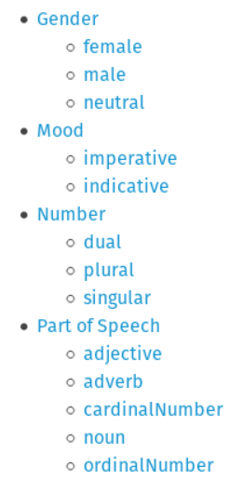
The VICAV Toolbox
Data Modelling: Controlled Vocabularies
Paratexts
Dictionaries
Bibliography
Feature Lists
Language Profiles
Sample Texts
https://vocabs.acdh.oeaw.ac.at/en/

Slide 96
The VICAV Toolbox
Data Modelling: Controlled Vocabularies
<form type="inflected" ana="fvLib:v_pres_sg_p3"> <orth xml:lang="ar-arz-x-cairo-vicav">yiktib</orth> </form>
<fvLib n="verbal forms"> <fs xml:id="v_pres_ind_sg_p1" feats="vf:pos.verb vf:tns.pres vf:mood.ind vf:num.sg vf:pers.1"/> <fs xml:id="v_pres_ind_sg_p2" feats="vf:pos.verb vf:tns.pres vf:mood.ind vf:num.sg vf:pers.2"/> <fs xml:id="v_pres_ind_sg_p3" feats="vf:pos.verb vf:tns.pres vf:mood.ind vf:num.sg vf:pers.3"/> <fs xml:id="v_pres_ind_pl_p1" feats="vf:pos.verb vf:tns.pres vf:mood.ind vf:num.pl vf:pers.1"/> <fs xml:id="v_pres_ind_pl_p2" feats="vf:pos.verb vf:tns.pres vf:mood.ind vf:num.pl vf:pers.2"/> <fs xml:id="v_pres_ind_pl_p3" feats="vf:pos.verb vf:tns.pres vf:mood.ind vf:num.pl vf:pers.3"/> … </fvLib>

Slide 97
The VICAV Toolbox
Data Modelling: Controlled Vocabularies
<form type="inflected" ana="fvLib:v_pres_sg_p3"> <orth xml:lang="ar-arz-x-cairo-vicav">yiktib</orth> </form>
<fvLib n="verbal forms"> <fs xml:id="v_pres_ind_sg_p1" feats="vf:pos.verb vf:tns.pres vf:mood.ind vf:num.sg vf:pers.1"/> <fs xml:id="v_pres_ind_sg_p2" feats="vf:pos.verb vf:tns.pres vf:mood.ind vf:num.sg vf:pers.2"/> <fs xml:id="v_pres_ind_sg_p3" feats="vf:pos.verb vf:tns.pres vf:mood.ind vf:num.sg vf:pers.3"/> <fs xml:id="v_pres_ind_pl_p1" feats="vf:pos.verb vf:tns.pres vf:mood.ind vf:num.pl vf:pers.1"/> <fs xml:id="v_pres_ind_pl_p2" feats="vf:pos.verb vf:tns.pres vf:mood.ind vf:num.pl vf:pers.2"/> <fs xml:id="v_pres_ind_pl_p3" feats="vf:pos.verb vf:tns.pres vf:mood.ind vf:num.pl vf:pers.3"/> … </fvLib>

Slide 98
The VICAV Toolbox
Data Modelling: Controlled Vocabularies
<form type="inflected" ana="fvLib:v_pres_sg_p3"> <orth xml:lang="ar-arz-x-cairo-vicav">yiktib</orth> </form>
<fvLib n="verbal forms"> <fs xml:id="v_pres_ind_sg_p1" feats="vf:pos.verb vf:tns.pres vf:mood.ind vf:num.sg vf:pers.1"/> <fs xml:id="v_pres_ind_sg_p2" feats="vf:pos.verb vf:tns.pres vf:mood.ind vf:num.sg vf:pers.2"/> <fs xml:id="v_pres_ind_sg_p3" feats="vf:pos.verb vf:tns.pres vf:mood.ind vf:num.sg vf:pers.3"/> <fs xml:id="v_pres_ind_pl_p1" feats="vf:pos.verb vf:tns.pres vf:mood.ind vf:num.pl vf:pers.1"/> <fs xml:id="v_pres_ind_pl_p2" feats="vf:pos.verb vf:tns.pres vf:mood.ind vf:num.pl vf:pers.2"/> <fs xml:id="v_pres_ind_pl_p3" feats="vf:pos.verb vf:tns.pres vf:mood.ind vf:num.pl vf:pers.3"/> … </fvLib>
<fLib n="pos"> <f xml:id="pos.verb" name="v"><symbol value="verb"/></f> … </fLib>
<fLib n="tense"> <f xml:id="tns.pres" name="presentTense"><symbol value="present"/></f> … </fLib>
<fLib n="mood"> <f xml:id="mood.ind" name="indicative"><symbol value="indicative"/></f> … </fLib>
<fLib n="number"> <f xml:id="num.pl" name="number"><symbol value="plural"/></f> … </fLib>
<fLib n="person"> <f xml:id="pers.3" name="person"><symbol value="3rd"/></f> … </fLib>

Slide 99
The VICAV Toolbox
Data Modelling: Controlled Vocabularies
<form type="inflected" ana="fvLib:v_pres_sg_p3"> <orth xml:lang="ar-arz-x-cairo-vicav">yiktib</orth> </form>
<fvLib n="verbal forms"> <fs xml:id="v_pres_ind_sg_p1" feats="vf:pos.verb vf:tns.pres vf:mood.ind vf:num.sg vf:pers.1"/> <fs xml:id="v_pres_ind_sg_p2" feats="vf:pos.verb vf:tns.pres vf:mood.ind vf:num.sg vf:pers.2"/> <fs xml:id="v_pres_ind_sg_p3" feats="vf:pos.verb vf:tns.pres vf:mood.ind vf:num.sg vf:pers.3"/> <fs xml:id="v_pres_ind_pl_p1" feats="vf:pos.verb vf:tns.pres vf:mood.ind vf:num.pl vf:pers.1"/> <fs xml:id="v_pres_ind_pl_p2" feats="vf:pos.verb vf:tns.pres vf:mood.ind vf:num.pl vf:pers.2"/> <fs xml:id="v_pres_ind_pl_p3" feats="vf:pos.verb vf:tns.pres vf:mood.ind vf:num.pl vf:pers.3"/> … </fvLib>
<fLib n="pos"> <f xml:id="pos.verb" name="v"><symbol value="verb"/></f> … </fLib>
<fLib n="tense"> <f xml:id="tns.pres" name="presentTense"><symbol value="present"/></f> … </fLib>
<fLib n="mood"> <f xml:id="mood.ind" name="indicative"><symbol value="indicative"/></f> … </fLib>
<fLib n="number"> <f xml:id="num.pl" name="number"><symbol value="plural"/></f> … </fLib>
<fLib n="person"> <f xml:id="pers.3" name="person"><symbol value="3rd"/></f> … </fLib>

Slide 100
The VICAV Toolbox
Data Modelling: Controlled Vocabularies
<form type="inflected" ana="#vLib:v_pres_sg_p3"> <orth xml:lang="ar-arz-x-cairo-vicav">yiktib</orth> </form>
<fvLib n="verbal forms"> <fs xml:id="v_pres_ind_sg_p1" feats="vf:pos.verb vf:tns.pres vf:mood.ind vf:num.sg vf:pers.1"/> <fs xml:id="v_pres_ind_sg_p2" feats="vf:pos.verb vf:tns.pres vf:mood.ind vf:num.sg vf:pers.2"/> <fs xml:id="v_pres_ind_sg_p3" feats="vf:pos.verb vf:tns.pres vf:mood.ind vf:num.sg vf:pers.3"/> <fs xml:id="v_pres_ind_pl_p1" feats="vf:pos.verb vf:tns.pres vf:mood.ind vf:num.pl vf:pers.1"/> <fs xml:id="v_pres_ind_pl_p2" feats="vf:pos.verb vf:tns.pres vf:mood.ind vf:num.pl vf:pers.2"/> <fs xml:id="v_pres_ind_pl_p3" feats="vf:pos.verb vf:tns.pres vf:mood.ind vf:num.pl vf:pers.3"/> … </fvLib>
<fLib n="pos"> <f xml:id="pos.verb" name="v"><symbol value="verb"/></f> … </fLib>
<fLib n="tense"> <f xml:id="tns.pres" name="presentTense"><symbol value="present"/></f> … </fLib>
<fLib n="mood"> <f xml:id="mood.ind" name="indicative"><symbol value="indicative"/></f> … </fLib>
<fLib n="number"> <f xml:id="num.pl" name="number"><symbol value="plural"/></f> … </fLib>
<fLib n="person"> <f xml:id="pers.3" name="person"><symbol value="3rd"/></f> … </fLib>

Slide 101
The VICAV Toolbox
Data Modelling: Controlled Vocabularies
<form type="inflected" ana="fvLib:v_pres_sg_p3"> <orth xml:lang="ar-arz-x-cairo-vicav">yiktib</orth> </form>
<fvLib n="verbal forms"> <fs xml:id="v_pres_ind_sg_p1" feats="vf:pos.verb vf:tns.pres vf:mood.ind vf:num.sg vf:pers.1"/> <fs xml:id="v_pres_ind_sg_p2" feats="vf:pos.verb vf:tns.pres vf:mood.ind vf:num.sg vf:pers.2"/> <fs xml:id="v_pres_ind_sg_p3" feats="vf:pos.verb vf:tns.pres vf:mood.ind vf:num.sg vf:pers.3"/> <fs xml:id="v_pres_ind_pl_p1" feats="vf:pos.verb vf:tns.pres vf:mood.ind vf:num.pl vf:pers.1"/> <fs xml:id="v_pres_ind_pl_p2" feats="vf:pos.verb vf:tns.pres vf:mood.ind vf:num.pl vf:pers.2"/> <fs xml:id="v_pres_ind_pl_p3" feats="vf:pos.verb vf:tns.pres vf:mood.ind vf:num.pl vf:pers.3"/> … </fvLib>
<fLib n="pos"> <f xml:id="pos.verb" name="v"><symbol value="verb"/></f> … </fLib>
<fLib n="tense"> <f xml:id="tns.pres" name="presentTense"><symbol value="present"/></f> … </fLib>
<fLib n="mood"> <f xml:id="mood.ind" name="indicative"><symbol value="indicative"/></f> … </fLib>
<fLib n="number"> <f xml:id="num.pl" name="number"><symbol value="plural"/></f> … </fLib>
<fLib n="person"> <f xml:id="pers.3" name="person"><symbol value="3rd"/></f> … </fLib>

Slide 102
Where to from here?
Harmonisation of dictionaries
More data
Enlargement of existing dictionaries
More varieties
??? Web-based dictionary editor ???

Slide 103
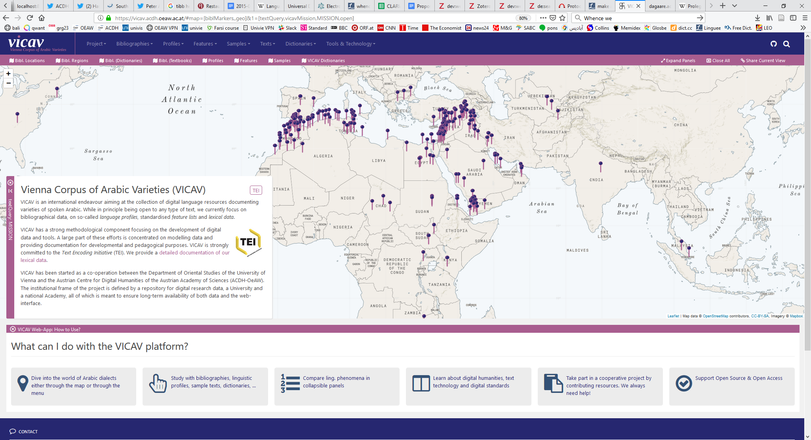
Where to from here?
https://vicav.acdh.oeaw.ac.at

Slide 104
Dank u voor uw aandacht!
Thank you for your attention!
Danke für Ihre Aufmerksamkeit!
Merci pour votre attention!
感谢您的聆听!
Ďakujem za vašu pozornosť!
Gracias por su atención
Ngiyabonga ukulalela kwenu!
Grazie per l’attenzione!
Спасибо за внимание!
Asante sana kwa kunisikiliza!
!وشكرا لكم على اهتمامكم

